Slide 1
Getting to Know
Internal Auditing
The Profession that Makes a Difference
Notes:
This presentation is intended for audiences outside the internal audit profession.

Slide 2
What is Internal Auditing?
Internal auditing is an independent, objective activity designed to add value and improve an organization’s operations.
Internal auditing is critical to strong corporate governance, risk management, effective internal control, and efficient operations.
Notes:
Internal auditors have an in-depth understanding of the organization’s culture, systems and processes and helps senior management and the Board fulfill their governance and oversight responsibilities by providing assurance about the effectiveness of internal controls.
Internal controls are those elements that support people to:
Operative effectively
Operative efficiently
Safeguard assets
Produce reliable and timely information
Comply with laws and regulations

Slide 3
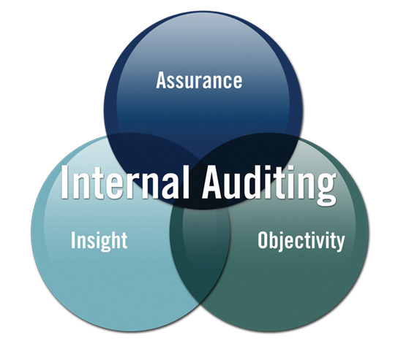
Value Proposition
Offer objective assurance
Provides insight
Improve effectiveness and efficiency
Long-term sustainability
Notes:
To help internal auditors effectively communicate the value of their work to primary stakeholders (such as Audit Committees, Boards of Directors, and senior management, The IIA developed an easy-to-understand Value Proposition tool. With 3 intersecting circles, the value proposition is based on the 3 core elements of value delivered by internal audit to all organizations: Assurance, Insight, and Objectivity.

Slide 4
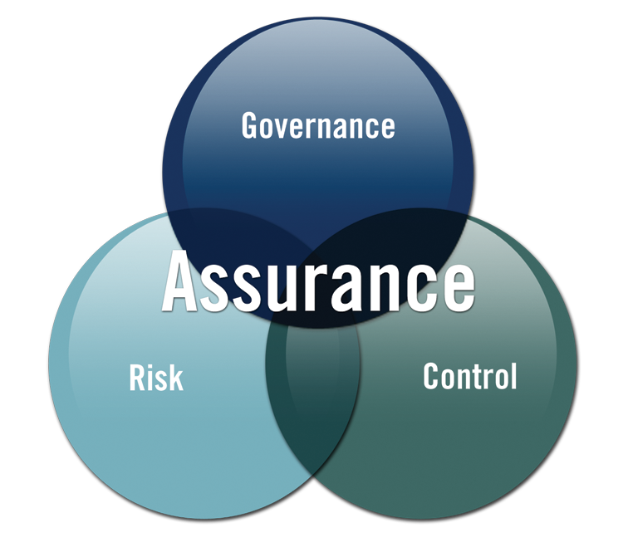
Assurance: Governance, Risk, Control
Notes:
Internal auditing provides assurance on the organization’s governance, risk management and control processes to help the organization achieve its strategic, operational, financial, and compliance objectives.
Helps organization focus on strong controls, accurate reporting, effective oversight, and protection of investments
Assists management & governing bodies in identifying risks
Provides insight on effectiveness of controls and compliance with procedures and regulations, and recommends improvements

Slide 5
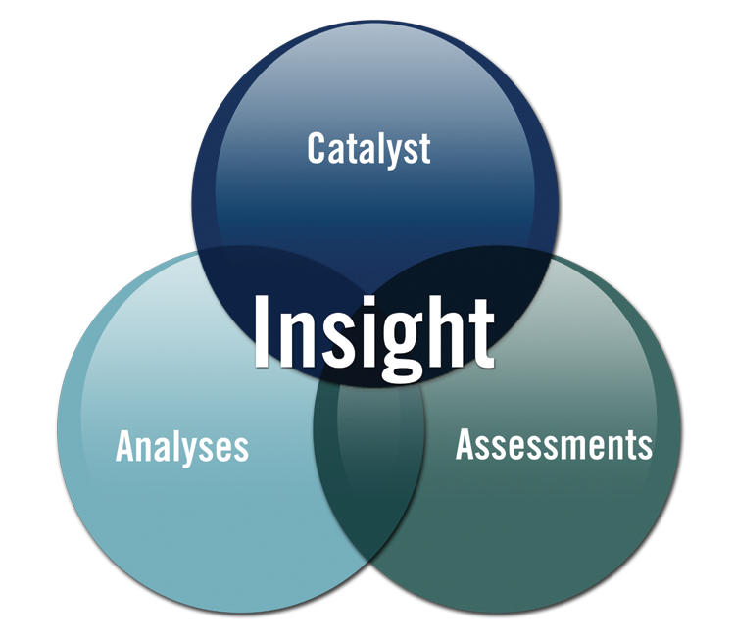
Insight: Catalyst, Analyses, Assessments
Notes:
Internal auditing is a catalyst for improving an organization’s effectiveness and efficiency by providing insight and recommendations based on analyses and assessments of data and business processes.
As catalyst for improvement, evaluates processes, reports findings and recommends appropriate courses of action; and advises on key projects/initiatives.
Through analyses of data and information, provides insight into process improvements.
Through understanding of the business and its objectives, assesses the efficiency and effectiveness of operations and protection of assets.

Slide 6
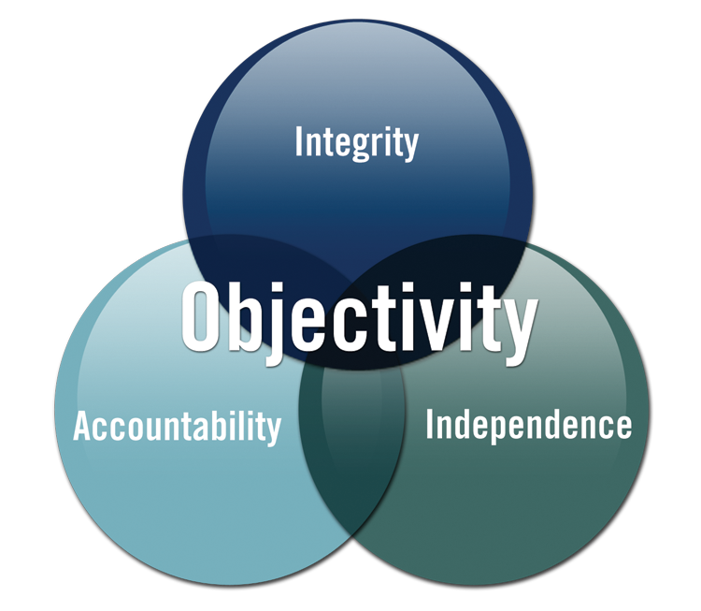
Objectivity: Integrity, Accountability, Independence
Notes:
With commitment to integrity and accountability, Internal Auditing provides value to governing bodies and senior management as an independent source of objective advice.
Integrity through professional Standards and Code of Ethics
Accountable in helping management and governing bodies achieve their objectives.
To ensure independence, internal audit should report to independent governing body for functional direction; and to management for administrative oversight. Maintains objectivity by not assuming any operational responsibilities.

Slide 7
What do Internal Auditors do?
Evaluate risks
Assess controls
Improve operations
Review processes & procedures
Assure safeguards
Provide insight & foresight
Communicate results & recommend action

Slide 8
Value of Internal Auditors
Find out what’s working and what’s not
Keep an eye on the corporate culture
Look at the organization objectively
Bring organization-wide perspective
Advocate improvements
Raise red flags
Tell it like it is
Trusted advisor

Slide 9
Internal Auditors Evaluate Risks
Help keep bad things from happening
Help assure good things can happen
Help management understand
  Where their risks are
  Whether the risks are under control
  Whether the risks are worth taking

Slide 10
Identifying Risks is Not Enough
Internal auditors evaluate the controls that help organizations manage risks
Are controls in place?
Do the controls work?
Are additional controls needed?
Any unnecessary controls?
Are the controls cost-effective?

Slide 11
High Level Comparison
Internal Audit | Financial Statement Audit
Broad focus | Specific focus
Accurate financial statements | Accurate financial statements
Efficiency/effectiveness | Going concern
Accomplishing objectives | Reviewing historical data
Compliance with laws, policy Safeguarding assets | Compliance with accounting & other regulations
Diverse skills required | Primarily accounting skills
Integral part of the organization | Independent from the organization
Notes:
Although they are independent of the activities they audit, internal auditors are integral to the organization and provide ongoing monitoring and assessment of all activities. In contrast, external auditors are independent of the organization and provide an annual opinion on the financial statements. The work of the internal and external auditors should be coordinated for optimal effectiveness and efficiency.

Slide 12
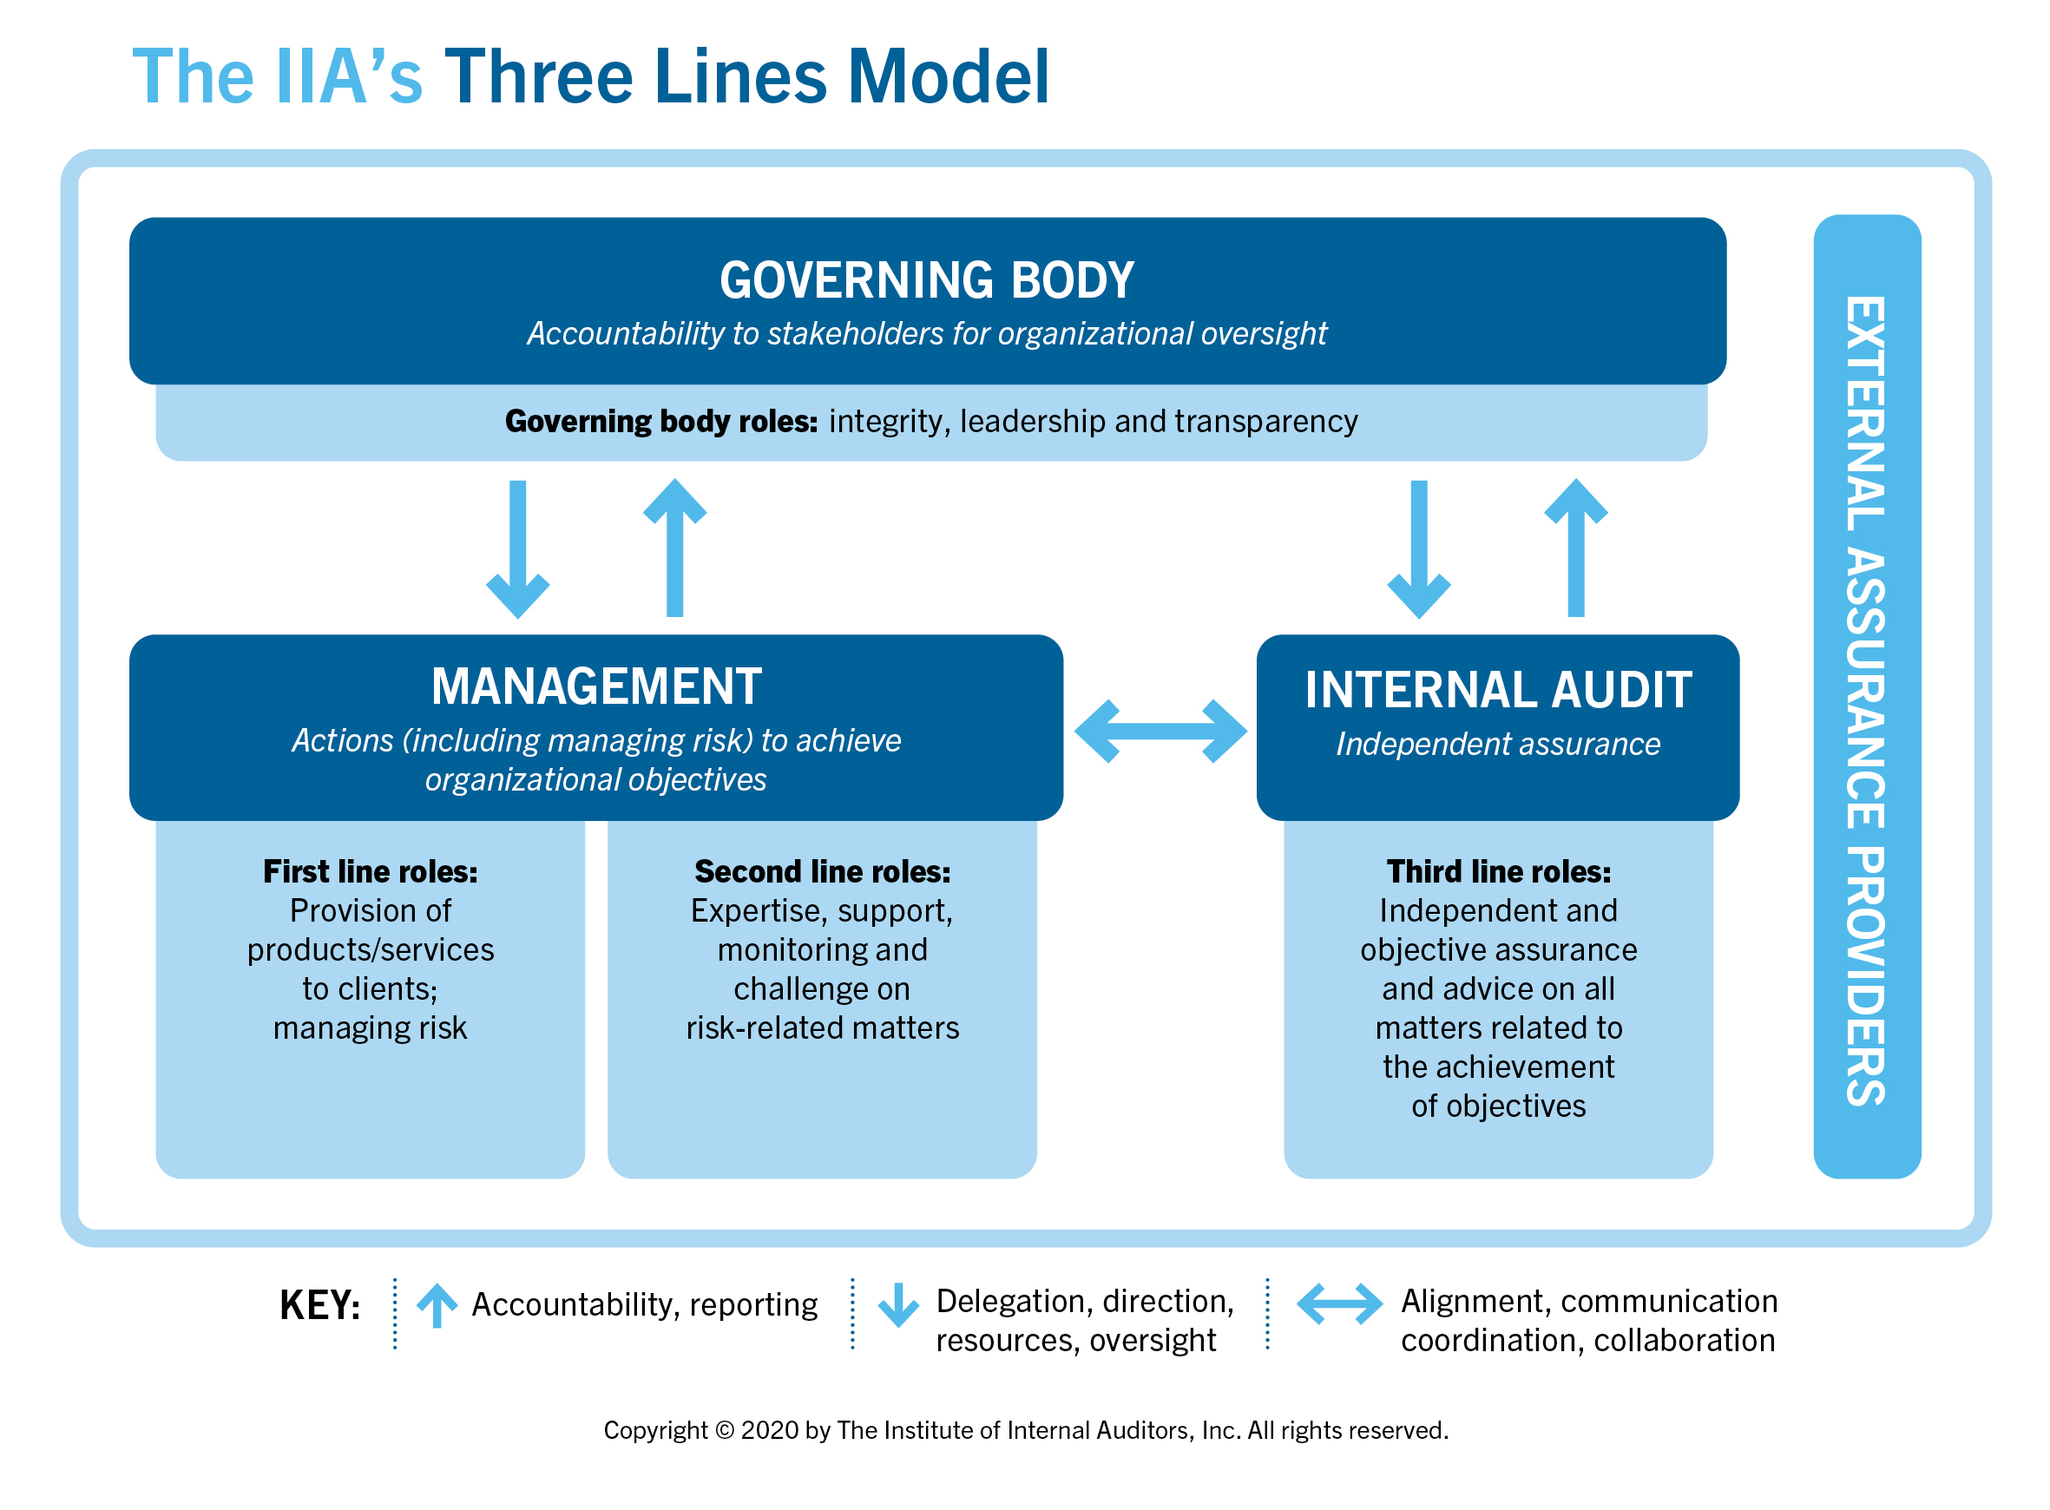
Notes:
The Three Lines of Defense model provides a simple and effective way to enhance communications on risk management and control by clarifying essential roles and duties. (Replace the dark blue boxes with names of people in your organization representing those roles to better explain the roles of each.)
The Model distinguishes among three groups (or lines) involved in effective risk management:
Functions that own and manage risks
Functions that oversee risks
Functions that provide independent assurance
More information can be found in The IIA’s Position Paper: The Three Lines of Defense in Effective Risk Management and Control which is available at www.theiia.org.

Slide 13
When Does an Organization Need an Internal Audit Function?
Internal audit is not legally required in the U.S.
  Exceptions: NYSE-listed corporations and a few specific industry/government organizations
Required in some countries
Every organization, regardless of its size, should have some type of internal control system/process
The IIA believes that an organization is best served by a fully resourced, independent and professionally competent internal auditing function

Slide 14
The Institute of Internal Auditors
(The IIA)
The internal audit profession’s most widely recognized advocate, educator, and provider of standards, guidance, and certifications.
Established in 1941, The IIA today serves more than 200,000 members from more than 170 countries and territories. www.theiia.org.

Slide 15
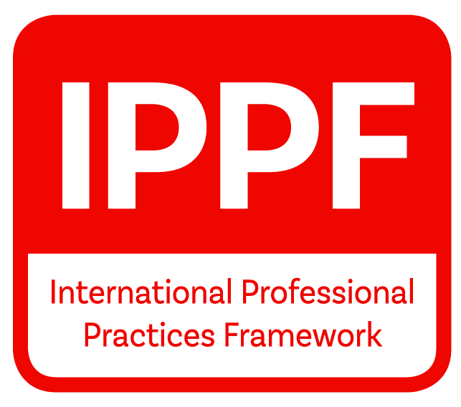
International Professional Practices Framework
The IIA sets the standard for the way internal auditing is practiced around the world through the International Professional Practices Framework (IPPF).

Slide 16
Questions?

