Slide 1
Explore Internal Audit
A Career with Purpose & Potential
Notes:
Welcome, everyone! Today we’re diving into a career path you may not have fully explored yet: Internal Audit. Whether you’re studying accounting, finance, IT, or business, this field offers skills, exposure, and opportunities that might surprise you.

Slide 2
The Institute of Internal Auditors
Who We Are

Slide 3
An International Professional Association
Standards
Certification
Education
Research
Technical Guidance
Advocating for the Profession
Global Network
Notes:
The IIA—The Institute of Internal Auditors—has been leading the internal audit profession since 1941. With over 260,000 members worldwide, The IIA sets the standards, offers certifications, and provides training, resources, and research for internal auditors everywhere. What does The IIA do? A lot:
Set global standards and offer professional credentials
Provide training and upskilling to grow your career
Share best practices and promote knowledge
Advocate for the profession and help shape its future
Build a worldwide network of internal auditors

Slide 4
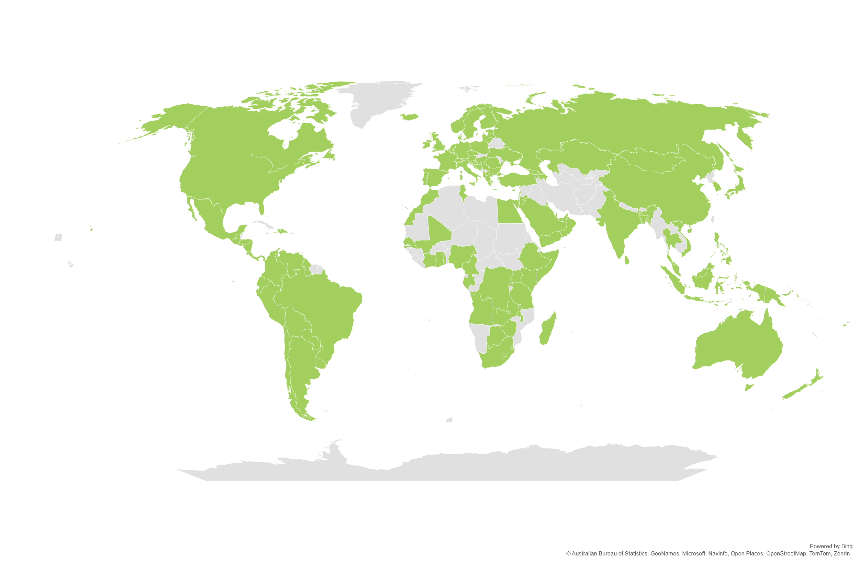
A Global Community of Auditors
260,000+
Members
200,000+
CIA’s Awarded
170+
Countries & Territories
117
Institutes Worldwide
NORTH AMERICA
CENTRAL & SOUTH AMERICA
143
EUROPE
AFRICA
North American Chapters
ASIA PACIFIC
MIDDLE EAST
Notes:
Internal audit is a global profession. The IIA has a presence in over 170 countries and connects more than 260,000 professionals. In North America alone, there are 143 local chapters. It’s a profession in high demand—especially as organizations around the world look for trusted advisors to help them navigate change, risk, and strategy.

Slide 5
Internal Auditing
What it is & Why it matters

Slide 6
What Do YOU Think Internal Auditors Do?
Notes:
Presenter Notes: [insert qr code to live poll/word cloud if can]
[If no live poll, pose as a discussion point] Let’s take a quick poll—what do you think internal auditors do?
Most people think we just “check math,” but there’s way more to it. Internal audit includes fraud prevention, process improvement, and yes… sometimes a little detective work! That variety is one of the reasons people love the field.

Slide 7
Internal Audit…
Helps Organizations Stay on Track
Protects Against Risks
Checks for Accuracy and Honesty
Advises Leaders
Drives Success
Notes:
So, what is internal audit all about? At its core, it’s about helping organizations operate better. Internal auditors:
Review how a business operates
Look for risks or inefficiencies
Help fix problems before they get big
Offer advice that strengthens the organization
They’re problem-solvers and trusted advisors who help protect and improve companies from the inside out.

Slide 8
Internal Audit is Evolving From Hindsight to Foresight
Move beyond assurance & compliance
Provide advice & strategy
Strategic planning with a long-term focus
Stronger advisory role
Notes:
Internal audit is no longer just about looking at what went wrong. Today, auditors are future-focused—they help shape smart strategies and prevent problems before they happen. They still review systems and controls, but they also give advice that improves decision-making and adds real value to the business.

Slide 9
Internal Auditors Help Companies Succeed
Spot risks early
Prevent costly mistakes
Improve systems & operations
Build trust & accountability
Strengthen companies for the future
Notes:
Internal auditors do more than catch mistakes—they make a difference. They help:
Identify risks early (like cyber threats or fraud)
Save money by improving operations
Make sure businesses follow laws and act ethically
Build trust with leadership and stakeholders
They’re strategic thinkers who help companies stay strong, smart, and competitive.

Slide 10
The Day to Day
Meet
Meet with department heads to understand processes
Analyze
Analyze data for inconsistencies
Brainstorm
Brainstorm control improvements
Present
Present findings to leadership
Notes:
Every day in internal audit is different. You might:
Analyze how a department works
Spot risks using data
Collaborate on solutions
Present findings to leadership It’s a great mix of analysis, communication, and problem-solving.

Slide 11
How Might That Look
Review Customer Experience
Evaluate Major Changes
Observe and Investigate
Recommend Improvements
Assess Organizational Culture
Notes:
Here’s how internal audit can show up in real life:
Reviewing food service quality in a restaurant
Checking how well two companies merge together
Watching how inventory is loaded to improve efficiency
Investigating fraud or ethical concerns
Auditing behavior to see if employees follow company values
Recommending ways to improve customer experience
It’s hands-on, insightful work across lots of different settings.

Slide 12
Skills, Insights, & Perspectives
A Path to Excellence

Slide 13
What Skills Might an Internal Auditor Need?
Notes:
Presenter Notes: [insert qr code to live poll/word cloud if can] [If no live poll, pose as a discussion point]
Let’s take another quick poll—what are some of the skills, technical and soft, that you have been growing for yourself either through your coursework or internship experiences?

Slide 14
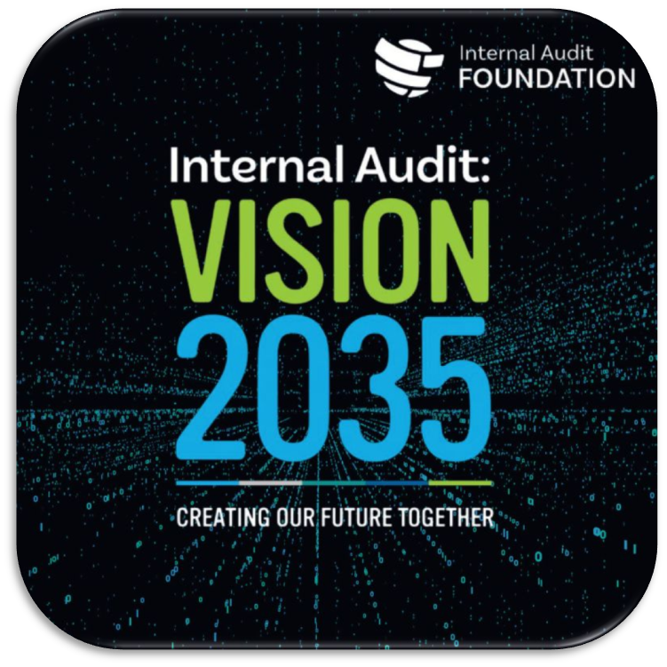
Future Ready Skills
Notes:
As internal audit evolves with the business world, so do the skills needed to succeed in the profession. The IIA’s Vision 2035 outlines a set of future-ready skills that internal auditors will need to stay relevant, add value, and lead in their organizations. While technical knowledge is key, it’s the human skills that truly set auditors apart: Critical Thinking & Curiosity: Auditors ask thoughtful questions, challenge assumptions, and look beyond the surface. Being naturally curious and analytical is a major strength.
Communication & Storytelling: It’s not just about finding the issues — it’s about explaining them clearly to others. Auditors need to present their findings in ways that people from all departments can understand and act on.
Collaboration & Relationship Building: Internal auditors often work across departments and need to build trust with stakeholders. Professionalism, diplomacy, and active listening are key.
Ethics & Integrity: Above all, internal auditors must be objective and ethical. They need to do what’s right, even when it’s difficult.

Slide 15
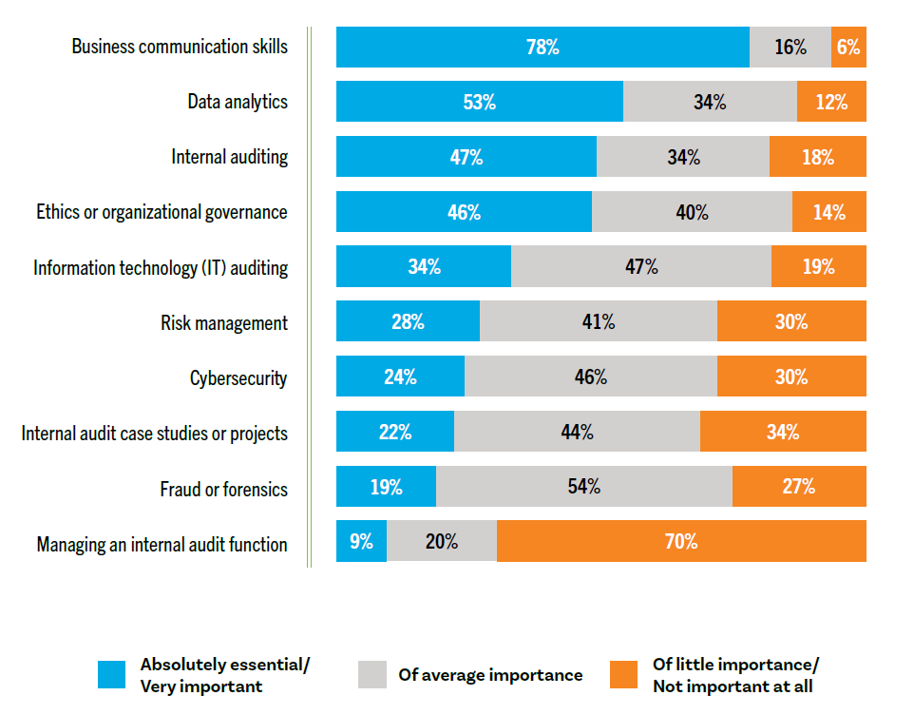
Knowledge Areas Influencing Hiring Decisions
Notes:
Let’s take a look at what hiring managers are really prioritizing when they look at candidates for internal audit roles. You’ll see that business communication skills top the list — 78% of respondents said it was very important. That means being able to clearly explain your ideas, work well with others, and communicate findings is a major factor in landing the job. Data analytics also stands out. over half of employers are looking for candidates who can work with data and use it to spot patterns and risks.
And finally, knowledge in internal audit, ethics, and IT auditing is also valued. These show you understand the profession and how it connects with technology and doing the right thing.
Focusing on these skills will help you stand out as you prepare for a career in internal audit.

Slide 16
Sought After Majors
Notes:
If you’re majoring in Accounting, Internal Audit, Business, Computer Science, or IT—you’re in a great spot. These are the most in-demand majors for internal audit roles, according to recent hiring data.

Slide 17
What Excites Current Students the Most
Source: Internal Audit Foundation Student Sentiment Survey
Notes:
Students say they love internal audit because:
There’s a lot of variety
You get to solve real-world problems
You interact with people
You make a real impact It’s a career that keeps you growing and helps you understand how businesses really work.

Slide 18
Real Voices- What Others Have to Say
“I love the idea that an internal auditor gets to look at so many areas of an organization. This makes for a career that will not get dull or repetitive. I crave an exciting career that will keep me moving forward and learning new things.” –Katie Scott (The IIA’s Viewpoints: Voices of the Future article)
“Internal audit helps protect people from risk, such as cybersecurity risk. As these threats evolve, we must, too. Technological advancement benefits my generation by making young auditors more savvy and more experienced with technology and data.” –Matthew Schabel (The IIA’s Viewpoints: Voices of the Future article)
“To students considering the jump from accounting to internal audit or trying to decide between the two professions, don't think too long; it is only natural to evolve and progress. You'll gain a much more in-depth perspective of the business as an internal auditor. This, to me, has been the fulfilling part of becoming an internal auditor.” –Noora Al Marri, CIA (On the Frontlines: My Journey from Accounting to Internal Audit)
Notes:
These quotes, taken from students and professionals featured in The IIA’s Viewpoints and On the Frontlines series, highlight why internal audit is an exciting path. Whether it’s the variety, tech focus, or big-picture business insight, these voices show how the field supports growth, curiosity, and real impact.

Slide 19
Real Voices- What Others Have to Say
“Internal auditing, for nearly 30 years now, has allowed me to quench my thirst for adventure, curiosity, diversity, creativity, innovation, fun, and leadership, and have the most extraordinary human encounters and experiences from the mailroom to the boardroom around the world.”
–Dominique Vincenti, CIA, CRMA
“The fact that we can help organizations achieve their goals and contribute to their efficiency and effectiveness gives me an unbelievable feeling. I consider internal auditing my career, not just an interlude on my way to some other job”
– Mike Padilla, CIA, CPA, CFE
“Internal audit has provided me with an unbelievable opportunity: I get paid to be skeptical and to get to know people, processes, and organizations — my favorite things. It has been fascinating to learn that audit is a mindset that is enhanced through experience and training, and those who naturally see the world through that lens are more prone to find not only career satisfaction, but daily enjoyment of the opportunities that it provides.”
– Jude Viator, CIA, CISA, CRISC
Notes:
These quotes come directly from internal auditors featured in The IIA’s IAm blog series. While this is just a snapshot, their full stories offer valuable insight into how a career in internal audit can support work-life balance and personal passions- showing there’s more to the profession than many might expect.

Slide 20
Opportunities & Earning Potential
Empowering Growth

Slide 21
Multiple Industries in Demand
Finance & Banking
Healthcare
Technology & IT
Manufacturers
Government & Public Agencies
Retail & E-commerce
Notes:
Internal auditors are needed everywhere—especially where there’s money, data, or rules to follow. That means opportunities in:
Finance
Healthcare
Tech and cybersecurity
Government
Manufacturing
Retail and e-commerce Internal audit is a great launchpad for careers in almost any industry. https://research.com/careers/internal-auditor-careers

Slide 22
Career Perks
🚪 Internal Audit Opens Doors
🛡️ Job Security
✈️ Work-Life Balance
📈 Career Growth
🌱 Plenty of Opportunity Within the Field
💡 Continuous Skill Building
✨ Purposeful & Impactful Profession
Notes:
Let’s talk benefits. Internal audit is one of the few careers where you can gain early exposure to senior leadership and multiple departments, its like a backstage pass to how a company really runs. You get to see everything—from finance to operations to IT—and that insight makes you valuable in all kinds of roles later on. Internal audit is a crash course in real-world skills. You’ll get better at analyzing data, solving problems, using tech tools, and explaining complex ideas clearly—skills that matter in any career. Internal Audit sets you up for leadership. You learn how the whole business works, and many auditors move into management roles quickly. Plus, internal audit is needed everywhere—from nonprofits to Fortune 500s—so you’re never stuck in one lane. If you like job options, this is a field where you won’t run out of doors to open. With regulations, cybersecurity threats, and financial oversight being top priorities, companies always need strong audit teams. It’s a field that stays strong even in uncertain times. Compared to some career paths, internal audit often offers a better balance—especially in corporate or in-house audit departments. Fewer late nights, more time for your life outside work. Internal auditors help protect organizations from risk, fraud, and waste. You're not just checking boxes—you’re making a difference and helping build trust inside and outside the company.

Slide 23
Are There Really Jobs for Me?
58%
of hiring managers have hired a college graduate for entry-level internal audit roles within the past 5 years
Source: 2024 Internal Audit Talent Pipeline Survey, Deloitte/Internal Audit Foundation
Notes:
Are there really jobs for me? Yes! According to recent research developed by The Internal Audit Foundation and Deloitte:
58% of hiring managers have hired recent grads into entry-level audit roles in the past 5 years
Larger audit teams (50+ employees) are especially likely to hire new grads That means real opportunity for students looking to start strong.

Slide 24
Okay, So How Much Can I Make?
Entry-level Internal Auditor- $63,000
Internal Auditor (1-3 yrs exp.)- $84,750
Senior Internal Auditor- $103,250
Manager of Internal Audit- $131,750
Director of Internal Audit- $199,000
Source: Robert Half Salary Guide 2025.
Notes:
Here’s a look at midpoint salary data from the 2025 Robert Half Salary Guide. It shows the earning potential as you move from entry-level to more senior roles in internal audit. It’s a strong path for growth.
***[Presenter Note- salary comparison to accounting track is provided below if receive student questions. Otherwise, would love for Internal Audit salary to stand alone and speak for itself as a great option]*** For comparison, starting salaries for accounting associates are typically in a similar range- Entry-level Staff Accountant- $60,500 Staff Accountant- $71,500 Senior Accountant- $94,250 Accounting Manager- $109,750 Director of Accounting- $164,250 -But one advantage internal audit offers is the opportunity to advance quickly, especially if you pursue certifications like the CIA. Many internal auditors find they’re able to step into senior roles or management tracks sooner, with fewer of the long hours often associated with public accounting.

Slide 25
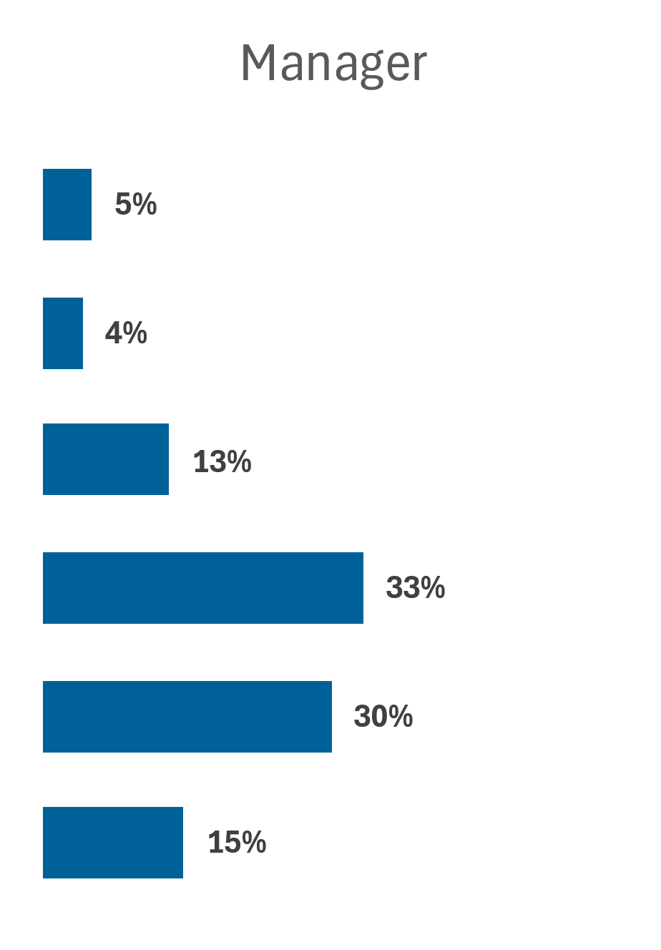
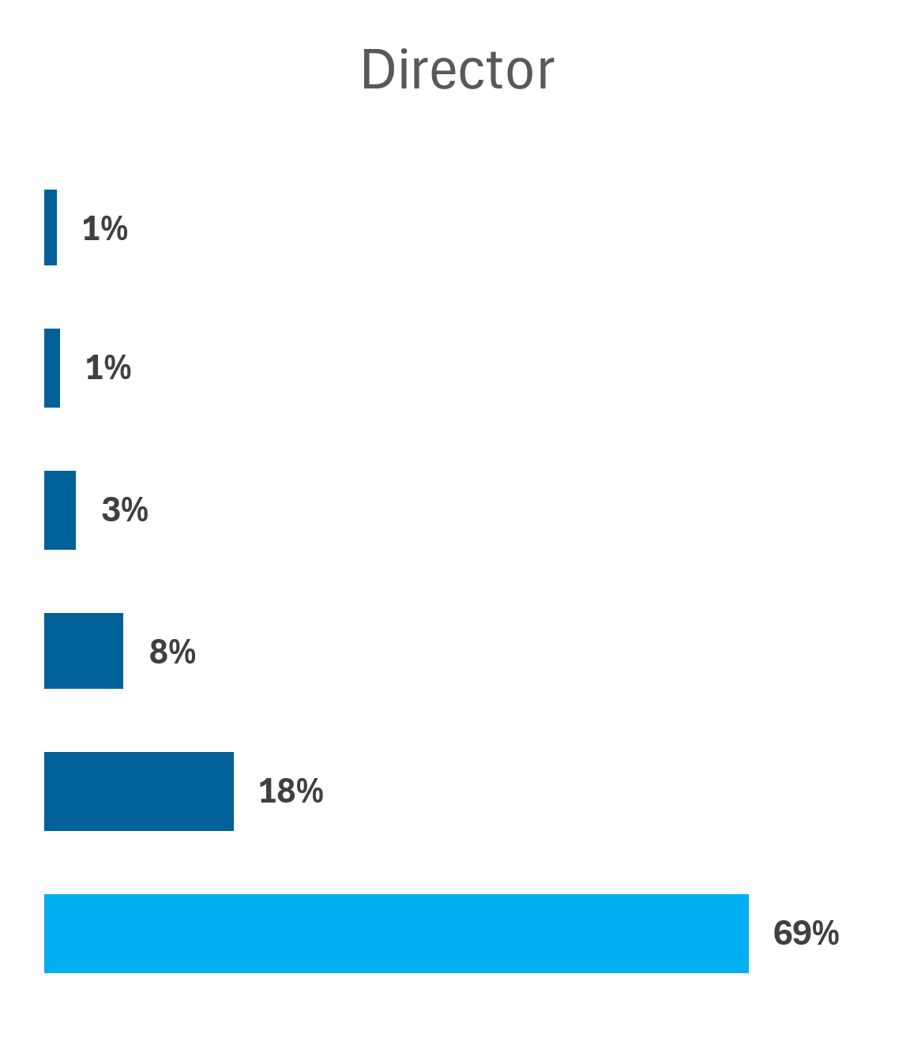
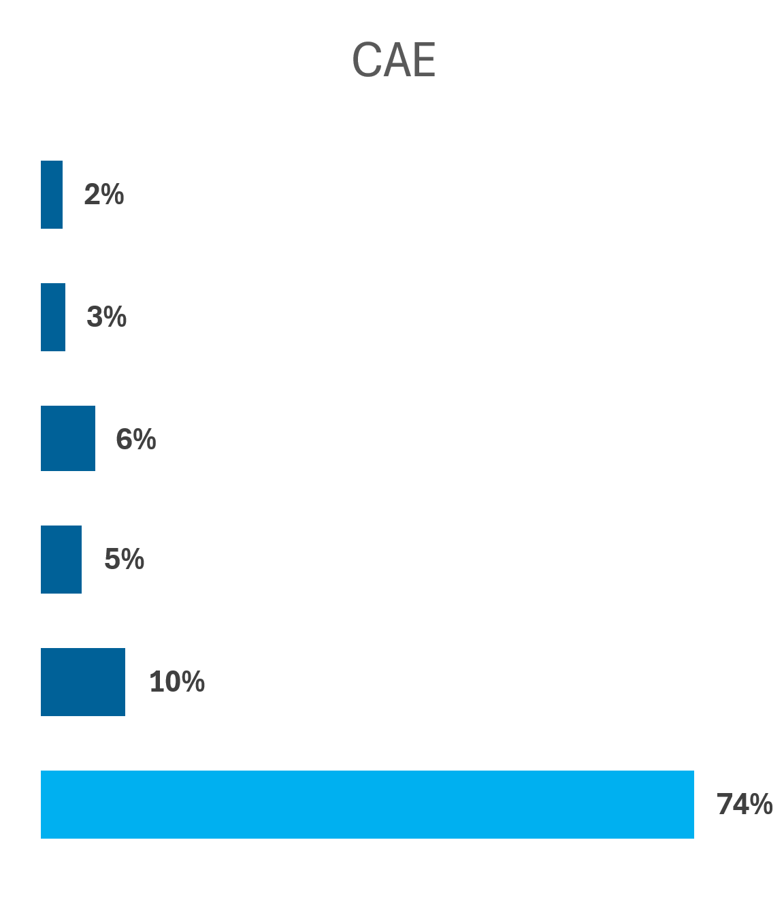
Real-World Salaries: From our Members
Source: The IIA's North American Member Satisfaction Survey, 2024. Public sector not included in analysis. n = 1,416.
Notes:
Internal auditing is a great career path that offers impressive opportunities.
The IIA asked over 1,400 internal auditors to share their current salaries. Here’s what we found:
35% of staff-level professionals earn more than $100K
Over 69% of Directors/Chief Audit Executives earn $150K+ Note: These numbers are from the private sector.

Slide 26
Certifications
What’s out there and Why pursue it

Slide 27
Internal Audit Practitioner
🎯 Perfect for students and career-changers
🧠 Demonstrates your internal audit aptitude
📄 Boost your résumé
⏱️ 1-Part Exam
📈 First step toward the CIA
🌟 Build confidence early
Notes:
The IAP is a fantastic entry-level certification from The IIA, great for students or early-career professionals who want to show they’re serious about internal auditing. It proves you understand the basics, You can earn it in less than two years, and It’s a great steppingstone to the Certified Internal Auditor (CIA) credential. If you’re serious about starting your career strong, this is a smart move.

Slide 28
Certified Internal Auditor
✅ Enhance credibility and respect
🚀 Boost your opportunities
💰 Increase your salary
🌍 Go global
📚 Sharpen your skills and proficiencies
📈 Invest in yourself
🌟 Gold Standard for 50+ Years
Notes:
The CIA is the gold standard in internal audit certifications—and it’s recognized around the world. So whether you stay local or want to work internationally, it carries serious weight
It shows employers you’re credible, skilled, and dedicated
CIA holders tend to earn more and advance faster
It can open global career doors you didn’t even know existed It’s an investment in your future—and a big confidence booster, too.

Slide 29
This Sounds Great
What can I do next?

Slide 30
Student Membership- The IIA
Chapter Affiliation
Career Networking
Grants & Scholarships
Financial Savings
Academic & Career Resources
Global Student Conference
How to Apply: 1. Create an IIA account
2. Log into MyIIA and complete the Student Application.
3. Access your free student membership!
Notes:
Presenter Note: [insert qr code (in green space on side) to student membership sign up list if you have one. You can then send the bulk list to StudentMembership@theiia.org] If this field sounds interesting, and you want to get ahead, Join The IIA as a student member. Becoming a student member of The IIA is more than just joining a professional organization — it’s a jumpstart for your career. You'll be connected to your local chapter, where you can meet internal audit professionals and build relationships that could lead to internships or jobs. Through career networking and mentorship, you'll get real-world insights and guidance from people already in the field. There’s also real financial support — including scholarships, discounted CIA exam fees, and reduced event registration, which all help make professional growth more accessible. As a member, you’ll have access to a wide range of academic and career development resources, including webinars, tools, and publications used by auditors around the world. You’ll enhance your knowledge and build your resume — and just having IIA student membership listed shows future employers you’re serious about your professional path. And finally, don’t miss the Global Student Conference, where you can meet peers nationwide, connect with employers, and attend sessions that bring the field of internal audit to life. Plus, by joining as a student, you’re automatically part of a global network of more than 260,000 professionals — a huge advantage as you start your career.

Slide 31
Thank You!
Notes:
Presenter Note- [insert QR Code to Student member sign up list and/or insert QR Code to your Personal LinkedIn if you have them]

