Slide 1
GETTING TO KNOW INTERNAL
AUDITING
THE PROFESSION THAT MAKES A DIFFERENCE
Presenter: Organization
Date
Presentation is complements of The IIA Academic Relations

Slide 2
WHAT’S INTERNAL AUDITING?
“Internal auditing is an independent, objective assurance and consulting activity designed to add value and improve an organization’s operations. It helps an organization accomplish its objectives by bringing a systematic, disciplined approach to evaluate and improve the effectiveness of risk management, control, and governance processes.”

Slide 3
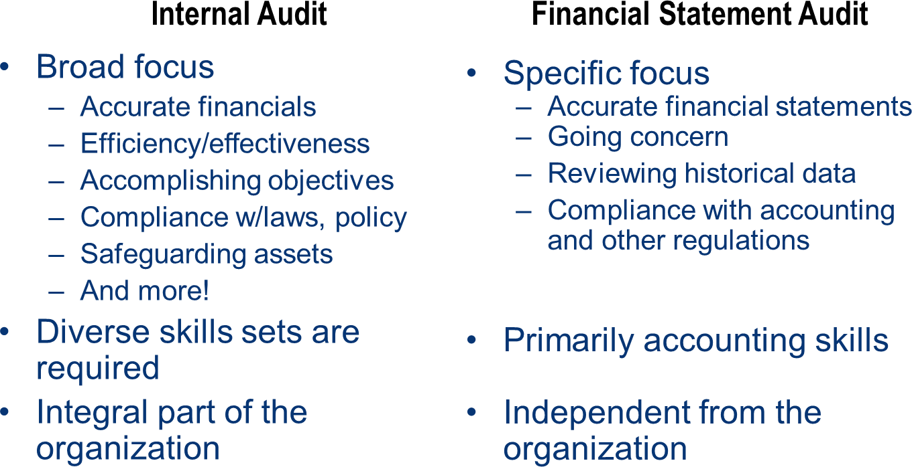
HIGH LEVEL COMPARISON

Slide 4
INTERNAL AUDITORS ASSESS RISK…
To help keep bad things from happening
To help assure good things can happen
To help management understand
Where their risks are
Whether the risks are under control
Whether the risks are worth taking

Slide 5
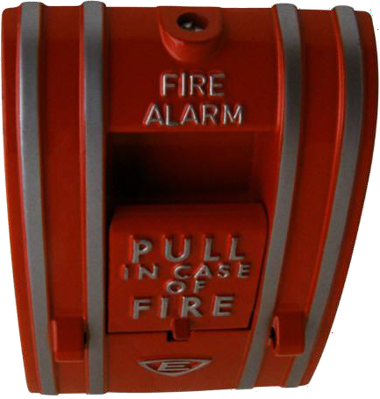
FINDING RISKS IS NOT ENOUGH
Internal auditors evaluate the controls that help organizations manage risks
Are controls in place?
Do the controls work?
Are additional controls needed?
Are there unnecessary controls?
Are the controls cost-effective?

Slide 6
FIVE CRITICAL TASKS
Determine whether controls are adequate
Suggest improvements to increase efficiency and effectiveness or to lower operating costs
Determine whether policies and procedures are followed
Determine whether laws and regulations are being obeyed
Detect fraud or manipulation of records

Slide 7
EFFECTIVE GOVERNANCE
Board of Directors
External Audit
Internal Audit
Management

Slide 8
MAINTAINING INDEPENDENCE: DUAL REPORTING RELATIONSHIPS
About 80 percent of Chief Audit Executives (CAEs) report functionally to the Audit Committee/Board of Directors
Independent from audited activities
Wide authority
Most common administrative reporting relationship is to the President/CEO

Slide 9
MEETING DIVERSE STAKEHOLDER NEEDS
Key Stakeholders
Audit committee/
board
CEO
CFO or individual to whom CAE reports administratively
Potentially, other chief
officers
Secondary Stakeholders
Other business unit
executives
External auditors and regulators
Investors and creditors
(Government audit)
citizens and taxpayers
Tertiary Stakeholders
Employees and
retirees
Investment analysts
Potentially, the general public

Slide 10
INTERNAL AUDITORS
Find out what’s working and what’s not
Keep an eye on the corporate climate
Look at the organization with fresh eyes
Look beyond the financial statements
Advocate improvements
Raise red flags
Tell it like it is

Slide 11
AUDITORS TELL IT LIKE IT IS
Keep senior management aware of critical issues
Ensure factual communications of financial, operational and compliance data
Make suggestions based on knowledge of operations throughout the organization

Slide 12
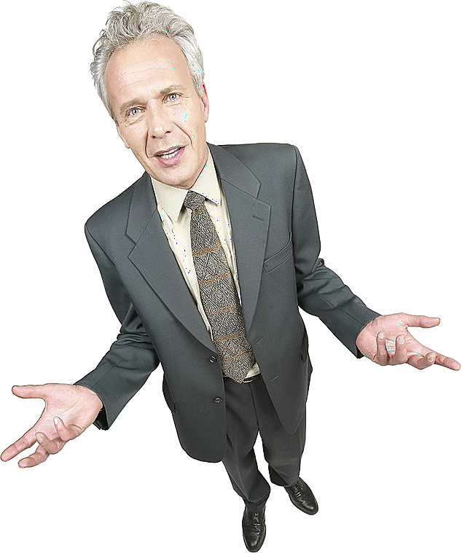
WHAT WOULD YOU SAY…
If someone asked you whether or not their organization needed internal auditors?

Slide 13
WHAT DOES A COMPANY NEED AN INTERNAL AUDIT FUNCTION?
Internal audit is not legally required in the U.S.
– Exceptions: NYSE-listed corporations and a few specific industry/government requirements
Required in some countries
Every organization, regardless of its size, should have some type of internal control system/process
The IIA believes that an organization is best served by a fully resourced and professionally competent internal auditing function

Slide 14
WHAT WILL AN INTERNAL AUDIT FUNCTION ACCOMPLISH?
Will it reduce liability or help control risks?
Will it free management to focus on core mission?
Will it improve the accuracy of financial and operational information?
Do we need a second opinion?
Can we improve service delivery?
Will it improve financial results?

Slide 15
INTERNATIONAL PROFESSIONAL PRACTICES FRAMEWORK
Mandatory Guidance
International Standards for the Professional Practice of Internal Auditing
Definition of Internal Auditing
Code of Ethics
Strongly Recommended
Position Papers
Practice Advisories
Practice Guides
www.theiia.org or https://global.theiia.org

Slide 16
QUESTIONS?

