Slide 1


VALUE OF INTERNAL AUDITING: ASSURANCE, INSIGHT, OBJECTIVITY
A PRESENTATION TO STAKEHOLDERS ABOUT THE VALUE
OF INTERNAL AUDITING
Presentation is complements of The IIA Academic Relations

Slide 2

WHAT SHOULD YOU EXPECT FROM YOUR INTERNAL AUDIT DEPARTMENT

Slide 3
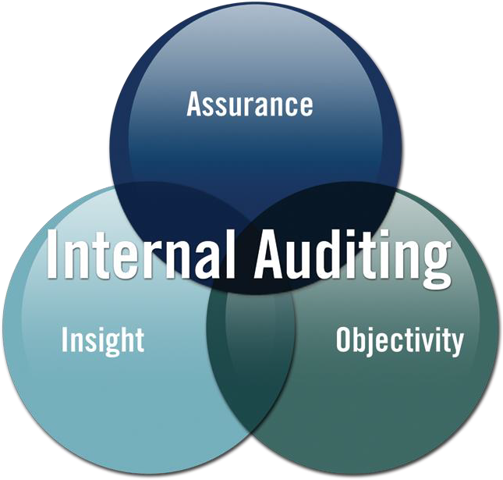
VALUE PROPOSITION OF INTERNAL AUDITING FOR KEY STAKEHOLDERS
Internal Auditing: Assurance ▪ Insight ▪
Objectivity
Governing bodies and senior management rely on Internal Auditing for objective assurance and insight on the effectiveness and efficiency of governance, risk management and internal control processes.

Slide 4
INTERNAL AUDITING PROVIDES
Assurance that the organization is operating as management intends.
Insight for improving controls, processes, procedures, performance, and risk management; and for reducing expenses, enhancing revenues, and improving profits.
Objective assessments of operations.

Slide 5
INTERNAL AUDITORS
Have variety of skills, educational backgrounds, and expertise.
Use their broad knowledge of the business to help management achieve its business objectives and assist the governing body in fulfilling its oversight responsibility.
Are catalysts, risk and control experts, efficiency specialists, and problem-solvers.

Slide 6
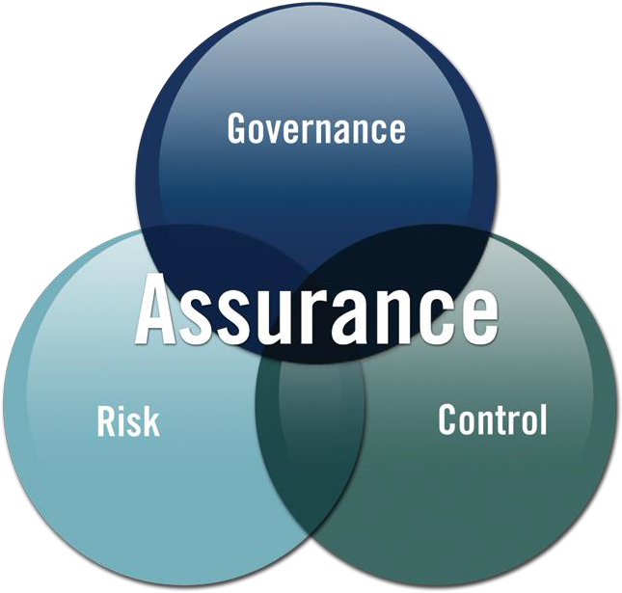
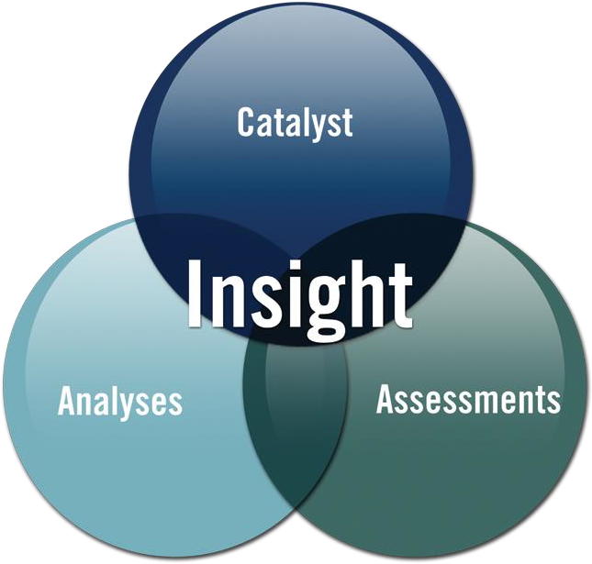
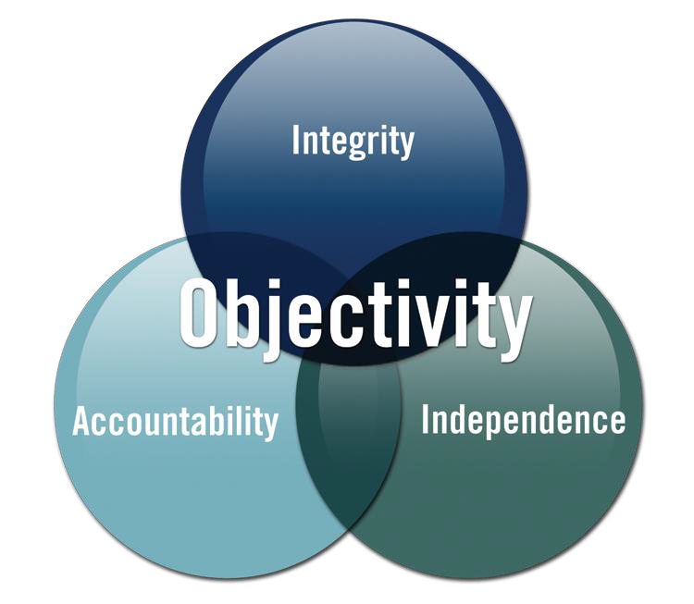
VALUE PROPOSITION OF INTERNAL AUDITING FOR KEY STAKEHOLDERS
What else should you expect from your IA Department?

Slide 7
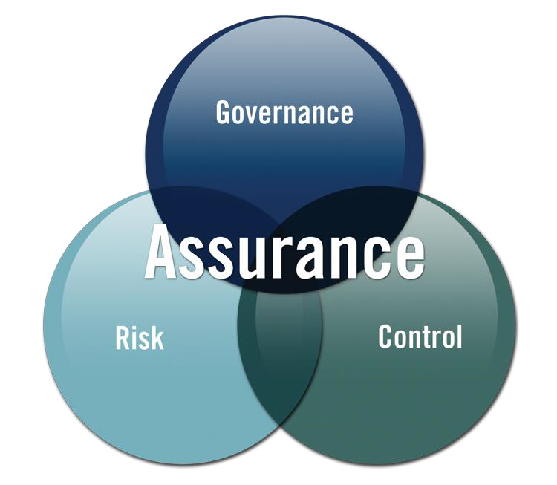
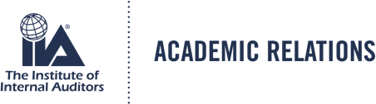
ASSURANCE:
GOVERNANCE, RISK, CONTROL
Internal Auditing provides assurance on the organization’s governance, risk management and control processes to help the organization achieve its strategic, operational,
financial, and compliance objectives.

Slide 8
GOVERNANCE, RISK, CONTROL
Internal Auditing, as one of the four cornerstones of corporate governance (along with the governing body, executive management, and external auditing) helps organization focus on strong controls, accurate reporting, effective oversight, mitigation of risks, and protection of investments.
Assists management and governing bodies in identifying risks.
Provides insight on effectiveness of controls and compliance with procedures and regulations, and recommends improvements.

Slide 9
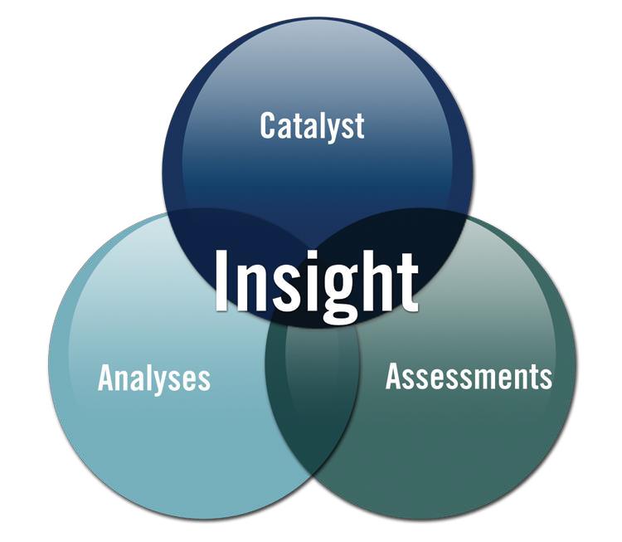
INSIGHT:
CATALYST, ANALYSES, ASSESSMENTS
Internal Auditing is a catalyst for improving an organization’s effectiveness and efficiency by providing insight and recommendations based on analyses and
assessments of data and business processes.

Slide 10
CATALYST, ANALYSES, ASSESSMENTS
As catalyst for improvement, evaluates processes, reports findings and recommends appropriate courses of action; and advises on key projects/initiatives.
Through analyses of data and information, provides insight into process improvements.
Through understanding of the business and its objectives, assesses the efficiency and effectiveness of operations and protection of assets.

Slide 11
OBJECTIVITY:
INTEGRITY, ACCOUNTABILITY, INDEPENDENCE
With commitment to integrity and accountability, Internal Auditing provides value to governing bodies and senior management as an independent source of objective advice.

Slide 12

INTEGRITY, ACCOUNTABILITY, INDEPENDENCE
Grounded in professionalism and integrity through professional Standards and Code of Ethics.
Accountable in helping management and governing bodies achieve their objectives.
To ensure independence, CAE should report to independent governing body for functional direction; and to management for administrative oversight. Maintains objectivity by not assuming any operational responsibilities.

Slide 13
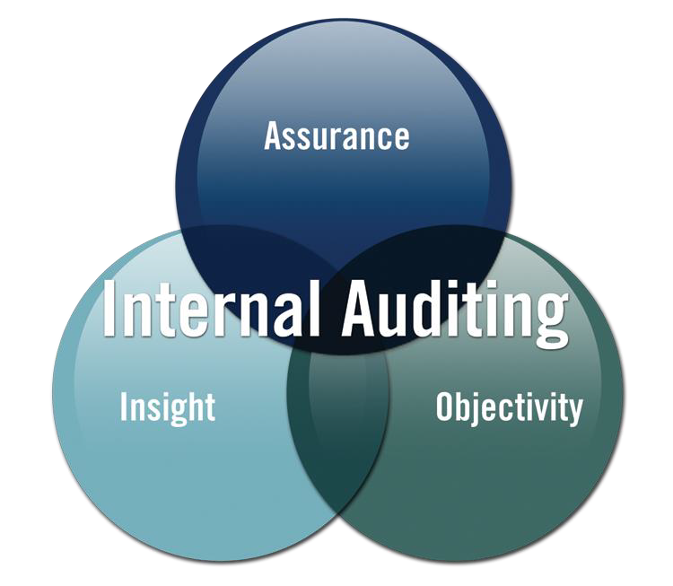
VALUE PROPOSITION OF INTERNAL AUDITING FOR KEY STAKEHOLDERS
WHAT YOU SHOULD EXPECT FROM YOUR INTERNAL AUDITORS

Slide 14
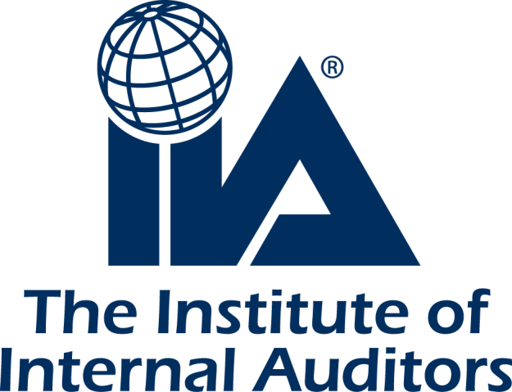
FOR MORE INFORMATION
The world’s leader in certification, education, research, and technological guidance for the profession of Internal Auditing.
www.theiia.org

