Slide 1
Life As An Internal
Auditor
Brought to you by The Institute of Internal Auditors
Erin Morrow Principal, Grant Thornton Advisory Services
Anthony Morton-Aiken
Grant Thornton Advisory Services

Slide 2
INTRODUCTIONS
Erin Morrow
Principal, Business Advisory Services - New York
Anthony Morton-Aiken
Manager, Business Advisory Services - Boston

Slide 3
INTERNAL AUDIT:
BASICS

Slide 4
INTERNAL AUDIT BASICS DEFINITION (IIA)
Internal auditing is an independent, objective assurance and consulting activity designed to add value and improve an organization's operations.
It helps an organization accomplish its objectives by bringing a systematic, disciplined approach to evaluate and improve the effectiveness of risk management, control, and governance processes.*
*Institute of Internal Auditors
http://www.theiia.org/theiia/about-the-profession/internal-audit-faqs/?i=1077

Slide 5
INTERNAL AUDIT BASICS DEFINITION (IIA)
Internal auditing is an independent, objective assurance and consulting activity designed to add value and improve an organization's operations.
It helps an organization accomplish its objectives by bringing a systematic, disciplined approach to evaluate and improve the effectiveness of risk management, control, and governance processes.*
*Institute of Internal Auditors
http://www.theiia.org/theiia/about-the-profession/internal-audit-faqs/?i=1077

Slide 6
INTERNAL AUDIT BASICS DEFINITION (IIA)
Inte ass add ope
It h obje dis the e con
rnal auditing is an independent, objecti
urance and consulting activity designe value and improve an organization's rations.
elps an organization accomplish its ctives by bringing a systematic,
ciplined approach to evaluate and impr ffectiveness of risk management,
trol, and governance processes.*
ve d to
INTERNAL
You perform audits internally within the company
You are part of the organization and act as a department within the company as opposed to external audit where you are an external entity
ove
*Institute of Internal Auditors
http://www.theiia.org/theiia/about-the-profession/internal-audit-faqs/?i=1077

Slide 7
INTERNAL AUDIT BASICS DEFINITION (IIA)
Internal auditing is an independent, objective assurance and consulting activity designed to add value and improve an organization's operations.
It helps an organization accomplish its objectives by bringing a systematic, disciplined approach to evaluate and improve the effectiveness of risk management, control, and governance processes.*
*Institute of Internal Auditors
http://www.theiia.org/theiia/about-the-profession/internal-audit-faqs/?i=1077

Slide 8
INTERNAL AUDIT BASICS DEFINITION (IIA)
In as a
ternal auditing is an independent, objec
surance and consulting activity design dd value and improve an organization's perations.
elps an organization accomplish its ectives by bringing a systematic, ciplined approach to evaluate and imp e effectiveness of risk management, ntrol, and governance processes.*
tive ed to
Independent: Not involved in the activity under review. Not part of the management hierarchy.
o
It h obj dis th co
Objective: Objectivity is a state of mind, it doesn’t depend on your boss. Opinions should be based on verifiable facts, viewed without bias.
rove
*Institute of Internal Auditors
http://www.theiia.org/theiia/about-the-profession/internal-audit-faqs/?i=1077

Slide 9
INTERNAL AUDIT BASICS DEFINITION (IIA)
Internal auditing is an independent, objective assurance and consulting activity designed to add value and improve an organization's operations.
It helps an organization accomplish its objectives by bringing a systematic, disciplined approach to evaluate and improve the effectiveness of risk management, control, and governance processes.*
*Institute of Internal Auditors
http://www.theiia.org/theiia/about-the-profession/internal-audit-faqs/?i=1077

Slide 10
INTERNAL AUDIT BASICS DEFINITION (IIA)
Internal auditing is an independent, objective
a ed to
a
ssurance and consulting activity design
dd value and improve an organization's perations.
helps an organization accomplish its bjectives by bringing a systematic, sciplined approach to evaluate and imp he effectiveness of risk management, ontrol, and governance processes.*
Assurance: To inform the management, and through them the stakeholders, that controls are operating as expected.
o
It
Consulting Activity: Your role is to provide help
and guidance to your company.
o
di t c
rove
*Institute of Internal Auditors
http://www.theiia.org/theiia/about-the-profession/internal-audit-faqs/?i=1077

Slide 11
INTERNAL AUDIT BASICS DEFINITION (IIA)
Internal auditing is an independent, objective assurance and consulting activity designed to add value and improve an organization's operations.
It helps an organization accomplish its objectives by bringing a systematic, disciplined approach to evaluate and improve the effectiveness of risk management, control, and governance processes.*
*Institute of Internal Auditors
http://www.theiia.org/theiia/about-the-profession/internal-audit-faqs/?i=1077

Slide 12
INTERNAL AUDIT BASICS DEFINITION (IIA)
I a a
nternal auditing is an independent, objectiv
ssurance and consulting activity designed dd value and improve an organization's perations.
helps an organization accomplish its obje y bringing a systematic, disciplined approa valuate and improve the effectiveness of ri anagement, control, and governance rocesses.*
e to
Systematic, disciplined approach:
o
Based on guidance issued by regulators, professional certifications, and training provided by your firm,
It b e m p
ctives ch to sk
*Institute of Internal Auditors
http://www.theiia.org/theiia/about-the-profession/internal-audit-faqs/?i=1077

Slide 13
INTERNAL AUDIT BASICS DEFINITION (IIA)
Internal auditing is an independent, objective assurance and consulting activity designed to add value and improve an organization's operations.
It helps an organization accomplish its objectives by bringing a systematic, disciplined approach to evaluate and improve the effectiveness of risk management, control, and governance processes.*
*Institute of Internal Auditors
http://www.theiia.org/theiia/about-the-profession/internal-audit-faqs/?i=1077

Slide 14
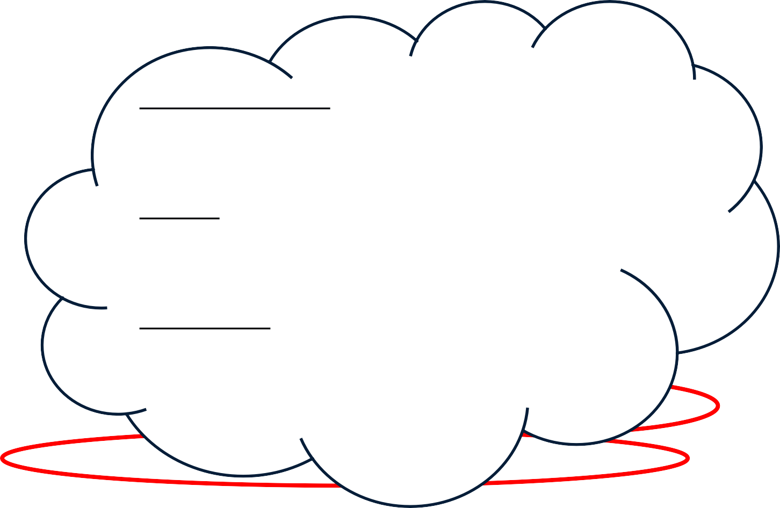
INTERNAL AUDIT BASICS DEFINITION (IIA)
Internal auditing is an independent, objective assuran_{Ris}c_{k}e_{Ma}a_{na}n_{ge}d_{me}c_{nt:}o_{O}n_{ne}s_{o}u_{f t}l_{h}t_{e}in_{ma}g_{in r}a_{ol}c_{es}t_{o}iv_{f} ity designed to
_{add val}In_{u}te_{e}rna_{a}l A_{n}ud_{d}it is_{im}to h_{p}elp_{ro}the_{v}c_{e}om_{a}pa_{n}ny _{o}ma_{r}n_{g}ag_{a}e _{nization's}
their risks.
^{operati}Cºo^{n}ntr^{s}ol.: Internal Audit helps the company to effectively manage and regulate their
It helps an organization accomplish its
business environment.
^{objectiv}G^{e}ov^{s}ern^{b}an^{y}ce:^{b}G^{r}o^{i}v^{n}ern^{g}a^{i}n^{n}ce^{g}deªals C^{s}w^{y}it^{s}h t^{t}h^{e}e ^{matic,}
disciplin^{pro}e^{ce}d^{sse}a^{s}p^{an}p^{d} r^{sy}o^{st}a^{em}c^{s}h^{by} t^{w}o^{hic}e^{h a}v^{n}aluate and improve
organization operates effectively
the effectiveness of risk management,
control, and governance processes.*
*Institute of Internal Auditors
http://www.theiia.org/theiia/about-the-profession/internal-audit-faqs/?i=1077

Slide 15
HISTORY OF INTERNAL AUDIT
5000 years ago, in the Middle Kingdom of the Nile, the Pharaoh's deputy was overseeing the storage of grains. Auditing was a matter of re-performing the work of others. Auditing meant observing, counting and double-checking records.
The processes and systems were very simple, and so was auditing.
As the business organizations grew in size and complexity, the practice of Internal Audit also evolved.
The modern practice of auditing internal control systems replaced
the prior technique of re-performing every step
Today, we use sophisticated risk modeling, statistical sampling, computer assisted audit techniques, and customer-focused total quality management as part of the audit process

Slide 16
INTERNAL AUDIT BASICS PURPOSE
The four cornerstones of effective corporate governance are:
audit committee of the board of directors
executive management
external auditors
internal auditors
When these groups work together with healthy interdependence, internal controls are strong, reporting is accurate, ethics are maintained, oversight is effective, risks are mitigated, and investments are protected.
From "INTERNAL AUDITING ALL IN A DAY’S WORK"
https://na.theiia.org/about-us/about-ia/Public%20Documents/06262_All_In_A_Days_Work-Rev.pdf

Slide 17
INTERNAL AUDIT: WHAT IS OUR ROLE

Slide 18
WHAT IS INTERNAL AUDIT’S ROLE IN THE ORGANIZATION?
Board of Directors
Internal Audit
External Audit
Management

Slide 19
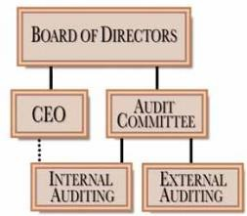
WHAT IS INTERNAL AUDIT’S ROLE IN THE ORGANIZATION

Slide 20
INTERNAL AUDIT:
CAREER OPPORTUNITIES

Slide 21
INTERNAL AUDIT WHAT IS THE CAREER PATH?
Broad range of degrees applicable
(financial, operational, social studies, etc.)
Work experience in companies (most experience is relevant)
Where do I
start?
Professional Internal Auditor
Join a Company / Government Department
(Directly into IA function, or through another role)
Professional Services Firm (out-sourced IA)
(Big Four, Grant Thornton, Smaller Firms)
Is it really a
career?
Head of IA Department
Other key management positions in the company
Partner in a professional services firm

Slide 22
INTERNAL AUDIT BASICS WHAT IS INTERNAL AUDITING?
Communicating with clarity and accuracy
Analyzing opportunities
Examining global issues
WHAT IS INTERNAL AUDITING?
Evaluating emerging technologies
Assessing risks, controls, ethics, quality, economy, and efficiency
Assuring that controls are adequate to mitigate the risks

Slide 23
INTERNAL AUDIT:
NEED

Slide 24
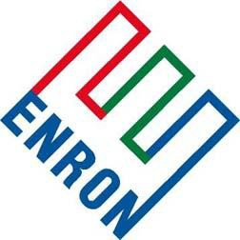
DOES INTERNAL AUDIT HAVE TO EXIST?
24

Slide 25
DOES INTERNAL AUDIT HAVE TO EXIST?
"WorldCom: Who's really gonna notice $9 billion dollars anyway?"¹
What began as a routine internal audit, transformed into the discovery of the largest accounting manipulation of all time.
Worldcom, a leading telecommunications company built from over 70 acquisitions, found itself ranked at the top of its class for illegal and creative accounting practices- Worldcom leaders successfully managed to erode the company market value from $180 billion in 1999 to approximately $350 million in 2002.
1. http://mba.tuck.dartmouth.edu/pages/faculty/syd.finkelstein/case_studies/03.html
25

Slide 26
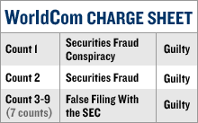
DOES INTERNAL AUDIT HAVE TO EXIST?
"WorldCom: Who's really gonna notice $9 billion dollars anyway?"¹.
In June of 2002, Cynthia Cooper, VP of Internal Audit, uncovered suspicious capitalizing of line costs that had been treated as expenses in prior years. By capitalizing these expenses, Worldcom managed to "produce" profits for five quarters that would have otherwise shown loses.
Other fraudulent accounting practices were unveiled going back to 1999. An additional $2 billion reserved for bad debts was improperly used to boost operating income.
Accounting manipulations included inflating profit-margin figures by arbitrarily reducing line costs and maintaining fake accounts on the accounts receivables books.
In total, Worldcom almost successfully misrepresented profits by approximately $7 billion with an additional $2 billion in question.
2
1 .http://mba.tuck.dartmouth.edu/pages/faculty/syd.finkelstein/case_studies/03.html
2. http://money.cnn.com/2005/03/15/news/newsmakers/ebbers/
26

Slide 27
INTERNAL AUDITORS BASICS WHO ARE INTERNAL AUDITORS?
Internal auditors are key to an organization’s success in today’s business world
Professionals with an in-depth understanding of the business culture, systems, and processes
Diversity of knowledge gives internal auditors a broad perspective on the organization
Education and expertise can differ broadly. They come from diverse areas such as engineering, operations, finance, and information technology
27

Slide 28
INTERNAL AUDIT: WHO WE ARE & WHAT WE DO

Slide 29
INTERNAL AUDITORS BASICS WHO ARE INTERNAL AUDITORS
A valuable resource to executive management and boards of directors in accomplishing overall goals and objectives, as well as in strengthening internal controls and organizational governance
Provide objective, independent, professional advice to management and strive for continuous improvement
Have extensive knowledge of computer systems and the Internet, regardless of background or industry
29

Slide 30
HOW DOES INTERNAL AUDIT DECIDE WHAT TO AUDIT?
1
2
3
4
5
Risk Identification | Validation | Prioritization | Mapping | Develop Audit Plan
Develop risk universe by first identifying organization’s goals and objectives, and then leveraging external thought leadership and prior audit experience to identify risks to achieving goals | Validate relevance of risk universe through a combination of data analytics and qualitative input from management | Rank risks according to likelihood and impact, taking into account such considerations as prior audit findings, organizational changes, and linkage to key strategic initiatives | Map top risks to relevant ‘auditable entities’, this may be a particular organization, project, or cross- functional process | Develop audit plan to evaluate process and controls for auditable entities linked to key risks
30

Slide 31
INTERNAL AUDIT WHAT DO WE DO?
Business Process Audits
Operational Audits
Determining if resources are being used effectively and efficiently to fulfill the organization's mission and objectives
Financial Audits
Reviewing accounting /financial transactions accuracy and proper treatment.
Compliance Audits
Determining if entities are complying with applicable laws,
regulations, policies and procedures
Internal Control Reviews
Review of operation and adequacy of controls around major business functions (i.e. payroll, accounts payable and financial reporting)

Slide 32
INTERNAL AUDIT WHAT DO WE DO?
Information Technology Audits
Penetration/Network Vulnerability Testing
Evaluating security of a system using proprietary tools used to identify exploits and vulnerabilities
Database Audits
Monitoring and analyzing a DB for authorization and authentication issues
Application/Automated Controls Audit
Evaluating an organization's systems, practices, and
operations
Ethical Hacking Audits
Simulated hacker attack to break into systems/networks to
identify and exploit security flaws

Slide 33
INTERNAL AUDIT MANAGEMENT & CHALLENGES
What are some factors to consider when conducting an internal audit?
Stakeholders expectations
People
Financials
Regulatory requirements
Communication
Timeliness

Slide 34
INTERNAL AUDIT: CHALLENGES

Slide 35
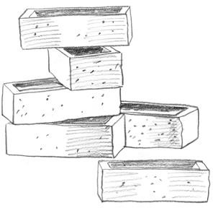
INTERNAL AUDIT MANAGEMENT & CHALLENGES
What are some challenges of internal auditing?
Prioritization of Audits
Skill / Knowledge Requirements
Regulatory Requirements
Corporate/Management Buy-in
Staffing / Resources
35

Slide 36
INTERNAL AUDIT: CERTIFICATIONS & ASSOCIATIONS

Slide 37
CERTIFICATION PROGRAMS
Certified Internal Auditor (CIA)
Certified Public Accountant (CPA)
Certified Information Systems Auditor (CISA)
Certified Fraud Examiner (CFE)
Certified Government Auditing Professional (CGAP)
Certified Financial Services Auditor (CFSA)

Slide 38
PROFESSIONAL ASSOCIATIONS
Institute of Internal Auditors (IIA)
Association of Certified Public Accountants (AICPA)
Information Systems and Control Association (ISACA)
Association of Certified Fraud Examiners (ACFE)

Slide 39
INTERNAL AUDIT: IS IT FOR YOU?

Slide 40
INTERNAL AUDIT WHAT’S IN IT FOR YOU?
Work with multiple clients in
diverse industries
Not locked into a specific audit area/function
Exposure to different methods
and approaches to auditing
Exposure to high level executives and audit committee members
You perform your work from various locations – not stuck in the same office
Possibility to obtain multiple certifications (i.e., CIA, CISA, etc.)
Travel to fun/exciting
locations
Premier status on multiple airlines and with multiple hotels
A ton of frequent flier miles and
hotel points (free vacations)

Slide 41
INTERNAL AUDIT WHAT’S THE CATCH?
Frequent change in work type
and subject matter
Hard schedules/deadlines
(get in, get out)
Accountable for every hour of work day (i.e., bill clients by the hour)
Challenging work environment
Work with and for different
people throughout the year
Often work and travel alone
Required to maintain multiple certifications (i.e., CIA, CISA, CPA, etc.)
Required training and firm
policy compliance
Travel to small locations with little to do in the evenings.
The hotel staff knows your
name and family history.
Staying at home is a "fun" vacation.

Slide 42
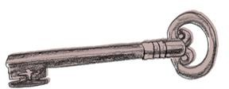
INTERNAL AUDIT
WHAT ARE THE KEYS TO SUCCESS?
Be comfortable with being uncomfortable.
Learn from those around you and above you.
Find the learning opportunity in every mistake you make.
Ask questions!

Slide 43
QUESTIONS

Slide 44
This presentation is the work of Grant Thornton LLP, the U.S. member firm of Grant Thornton International Ltd, and is in all respects subject to negotiation, agreement and signing of specific contracts. The information contained within this document is intended only for the entity or person to which it is addressed and contains confidential and/or proprietary material. Dissemination to third-parties, copying or use of this information is strictly prohibited without the prior written
consent of Grant Thornton LLP.

