Slide 1
Assessing the Risk of Your Cloud Deployment, the CSA’s Control Framework and Becoming CCAK Certified
Ted Dziekanowski – CISA, CISM, CRISC, CCAK, CDPSE

Slide 2
About your presenter
Ted Dziekanowski (Je-ka-now-ski) – Accredited ISACA CISA, CISM, CRISC, CCAK and IoT Instructor. Also, an ISC2 – CISSP, CAP, CCSP Accredited Instructor.
Contact Email – Ted@chathamtech.com
LinkedIn Profile - www.linkedin.com/in/tdziekanowski

Slide 3
Standard Disclaimer
First, the opinions I’m presenting are my own based on the delivery of many Cloud related classes and not that of ISACA or the Nur-Sultan Chapter. I am also not an Attorney, and you should consult with one prior to making any decisions regarding trans-national data transfers.

Slide 4
Agenda
Part 1 – How did we get here?
Reasons companies are running to the Cloud
Results of companies running to the Cloud
Shared Responsibility Models and Issues
Establishing Governance
Conclusion of Part 1
Part 2 – The Cloud Security Alliances Control Framework
What problems does the Framework Solve?
Control Families
Control Mappings
Control Gaps
CSA Assessments currently and in the future
Part 3 – The CCAK Certification Course and Exam
Part 4 – Q&A

Slide 5
Part 1 – How did we get here? (Here being the problem of auditing the Cloud)

Slide 6
Reasons Companies are Running to The Cloud
Digital Transformation being the buzzword of Boards of Directors of the day combined with an inability of the existing IT infrastructure to execute. Secondary consideration AI and ML which needs lots of data.
The CAPEX V. OPEX capital allocation argument. We will save money (or so they think)
ESG, especially the E. Data Centre consolidation, more efficient energy usage and high energy costs in some regions
Regulatory compliance issues around Incident Reporting and CDM (Continuous Diagnostics and Mitigation) requiring very short reporting intervals to Data Protection Authorities
Flexibility in scaling up or down depending on business requirements
COVID and the needs of virtual workforces scattered throughout the world and the inability of traditional IT to keep up.
Mitigation of risk through control inheritance
IT is not part of the core business, can’t find quality help and no one is selling on premises software anymore.

Slide 7
Results of Running to The Cloud
Lack of Governance over the Cloud Migration resulting in
Inadequate assessment of Risk resulting in
Potentially no right to audit
Shadow IT (People going off on their own)
Policies and supporting controls no longer being appropriate. Obsolete control frameworks
Lost opportunities by simply doing a lift and shift of the existing infrastructure
Increased compliance risk from inappropriate data consolidation
Failure to appreciate the capabilities of Cloud Service Providers and determining if those capabilities should become requirements
Poorly trained staff and developers
Costs in onboarding/offboarding (if it doesn’t work out)
Dismantling of the existing IT infrastructure with no way back
Broken BIA, BCP and DR plans along with issues around forensics and incident response ……

Slide 8
Results of Running to The Cloud
Lack of Governance over the Cloud Migration resulting in
Inadequate assessment of Risk resulting in
Broken SDLC’s including management of API’s, infrastructure as code, Containers, Cloud-native application protection platforms, SaaS security posture management, enhanced identity protection tools and zero-trust network access
Misconfigurations – According to Gartner, by 2023, nearly all (99%) of cloud security failures will be tracked back to manual controls not being set correctly. BTW when has anyone successfully sued Microsoft or AWS for a data breech?
Log management across multi-clouds becomes a nightmare
Cryptographic key management challenges
Configuration and change management challenges (who is doing what and developer access to production)
Limitations on Pen Testing
Asset valuation (what’s a virtual machine worth in terms of monetary value and protection
Ensuring tenant isolation
Control gaps caused by failing to understand…….

Slide 9
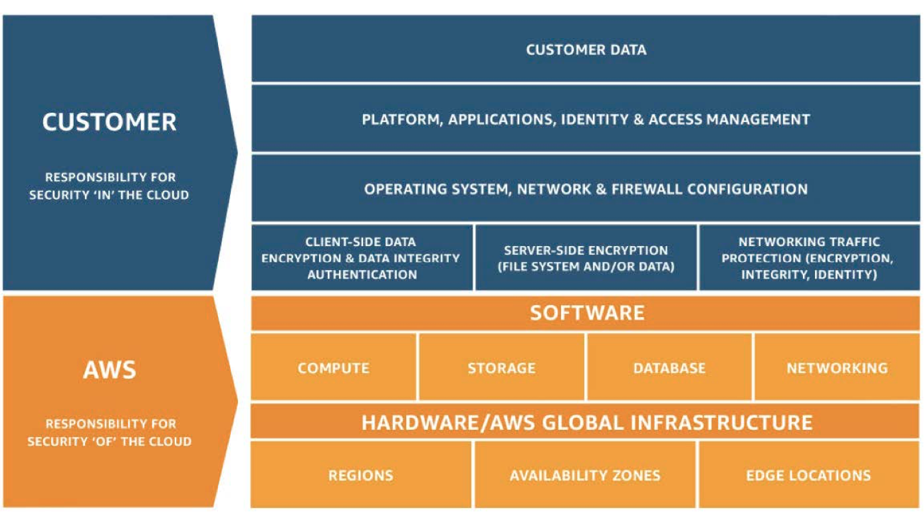
The Shared Responsibility Model Problem
Do User’s of the Cloud understand what they are supposed to do?
The AWS Model

Slide 10
AWS Shared Governance
Inherited Controls – Controls which a customer fully inherits from AWS.
Physical and Environmental controls
Shared Controls – Controls which apply to both the infrastructure layer and customer layers, but in completely separate contexts or perspectives. In a shared control, AWS provides the requirements for the infrastructure and the customer must provide their own control implementation within their use of AWS services. Examples include:
Patch Management – AWS is responsible for patching and fixing flaws within the infrastructure, but customers are responsible for patching their guest OS and applications.
Configuration Management – AWS maintains the configuration of its infrastructure devices, but a customer is responsible for configuring their own guest operating systems, databases, and applications.
Awareness & Training - AWS trains AWS employees, but a customer must train their own employees.

Slide 11
AWS Shared Governance
Customer Specific – Controls which are solely the responsibility of the customer based on the application they are deploying within AWS services. Examples include:
Service and Communications Protection or Zone Security which may require a customer to route or zone data within specific security environments.

Slide 12
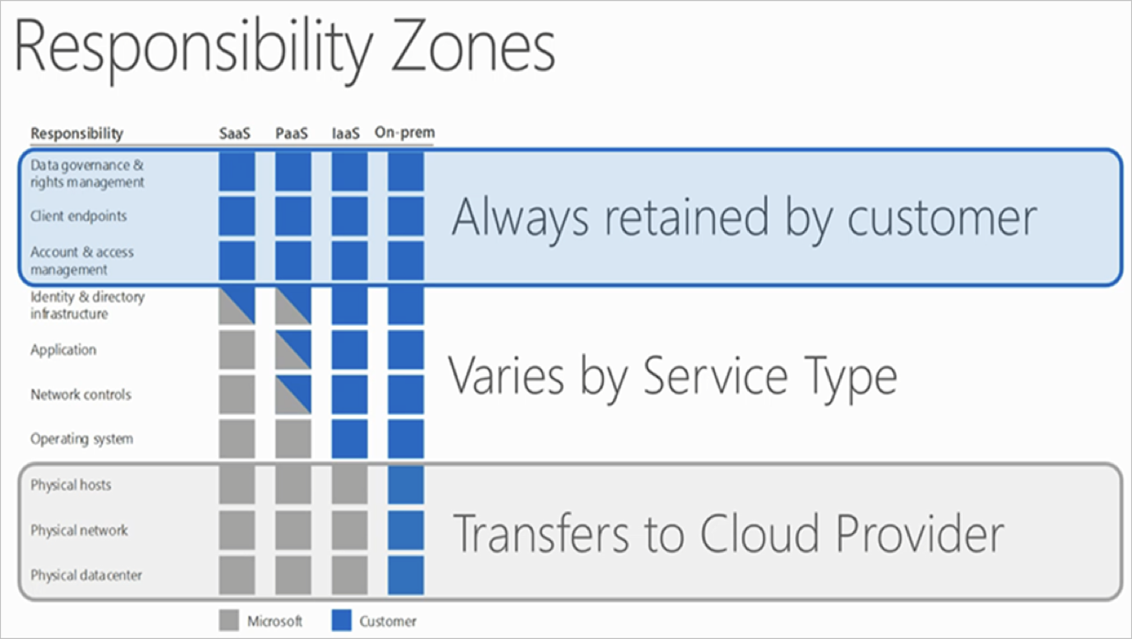
Microsoft’s Shared Governance Model

Slide 13
Microsoft’s Shared Governance Model
For on-premises solutions, the customer is both accountable and responsible for all aspects of security and operations.
For IaaS solutions, the elements such as buildings, servers, networking hardware, and the hypervisor should be managed by the platform vendor. The customer is responsible or has a shared responsibility for securing and managing the operating system, network configuration, applications, identity, clients, and data

Slide 14
Microsoft’s Shared Governance Model
PaaS solutions build on IaaS deployments, and the provider is additionally responsible to manage and secure the network controls. The customer is still responsible or has a shared responsibility for securing and managing applications, identity, clients, and data.
For SaaS solutions, a vendor provides the application and abstracts customers from the underlying components. Nonetheless, the customer continues to be accountable; they must ensure that data is classified correctly, and they share a responsibility to manage their users and end-point devices

Slide 15
Example of Shared Responsibility
NIST SP 800-53R5 AC-1
Control Description:
The organization develops, documents, and disseminates to [Assignment: organization-defined personnel or roles] an access control policy that addresses purpose, scope, roles, responsibilities, management commitment, coordination among organizational entities, and compliance; and procedures to facilitate the implementation of the access control policy and associated access controls; and reviews and updates the current access control policy [Assignment: organization-defined frequency]; and access control procedures [Assignment: organization-defined frequency]

Slide 16
Example of Shared Responsibility
NIST SP 800-53R5 AC-1
What Does Microsoft say they do?
For PAAS Control Coverage - The customer is responsible for implementing this control.
What is the Customer supposed to do?
The customer is responsible for developing, documenting, reviewing, updating, and disseminating the access control policy and procedures. The customer access control policy and procedures address access to all customer-deployed resources and customer system access (e.g., access to customer-deployed virtual machines, access to customer-built applications). The customer implementation statement should address the content of the policy (which must include purpose, scope, roles, responsibilities, management commitment, coordination, and compliance), procedures (which must facilitate the implementation of the policies and associated controls), frequency of review, and the role(s) responsible.

Slide 17
Example of Shared Responsibility
Multiple this by the total number of controls in any given framework and you begin to see
The challenging in maintaining an updated risk register to cover
Every application and control where there is a shared responsibility
Across numerous cloud providers
Covering all of the compliance and data an organization collects and manages
Across all the Clouds a company uses
While obtaining assurance that the Cloud Providers are doing their part

Slide 18
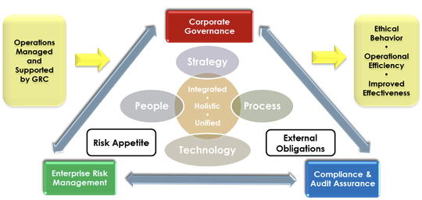
So How Do We Fix this?
The Overarching Objective

Slide 19
So, How do we Fix this?
ISACA’s Cloud Governance Recommendations from the Cloud Computing Audit Program
Governance of Cloud Computing Services |  | CO1. Governance functions are established to ensure effective and sustainable management processes that result in transparency of business decisions, clear lines of responsibility, information security in alignment with regulatory and customer organization standards, and accountability.
Enterprise Risk Management |  | CO2. Risk management practices are implemented to evaluate inherent risk within the cloud computing model, identify appropriate control mechanisms and ensure that residual risk is within acceptable levels.
Information Risk Management |  | CO3. A process to manage information risk exists and is integrated into the organization’s overall ERM framework. Information risk management information and metrics are available for the information security function to manage risk within the risk tolerance of the data owner.
Third-party Management |  | CO4. The customer recognizes the outsourced relationship with the service provider. The customer understands its responsibilities for controls, and the service provider has provided assurances of sustainability of those controls.
Legal and Electronic Discovery |  | CO5. The service provider and customer establish bilateral agreements and procedures to ensure contractual obligations are satisfied, and these obligations address the compliance requirements of both the customer and service provider.

Slide 20
So, How do we Fix this?
ISACA’s Cloud Governance Recommendations from the Cloud Computing Audit Program
Right to Audit |  | CO7. The right to audit is clearly defined and satisfies the assurance requirements of the customer’s board of directors, audit charter, external auditors and any regulators having jurisdiction over the customer.
Auditability |  | CO8. The service provider’s operating environment should be subject to audit to satisfy the customer’s audit charter, compliance requirements and good practice controls without restriction.
Compliance Scope |  | CO9. The use of cloud computing does not invalidate or violate any customer compliance requirements
Certifications |  | CO10. Service provider security assurance is provided through ISO 27001 Certification.
Service Transition Planning |  | CO11. Planning for the migration of data, such as formats and access, is essential to reducing operational and financial risk at the end of the contract. The transition of services should be considered at the beginning of contract negotiations.

Slide 21
So Where are we?
So Far, we have looked at
The business drivers of going to the cloud
Consequences of Cloud Fast
Shared Responsibility Model
Governance Recommendations from ISACA
But we still have a major problem
Although desirable we may not have a right to audit
We may have many different frameworks to deal with
How do we know the Cloud Providers are doing what they are supposed to do?
We need a Rosetta Stone or Lingua Franca
Which we now discuss in Part 2, The Cloud Security Alliances Cloud control Matrix and CAIQ along with the Star Registry.

Slide 22
Part 2 – The CSA’s Cloud Control Matrix, CAIQ and Star Registry

Slide 23
Cloud Security Alliance CCM and CAIQ
What is the Cloud Control Matrix (CCM)?
The CCM is a cloud specific controls created by industry consensus. Members who are in the Star Registry agree to document their adherence to the control's framework. This is above and beyond the traditional SSAE 18 SOC 1, 2 and 3 reports.
Because the controls are consensus driven and agreed upon moving between Cloud providers and using multiple providers is simpler. Do the control mapping once, analyze the CAIQ reports, and you’re done.
The CCM is also a kind of Rosetta Stone and Lingua Franca in providing mapping to the major control frameworks
There is also timely revision of the controls by the industry
The CCM acts as a companion to the CSA Security Guidance V4 and the CSA Enterprise Reference Guide
CCM goes through an open peer review process which is part of the standard CSA Research Lifecycle.

Slide 24
Cloud Security Alliance CCM and CAIQ
What is the Cloud Control Matrix (CCM) cont.?
There are three forms of CSA CCM releases and are defined as follows:
A Full or Major release (i.e., V3.0 =>V4.0) entails:
A revision of the CCM domain structure
A technical change (revision or addition or deletion) of a number of controls greater than 10% compared to the previous “Full” release
A Dot release (i.e., V1.0 => 1.1) constitutes the following forms of CSA CCM modifications:
A change in the matrix column
A technical change of number of controls smaller than 10%
A Minor release (i.e. V3.0 => V.3.0.1) constitutes the following forms of CSA CCM modifications:
An editorial change in the controls
Updated control framework mapping – revisions to previously-published mapped control frameworks; or
New control framework mapping – introduction of new control frameworks mapped to previously-published CSA CCM controls

Slide 25
Cloud Security Alliance CCM and CAIQ
How a Cloud Customer can use the CCM
Map organizational, operational and legal requirements to control objectives.
Build an operational cloud risk management program.
Build a third-party risk management program.
Build an internal and external cloud audit plan.
When building a cloud risk management program the CCM can help to measure, assess and monitor the risk associated with a CSP or a particular service.
It allows a customer to understand the gaps between an organization’s security needs and the cloud service security capabilities.
The customer can then use it to identify the compensating controls to close the gap between the organization’s needs and the providers offerings
When building a third-party risk management program, the CCM allows customers to assess a cloud service during the overall service lifecycle.
It can be used to make the initial evaluation of the service before its acquisition, compare offerings from different CSPs and monitor the alignment with internal requirements during the service execution.

Slide 26
Cloud Security Alliance CCM and CAIQ
CCM Domains and Controls
Audit and Assurance – A&A
Audit and Assurance Policy and Procedures | A&A-01 | Establish, document, approve, communicate, apply, evaluate and maintain audit and assurance policies and procedures and standards. Review and update the policies and procedures at least annually.
Independent Assessments | A&A-02 | Conduct independent audit and assurance assessments according to relevant standards at least annually.
Risk Based Planning Assessment | A&A-03 | Perform independent audit and assurance assessments according to risk-based plans and policies.
Requirements Compliance | A&A-04 | Verify compliance with all relevant standards, regulations, legal/contractual, and statutory requirements applicable to the audit.
Audit Management Process | A&A-05 | Define and implement an Audit Management process to support audit planning, risk analysis, security control assessment, conclusion, remediation schedules, report generation, and review of past reports and supporting evidence.
Remediation | A&A-06 | Establish, document, approve, communicate, apply, evaluate and maintain a risk-based corrective action plan to remediate audit findings, review and report remediation status to relevant stakeholders.

Slide 27
Cloud Security Alliance CCM and CAIQ
CCM Domains and Controls
Application & Interface Security - AIS
Application and Interface Security Policy and Procedures | AIS-01 | Establish, document, approve, communicate, apply, evaluate and maintain policies and procedures for application security to provide guidance to the appropriate planning, delivery and support of the organization's application security capabilities. Review and update the policies and procedures at least annually.
Application Security Baseline Requirements | AIS-02 | Establish, document and maintain baseline requirements for securing different applications.
Application Security Metrics | AIS-03 | Define and implement technical and operational metrics in alignment with business objectives, security requirements, and compliance obligations.
Secure Application Design and Development | AIS-04 | Define and implement a SDLC process for application design, development, deployment, and operation in accordance with security requirements defined by the organization.
Automated Application Security Testing | AIS-05 | Implement a testing strategy, including criteria for acceptance of new information systems, upgrades and new versions, which provides application security assurance and maintains compliance while enabling organizational speed of delivery goals. Automate when applicable and possible.
Automated Secure Application Deployment | AIS-06 | Establish and implement strategies and capabilities for secure, standardized, and compliant application deployment. Automate where possible.
Application Vulnerability Remediation | AIS-07 | Define and implement a process to remediate application security vulnerabilities, automating remediation when possible.

Slide 28
Cloud Security Alliance CCM and CAIQ
CCM Domains and Controls
Business Continuity Management and Operational Resilience – BCR
Business Continuity Management Policy and Procedures | BCR-01 | Establish, document, approve, communicate, apply, evaluate and maintain business continuity management and operational resilience policies and procedures. Review and update the policies and procedures at least annually.
Risk Assessment and Impact Analysis | BCR-02 | Determine the impact of business disruptions and risks to establish criteria for developing business continuity and operational resilience strategies and capabilities.
Business Continuity Strategy | BCR-03 | Establish strategies to reduce the impact of, withstand, and recover from business disruptions within risk appetite.
Business Continuity Planning | BCR-04 | Establish, document, approve, communicate, apply, evaluate and maintain a business continuity plan based on the results of the operational resilience strategies and capabilities.
Documentation | BCR-05 | Develop, identify, and acquire documentation that is relevant to support the business continuity and operational resilience programs. Make the documentation available to authorized stakeholders and review periodically.
Business Continuity Exercises | BCR-06 | Exercise and test business continuity and operational resilience plans at least annually or upon significant changes.
Communication | BCR-07 | Establish communication with stakeholders and participants in the course of business continuity and resilience procedures.
Backup | BCR-08 | Periodically backup data stored in the cloud. Ensure the confidentiality, integrity and availability of the backup, and verify data restoration from backup for resiliency.
Disaster Response Plan | BCR-09 | Establish, document, approve, communicate, apply, evaluate and maintain a disaster response plan to recover from natural and man-made disasters. Update the plan at least annually or upon significant changes.
Response Plan Exercise | BCR-10 | Exercise the disaster response plan annually or upon significant changes, including if possible local emergency authorities.
Equipment Redundancy | BCR-11 | Supplement business-critical equipment with redundant equipment independently located at a reasonable minimum distance in accordance with applicable industry standards.

Slide 29
Cloud Security Alliance CCM and CAIQ
CCM Domains and Controls
Change Control and Configuration Management – CCC
Change Management Policy and Procedures | CCC-01 | Establish, document, approve, communicate, apply, evaluate and maintain policies and procedures for managing the risks associated with applying changes to organization assets, including application, systems, infrastructure, configuration, etc., regardless of whether the assets are managed internally or externally (i.e., outsourced). Review and update the policies and procedures at least annually.
Quality Testing | CCC-02 | Follow a defined quality change control, approval and testing process with established baselines, testing, and release standards.
Change Management Technology | CCC-03 | Manage the risks associated with applying changes to organization assets, including application, systems, infrastructure, configuration, etc., regardless of whether the assets are managed internally or externally (i.e., outsourced).
Unauthorized Change Protection | CCC-04 | Restrict the unauthorized addition, removal, update, and management of organization assets.
Change Agreements | CCC-05 | Include provisions limiting changes directly impacting CSCs owned environments/tenants to explicitly authorized requests within service level agreements between CSPs and CSCs.
Change Management Baseline | CCC-06 | Establish change management baselines for all relevant authorized changes on organization assets.
Detection of Baseline Deviation | CCC-07 | Implement detection measures with proactive notification in case of changes deviating from the established baseline.
Exception Management | CCC-08 | 'Implement a procedure for the management of exceptions, including emergencies, in the change and configuration process. Align the procedure with the requirements of GRC-04: Policy Exception Process.'
Change Restoration | CCC-09 | Define and implement a process to proactively roll back changes to a previous known good state in case of errors or security concerns.

Slide 30
Cloud Security Alliance CCM and CAIQ
CCM Domains and Controls
Cryptography, Encryption &Key Management – CEK
CEK Roles and Responsibilities | CEK-02 | Define and implement cryptographic, encryption and key management roles and responsibilities.
Data Encryption | CEK-03 | Provide cryptographic protection to data at-rest and in-transit, using cryptographic libraries certified to approved standards.
Encryption Algorithm | CEK-04 | Use encryption algorithms that are appropriate for data protection, considering the classification of data, associated risks, and usability of the encryption technology.
Encryption Change Management | CEK-05 | Establish a standard change management procedure, to accommodate changes from internal and external sources, for review, approval, implementation and communication of cryptographic, encryption and key management technology changes.
Encryption Change Cost Benefit Analysis | CEK-06 | Manage and adopt changes to cryptography-, encryption-, and key management-related systems (including policies and procedures) that fully account for downstream effects of proposed changes, including residual risk, cost, and benefits analysis.
Encryption Risk Management | CEK-07 | Establish and maintain an encryption and key management risk program that includes provisions for risk assessment, risk treatment, risk context, monitoring, and feedback.

Slide 31
Cloud Security Alliance CCM and CAIQ
CCM Domains and Controls
Cryptography, Encryption &Key Management – CEK
CSC Key Management Capability | CEK-08 | CSPs must provide the capability for CSCs to manage their own data encryption keys.
Encryption and Key Management Audit | CEK-09 | Audit encryption and key management systems, policies, and processes with a frequency that is proportional to the risk exposure of the system with audit occurring preferably continuously but at least annually and after any security event(s).
Key Generation | CEK-10 | Generate Cryptographic keys using industry accepted cryptographic libraries specifying the algorithm strength and the random number generator used.
Key Purpose | CEK-11 | Manage cryptographic secret and private keys that are provisioned for a unique purpose.
Key Rotation | CEK-12 | Rotate cryptographic keys in accordance with the calculated cryptoperiod, which includes provisions for considering the risk of information disclosure and legal and regulatory requirements.
Key Revocation | CEK-13 | Define, implement and evaluate processes, procedures and technical measures to revoke and remove cryptographic keys prior to the end of its established cryptoperiod, when a key is compromised, or an entity is no longer part of the organization, which include provisions for legal and regulatory requirements.
Key Destruction | CEK-14 | Define, implement and evaluate processes, procedures and technical measures to destroy keys stored outside a secure environment and revoke keys stored in Hardware Security Modules (HSMs) when they are no longer needed, which include provisions for legal and regulatory requirements.

Slide 32
Cloud Security Alliance CCM and CAIQ
CCM Domains and Controls
Cryptography, Encryption &Key Management – CEK
Key Activation | CEK-15 | Define, implement and evaluate processes, procedures and technical measures to create keys in a pre-activated state when they have been generated but not authorized for use, which include provisions for legal and regulatory requirements.
Key Suspension | CEK-16 | Define, implement and evaluate processes, procedures and technical measures to monitor, review and approve key transitions from any state to/from suspension, which include provisions for legal and regulatory requirements.
Key Deactivation | CEK-17 | Define, implement and evaluate processes, procedures and technical measures to deactivate keys at the time of their expiration date, which include provisions for legal and regulatory requirements.
Key Archival | CEK-18 | Define, implement and evaluate processes, procedures and technical measures to manage archived keys in a secure repository requiring least privilege access, which include provisions for legal and regulatory requirements.
Key Compromise | CEK-19 | Define, implement and evaluate processes, procedures and technical measures to use compromised keys to encrypt information only in controlled circumstance, and thereafter exclusively for decrypting data and never for encrypting data, which include provisions for legal and regulatory requirements.
Key Recovery | CEK-20 | Define, implement and evaluate processes, procedures and technical measures to assess the risk to operational continuity versus the risk of the keying material and the information it protects being exposed if control of the keying material is lost, which include provisions for legal and regulatory requirements.
Key Inventory Management | CEK-21 | Define, implement and evaluate processes, procedures and technical measures in order for the key management system to track and report all cryptographic materials and changes in status, which include provisions for legal and regulatory requirements.

Slide 33
Cloud Security Alliance CCM and CAIQ
CCM Domains and Controls
Datacenter Security – DCS
Off-Site Equipment Disposal Policy and Procedures | DCS-01 | Establish, document, approve, communicate, apply, evaluate and maintain policies and procedures for the secure disposal of equipment used outside the organization's premises. If the equipment is not physically destroyed a data destruction procedure that renders recovery of information impossible must be applied. Review and update the policies and procedures at least annually.
Off-Site Transfer Authorization Policy and Procedures | DCS-02 | Establish, document, approve, communicate, apply, evaluate and maintain policies and procedures for the relocation or transfer of hardware, software, or data/information to an offsite or alternate location. The relocation or transfer request requires the written or cryptographically verifiable authorization. Review and update the policies and procedures at least annually.
Secure Area Policy and Procedures | DCS-03 | Establish, document, approve, communicate, apply, evaluate and maintain policies and procedures for maintaining a safe and secure working environment in offices, rooms, and facilities. Review and update the policies and procedures at least annually.
Secure Media Transportation Policy and Procedures | DCS-04 | Establish, document, approve, communicate, apply, evaluate and maintain policies and procedures for the secure transportation of physical media. Review and update the policies and procedures at least annually.
Assets Classification | DCS-05 | Classify and document the physical, and logical assets (e.g., applications) based on the organizational business risk.
Assets Cataloguing and Tracking | DCS-06 | Catalogue and track all relevant physical and logical assets located at all of the CSP's sites within a secured system.
Controlled Access Points | DCS-07 | Implement physical security perimeters to safeguard personnel, data, and information systems. Establish physical security perimeters between the administrative and business areas and the data storage and processing facilities areas.
Equipment Identification | DCS-08 | Use equipment identification as a method for connection authentication.

Slide 34
Cloud Security Alliance CCM and CAIQ
CCM Domains and Controls
Datacenter Security – DCS
Secure Area Authorization | DCS-09 | Allow only authorized personnel access to secure areas, with all ingress and egress points restricted, documented, and monitored by physical access control mechanisms. Retain access control records on a periodic basis as deemed appropriate by the organization.
Surveillance System | DCS-10 | Implement, maintain, and operate datacenter surveillance systems at the external perimeter and at all the ingress and egress points to detect unauthorized ingress and egress attempts.
Unauthorized Access Response Training | DCS-11 | Train datacenter personnel to respond to unauthorized ingress or egress attempts.
Cabling Security | DCS-12 | Define, implement and evaluate processes, procedures and technical measures that ensure a risk-based protection of power and telecommunication cables from a threat of interception, interference or damage at all facilities, offices and rooms.
Environmental Systems | DCS-13 | Implement and maintain data center environmental control systems that monitor, maintain and test for continual effectiveness the temperature and humidity conditions within accepted industry standards.
Secure Utilities | DCS-14 | Secure, monitor, maintain, and test utilities services for continual effectiveness at planned intervals.
Equipment Location | DCS-15 | Keep business-critical equipment away from locations subject to high probability for environmental risk events.

Slide 35
Cloud Security Alliance CCM and CAIQ
CCM Domains and Controls
Data Security and Privacy Lifecycle Management – DSP
Security and Privacy Policy and Procedures | DSP-01 | Establish, document, approve, communicate, apply, evaluate and maintain policies and procedures for the classification, protection and handling of data throughout its lifecycle, and according to all applicable laws and regulations, standards, and risk level. Review and update the policies and procedures at least annually.
Secure Disposal | DSP-02 | Apply industry accepted methods for the secure disposal of data from storage media such that data is not recoverable by any forensic means.
Data Inventory | DSP-03 | Create and maintain a data inventory, at least for any sensitive data and personal data.
Data Classification | DSP-04 | Classify data according to its type and sensitivity level.
Data Flow Documentation | DSP-05 | Create data flow documentation to identify what data is processed, stored or transmitted where. Review data flow documentation at defined intervals, at least annually, and after any change.
Data Ownership and Stewardship | DSP-06 | Document ownership and stewardship of all relevant documented personal and sensitive data. Perform review at least annually.
Data Protection by Design and Default | DSP-07 | Develop systems, products, and business practices based upon a principle of security by design and industry best practices.

Slide 36
Cloud Security Alliance CCM and CAIQ
CCM Domains and Controls
Data Security and Privacy Lifecycle Management – DSP
Data Privacy by Design and Default | DSP-08 | Develop systems, products, and business practices based upon a principle of privacy by design and industry best practices. Ensure that systems' privacy settings are configured by default, according to all applicable laws and regulations.
Data Protection Impact Assessment | DSP-09 | Conduct a Data Protection Impact Assessment (DPIA) to evaluate the origin, nature, particularity and severity of the risks upon the processing of personal data, according to any applicable laws, regulations and industry best practices.
Sensitive Data Transfer | DSP-10 | Define, implement and evaluate processes, procedures and technical measures that ensure any transfer of personal or sensitive data is protected from unauthorized access and only processed within scope as permitted by the respective laws and regulations.
Personal Data Access, Reversal, Rectification and Deletion | DSP-11 | Define and implement, processes, procedures and technical measures to enable data subjects to request access to, modification, or deletion of their personal data, according to any applicable laws and regulations.
Limitation of Purpose in Personal Data Processing | DSP-12 | Define, implement and evaluate processes, procedures and technical measures to ensure that personal data is processed according to any applicable laws and regulations and for the purposes declared to the data subject.
Personal Data Sub-processing | DSP-13 | Define, implement and evaluate processes, procedures and technical measures for the transfer and sub-processing of personal data within the service supply chain, according to any applicable laws and regulations.
Disclosure of Data Sub-processors | DSP-14 | Define, implement and evaluate processes, procedures and technical measures to disclose the details of any personal or sensitive data access by sub-processors to the data owner prior to initiation of that processing.
Limitation of Production Data Use | DSP-15 | Obtain authorization from data owners, and manage associated risk before replicating or using production data in non-production environments.

Slide 37
Cloud Security Alliance CCM and CAIQ
CCM Domains and Controls
Data Security and Privacy Lifecycle Management – DSP
Data Retention and Deletion | DSP-16 | Data retention, archiving and deletion is managed in accordance with business requirements, applicable laws and regulations.
Sensitive Data Protection | DSP-17 | Define and implement, processes, procedures and technical measures to protect sensitive data throughout it's lifecycle.
Disclosure Notification | DSP-18 | The CSP must have in place, and describe to CSCs the procedure to manage and respond to requests for disclosure of Personal Data by Law Enforcement Authorities according to applicable laws and regulations. The CSP must give special attention to the notification procedure to interested CSCs, unless otherwise prohibited, such as a prohibition under criminal law to preserve confidentiality of a law enforcement investigation.
Data Location | DSP-19 | Define and implement, processes, procedures and technical measures to specify and document the physical locations of data, including any locations in which data is processed or backed up.

Slide 38
Cloud Security Alliance CCM and CAIQ
CCM Domains and Controls
Governance, Risk and Compliance – GRC
Governance Program Policy and Procedures | GRC-01 | Establish, document, approve, communicate, apply, evaluate and maintain policies and procedures for an information governance program, which is sponsored by the leadership of the organization. Review and update the policies and procedures at least annually.
Risk Management Program | GRC-02 | Establish a formal, documented, and leadership-sponsored Enterprise Risk Management (ERM) program that includes policies and procedures for identification, evaluation, ownership, treatment, and acceptance of cloud security and privacy risks.
Organizational Policy Reviews | GRC-03 | Review all relevant organizational policies and associated procedures at least annually or when a substantial change occurs within the organization.
Policy Exception Process | GRC-04 | Establish and follow an approved exception process as mandated by the governance program whenever a deviation from an established policy occurs.
Information Security Program | GRC-05 | Develop and implement an Information Security Program, which includes programs for all the relevant domains of the CCM.
Governance Responsibility Model | GRC-06 | Define and document roles and responsibilities for planning, implementing, operating, assessing, and improving governance programs.
Information System Regulatory Mapping | GRC-07 | Identify and document all relevant standards, regulations, legal/contractual, and statutory requirements, which are applicable to your organization.
Special Interest Groups | GRC-08 | Establish and maintain contact with cloud-related special interest groups and other relevant entities in line with business context.

Slide 39
Cloud Security Alliance CCM and CAIQ
CCM Domains and Controls
Human Resources – HRS
Background Screening Policy and Procedures | HRS-01 | Establish, document, approve, communicate, apply, evaluate and maintain policies and procedures for background verification of all new employees (including but not limited to remote employees, contractors, and third parties) according to local laws, regulations, ethics, and contractual constraints and proportional to the data classification to be accessed, the business requirements, and acceptable risk. Review and update the policies and procedures at least annually.
Acceptable Use of Technology Policy and Procedures | HRS-02 | Establish, document, approve, communicate, apply, evaluate and maintain policies and procedures for defining allowances and conditions for the acceptable use of organizationally-owned or managed assets. Review and update the policies and procedures at least annually.
Clean Desk Policy and Procedures | HRS-03 | Establish, document, approve, communicate, apply, evaluate and maintain policies and procedures that require unattended workspaces to not have openly visible confidential data. Review and update the policies and procedures at least annually.
Remote and Home Working Policy and Procedures | HRS-04 | Establish, document, approve, communicate, apply, evaluate and maintain policies and procedures to protect information accessed, processed or stored at remote sites and locations. Review and update the policies and procedures at least annually.
Asset returns | HRS-05 | Establish and document procedures for the return of organization-owned assets by terminated employees.
Employment Termination | HRS-06 | Establish, document, and communicate to all personnel the procedures outlining the roles and responsibilities concerning changes in employment.

Slide 40
Cloud Security Alliance CCM and CAIQ
CCM Domains and Controls
Human Resources – HRS
Employment Agreement Process | HRS-07 | Employees sign the employee agreement prior to being granted access to organizational information systems, resources and assets.
Employment Agreement Content | HRS-08 | The organization includes within the employment agreements provisions and/or terms for adherence to established information governance and security policies.
Personnel Roles and Responsibilities | HRS-09 | Document and communicate roles and responsibilities of employees, as they relate to information assets and security.
Non-Disclosure Agreements | HRS-10 | Identify, document, and review, at planned intervals, requirements for non-disclosure/confidentiality agreements reflecting the organization's needs for the protection of data and operational details.
Security Awareness Training | HRS-11 | Establish, document, approve, communicate, apply, evaluate and maintain a security awareness training program for all employees of the organization and provide regular training updates.
Personal and Sensitive Data Awareness and Training | HRS-12 | Provide all employees with access to sensitive organizational and personal data with appropriate security awareness training and regular updates in organizational procedures, processes, and policies relating to their professional function relative to the organization.
Compliance User Responsibility | HRS-13 | Make employees aware of their roles and responsibilities for maintaining awareness and compliance with established policies and procedures and applicable legal, statutory, or regulatory compliance obligations.

Slide 41
Cloud Security Alliance CCM and CAIQ
CCM Domains and Controls
Identity & Access Management – IAM
Identity and Access Management Policy and Procedures | IAM-01 | Establish, document, approve, communicate, implement, apply, evaluate and maintain policies and procedures for identity and access management. Review and update the policies and procedures at least annually.
Strong Password Policy and Procedures | IAM-02 | Establish, document, approve, communicate, implement, apply, evaluate and maintain strong password policies and procedures. Review and update the policies and procedures at least annually.
Identity Inventory | IAM-03 | Manage, store, and review the information of system identities, and level of access.
Separation of Duties | IAM-04 | Employ the separation of duties principle when implementing information system access.
Least Privilege | IAM-05 | Employ the least privilege principle when implementing information system access.
User Access Provisioning | IAM-06 | Define and implement a user access provisioning process which authorizes, records, and communicates access changes to data and assets.
User Access Changes and Revocation | IAM-07 | De-provision or respectively modify access of movers / leavers or system identity changes in a timely manner in order to effectively adopt and communicate identity and access management policies.
User Access Review | IAM-08 | Review and revalidate user access for least privilege and separation of duties with a frequency that is commensurate with organizational risk tolerance.

Slide 42
Cloud Security Alliance CCM and CAIQ
CCM Domains and Controls
Identity & Access Management – IAM
Segregation of Privileged Access Roles | IAM-09 | Define, implement and evaluate processes, procedures and technical measures for the segregation of privileged access roles such that administrative access to data, encryption and key management capabilities and logging capabilities are distinct and separated.
Management of Privileged Access Roles | IAM-10 | Define and implement an access process to ensure privileged access roles and rights are granted for a time limited period, and implement procedures to prevent the culmination of segregated privileged access.
CSCs Approval for Agreed Privileged Access Roles | IAM-11 | Define, implement and evaluate processes and procedures for customers to participate, where applicable, in the granting of access for agreed, high risk (as defined by the organizational risk assessment) privileged access roles.
Safeguard Logs Integrity | IAM-12 | Define, implement and evaluate processes, procedures and technical measures to ensure the logging infrastructure is read-only for all with write access, including privileged access roles, and that the ability to disable it is controlled through a procedure that ensures the segregation of duties and break glass procedures.
Uniquely Identifiable Users | IAM-13 | Define, implement and evaluate processes, procedures and technical measures that ensure users are identifiable through unique IDs or which can associate individuals to the usage of user IDs.
Strong Authentication | IAM-14 | Define, implement and evaluate processes, procedures and technical measures for authenticating access to systems, application and data assets, including multifactor authentication for at least privileged user and sensitive data access. Adopt digital certificates or alternatives which achieve an equivalent level of security for system identities.
Passwords Management | IAM-15 | Define, implement and evaluate processes, procedures and technical measures for the secure management of passwords.
Authorization Mechanisms | IAM-16 | Define, implement and evaluate processes, procedures and technical measures to verify access to data and system functions is authorized.

Slide 43
Cloud Security Alliance CCM and CAIQ
CCM Domains and Controls
Interoperability & Portability – IPY
Interoperability and Portability Policy and Procedures | IPY-01 | Establish, document, approve, communicate, apply, evaluate and maintain policies and procedures for interoperability and portability including requirements for: a. Communications between application interfaces b. Information processing interoperability c. Application development portability d. Information/Data exchange, usage, portability, integrity, and persistence Review and update the policies and procedures at least annually.
Application Interface Availability | IPY-02 | Provide application interface(s) to CSCs so that they programmatically retrieve their data to enable interoperability and portability.
Secure Interoperability and Portability Management | IPY-03 | Implement cryptographically secure and standardized network protocols for the management, import and export of data.
Data Portability Contractual Obligations | IPY-04 | Agreements must include provisions specifying CSCs access to data upon contract termination and will include: a. Data format b. Length of time the data will be stored c. Scope of the data retained and made available to the CSCs d. Data deletion policy

Slide 44
Cloud Security Alliance CCM and CAIQ
CCM Domains and Controls
Infrastructure & Virtualization Security – IVS
Infrastructure and Virtualization Security Policy and Procedures | IVS-01 | Establish, document, approve, communicate, apply, evaluate and maintain policies and procedures for infrastructure and virtualization security. Review and update the policies and procedures at least annually.
Capacity and Resource Planning | IVS-02 | Plan and monitor the availability, quality, and adequate capacity of resources in order to deliver the required system performance as determined by the business.
Network Security | IVS-03 | Monitor, encrypt and restrict communications between environments to only authenticated and authorized connections, as justified by the business. Review these configurations at least annually, and support them by a documented justification of all allowed services, protocols, ports, and compensating controls.
OS Hardening and Base Controls | IVS-04 | Harden host and guest OS, hypervisor or infrastructure control plane according to their respective best practices, and supported by technical controls, as part of a security baseline.
Production and Non-Production Environments | IVS-05 | Separate production and non-production environments.
Segmentation and Segregation | IVS-06 | Design, develop, deploy and configure applications and infrastructures such that CSP and CSC (tenant) user access and intra-tenant access is appropriately segmented and segregated, monitored and restricted from other tenants.
Migration to Cloud Environments | IVS-07 | Use secure and encrypted communication channels when migrating servers, services, applications, or data to cloud environments. Such channels must include only up-to-date and approved protocols.
Network Architecture Documentation | IVS-08 | Identify and document high-risk environments.
Network Defense | IVS-09 | Define, implement and evaluate processes, procedures and defense-in-depth techniques for protection, detection, and timely response to network-based attacks.

Slide 45
Cloud Security Alliance CCM and CAIQ
CCM Domains and Controls
Logging and Monitoring – LOG
Logging and Monitoring Policy and Procedures | LOG-01 | Establish, document, approve, communicate, apply, evaluate and maintain policies and procedures for logging and monitoring. Review and update the policies and procedures at least annually.
Audit Logs Protection | LOG-02 | Define, implement and evaluate processes, procedures and technical measures to ensure the security and retention of audit logs.
Security Monitoring and Alerting | LOG-03 | Identify and monitor security-related events within applications and the underlying infrastructure. Define and implement a system to generate alerts to responsible stakeholders based on such events and corresponding metrics.
Audit Logs Access and Accountability | LOG-04 | Restrict audit logs access to authorized personnel and maintain records that provide unique access accountability.
Audit Logs Monitoring and Response | LOG-05 | Monitor security audit logs to detect activity outside of typical or expected patterns. Establish and follow a defined process to review and take appropriate and timely actions on detected anomalies.
Clock Synchronization | LOG-06 | Use a reliable time source across all relevant information processing systems.

Slide 46
Cloud Security Alliance CCM and CAIQ
CCM Domains and Controls
Logging and Monitoring – LOG
Logging Scope | LOG-07 | Establish, document and implement which information meta/data system events should be logged. Review and update the scope at least annually or whenever there is a change in the threat environment.
Log Records | LOG-08 | Generate audit records containing relevant security information.
Log Protection | LOG-09 | The information system protects audit records from unauthorized access, modification, and deletion.
Encryption Monitoring and Reporting | LOG-10 | Establish and maintain a monitoring and internal reporting capability over the operations of cryptographic, encryption and key management policies, processes, procedures, and controls.
Transaction/Activity Logging | LOG-11 | Log and monitor key lifecycle management events to enable auditing and reporting on usage of cryptographic keys.
Access Control Logs | LOG-12 | Monitor and log physical access using an auditable access control system.
Failures and Anomalies Reporting | LOG-13 | Define, implement and evaluate processes, procedures and technical measures for the reporting of anomalies and failures of the monitoring system and provide immediate notification to the accountable party.

Slide 47
Cloud Security Alliance CCM and CAIQ
CCM Domains and Controls
Security Incident Management, E-Discovery, & Cloud Forensics –SEF
Security Incident Management Policy and Procedures | SEF-01 | Establish, document, approve, communicate, apply, evaluate and maintain policies and procedures for Security Incident Management, E-Discovery, and Cloud Forensics. Review and update the policies and procedures at least annually.
Service Management Policy and Procedures | SEF-02 | Establish, document, approve, communicate, apply, evaluate and maintain policies and procedures for the timely management of security incidents. Review and update the policies and procedures at least annually.
Incident Response Plans | SEF-03 | 'Establish, document, approve, communicate, apply, evaluate and maintain a security incident response plan, which includes but is not limited to: relevant internal departments, impacted CSCs, and other business critical relationships (such as supply-chain) that may be impacted.'
Incident Response Testing | SEF-04 | Test and update as necessary incident response plans at planned intervals or upon significant organizational or environmental changes for effectiveness.
Incident Response Metrics | SEF-05 | Establish and monitor information security incident metrics.
Event Triage Processes | SEF-06 | Define, implement and evaluate processes, procedures and technical measures supporting business processes to triage security-related events.
Security Breach Notification | SEF-07 | Define and implement, processes, procedures and technical measures for security breach notifications. Report security breaches and assumed security breaches including any relevant supply chain breaches, as per applicable SLAs, laws and regulations.
Points of Contact Maintenance | SEF-08 | Maintain points of contact for applicable regulation authorities, national and local law enforcement, and other legal jurisdictional authorities.

Slide 48
Cloud Security Alliance CCM and CAIQ
CCM Domains and Controls
Supply Chain Management, Transparency, and Accountability – STA
SSRM Policy and Procedures | STA-01 | Establish, document, approve, communicate, apply, evaluate and maintain policies and procedures for the application of the Shared Security Responsibility Model (SSRM) within the organization. Review and update the policies and procedures at least annually.
SSRM Supply Chain | STA-02 | Apply, document, implement and manage the SSRM throughout the supply chain for the cloud service offering.
SSRM Guidance | STA-03 | Provide SSRM Guidance to the CSC detailing information about the SSRM applicability throughout the supply chain.
SSRM Control Ownership | STA-04 | Delineate the shared ownership and applicability of all CSA CCM controls according to the SSRM for the cloud service offering.
SSRM Documentation Review | STA-05 | Review and validate SSRM documentation for all cloud services offerings the organization uses.
SSRM Control Implementation | STA-06 | Implement, operate, and audit or assess the portions of the SSRM which the organization is responsible for.
Supply Chain Inventory | STA-07 | Develop and maintain an inventory of all supply chain relationships.

Slide 49
Cloud Security Alliance CCM and CAIQ
CCM Domains and Controls
Supply Chain Management, Transparency, and Accountability – STA
Supply Chain Risk Management | STA-08 | CSPs periodically review risk factors associated with all organizations within their supply chain.
Primary Service and Contractual Agreement | STA-09 | Service agreements between CSPs and CSCs (tenants) must incorporate at least the following mutually-agreed upon provisions and/or terms: • Scope, characteristics and location of business relationship and services offered • Information security requirements (including SSRM) • Change management process • Logging and monitoring capability • Incident management and communication procedures • Right to audit and third party assessment • Service termination • Interoperability and portability requirements • Data privacy
Supply Chain Agreement Review | STA-10 | Review supply chain agreements between CSPs and CSCs at least annually.
Internal Compliance Testing | STA-11 | Define and implement a process for conducting internal assessments to confirm conformance and effectiveness of standards, policies, procedures, and service level agreement activities at least annually.

Slide 50
Cloud Security Alliance CCM and CAIQ
CCM Domains and Controls
Supply Chain Management, Transparency, and Accountability – STA
Supply Chain Service Agreement Compliance | STA-12 | Implement policies requiring all CSPs throughout the supply chain to comply with information security, confidentiality, access control, privacy, audit, personnel policy and service level requirements and standards.
Supply Chain Governance Review | STA-13 | Periodically review the organization's supply chain partners' IT governance policies and procedures.
Supply Chain Data Security Assessment | STA-14 | Define and implement a process for conducting security assessments periodically for all organizations within the supply chain.

Slide 51
Cloud Security Alliance CCM and CAIQ
CCM Domains and Controls
Threat & Vulnerability Management – TVM
Threat and Vulnerability Management Policy and Procedures | TVM-01 | Establish, document, approve, communicate, apply, evaluate and maintain policies and procedures to identify, report and prioritize the remediation of vulnerabilities, in order to protect systems against vulnerability exploitation. Review and update the policies and procedures at least annually.
Malware Protection Policy and Procedures | TVM-02 | Establish, document, approve, communicate, apply, evaluate and maintain policies and procedures to protect against malware on managed assets. Review and update the policies and procedures at least annually.
Vulnerability Remediation Schedule | TVM-03 | Define, implement and evaluate processes, procedures and technical measures to enable both scheduled and emergency responses to vulnerability identifications, based on the identified risk.
Detection Updates | TVM-04 | Define, implement and evaluate processes, procedures and technical measures to update detection tools, threat signatures, and indicators of compromise on a weekly, or more frequent basis.
External Library Vulnerabilities | TVM-05 | Define, implement and evaluate processes, procedures and technical measures to identify updates for applications which use third party or open source libraries according to the organization's vulnerability management policy.

Slide 52
Cloud Security Alliance CCM and CAIQ
CCM Domains and Controls
Threat & Vulnerability Management – TVM
Penetration Testing | TVM-06 | Define, implement and evaluate processes, procedures and technical measures for the periodic performance of penetration testing by independent third parties.
Vulnerability Identification | TVM-07 | Define, implement and evaluate processes, procedures and technical measures for the detection of vulnerabilities on organizationally managed assets at least monthly.
Vulnerability Prioritization | TVM-08 | Use a risk-based model for effective prioritization of vulnerability remediation using an industry recognized framework.
Vulnerability Management Reporting | TVM-09 | Define and implement a process for tracking and reporting vulnerability identification and remediation activities that includes stakeholder notification.
Vulnerability Management Metrics | TVM-10 | Establish, monitor and report metrics for vulnerability identification and remediation at defined intervals.

Slide 53
Cloud Security Alliance CCM and CAIQ
CCM Domains and Controls
Universal Endpoint Management – UEM
Endpoint Devices Policy and Procedures | UEM-01 | Establish, document, approve, communicate, apply, evaluate and maintain policies and procedures for all endpoints. Review and update the policies and procedures at least annually.
Application and Service Approval | UEM-02 | Define, document, apply and evaluate a list of approved services, applications and sources of applications (stores) acceptable for use by endpoints when accessing or storing organization-managed data.
Compatibility | UEM-03 | Define and implement a process for the validation of the endpoint device's compatibility with operating systems and applications.
Endpoint Inventory | UEM-04 | Maintain an inventory of all endpoints used to store and access company data.
Endpoint Management | UEM-05 | Define, implement and evaluate processes, procedures and technical measures to enforce policies and controls for all endpoints permitted to access systems and/or store, transmit, or process organizational data.
Automatic Lock Screen | UEM-06 | Configure all relevant interactive-use endpoints to require an automatic lock screen.
Operating Systems | UEM-07 | Manage changes to endpoint operating systems, patch levels, and/or applications through the company's change management processes.

Slide 54
Cloud Security Alliance CCM and CAIQ
CCM Domains and Controls
Universal Endpoint Management – UEM
Storage Encryption | UEM-08 | Protect information from unauthorized disclosure on managed endpoint devices with storage encryption.
Anti-Malware Detection and Prevention | UEM-09 | Configure managed endpoints with anti-malware detection and prevention technology and services.
Software Firewall | UEM-10 | Configure managed endpoints with properly configured software firewalls.
Data Loss Prevention | UEM-11 | Configure managed endpoints with Data Loss Prevention (DLP) technologies and rules in accordance with a risk assessment.
Remote Locate | UEM-12 | Enable remote geo-location capabilities for all managed mobile endpoints.
Remote Wipe | UEM-13 | Define, implement and evaluate processes, procedures and technical measures to enable the deletion of company data remotely on managed endpoint devices.
Third-Party Endpoint Security Posture | UEM-14 | Define, implement and evaluate processes, procedures and technical and/or contractual measures to maintain proper security of third-party endpoints with access to organizational assets.

Slide 55
Cloud Security Alliance CCM and CAIQ
So, knowing the CCM Controls what’s next?
Review the CCM Implementation Guidelines
Then the CCM Auditing Guidelines
Now comes the hard part.

Slide 56
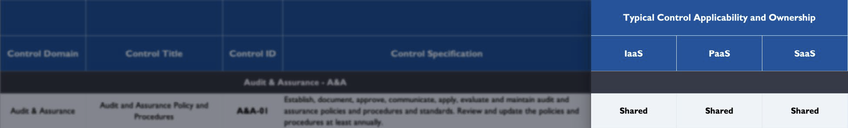
Cloud Security Alliance CCM and CAIQ
Who is responsible for implementing a given CCM control between a CSP and a CSC. The matrix indicates whether a control’s responsibility is usually “CSP-Owned”, “CSC-Owned”, or “Shared” between the CSP and CSC.

Slide 57
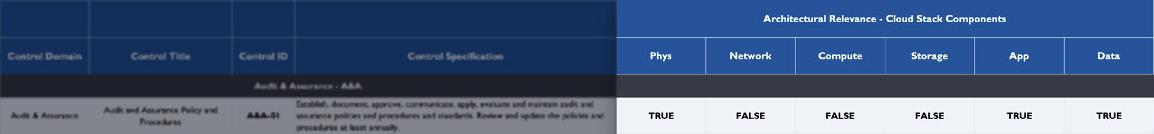
Cloud Security Alliance CCM and CAIQ
What is the Architectural Relevance and Cloud Stack?

Slide 58
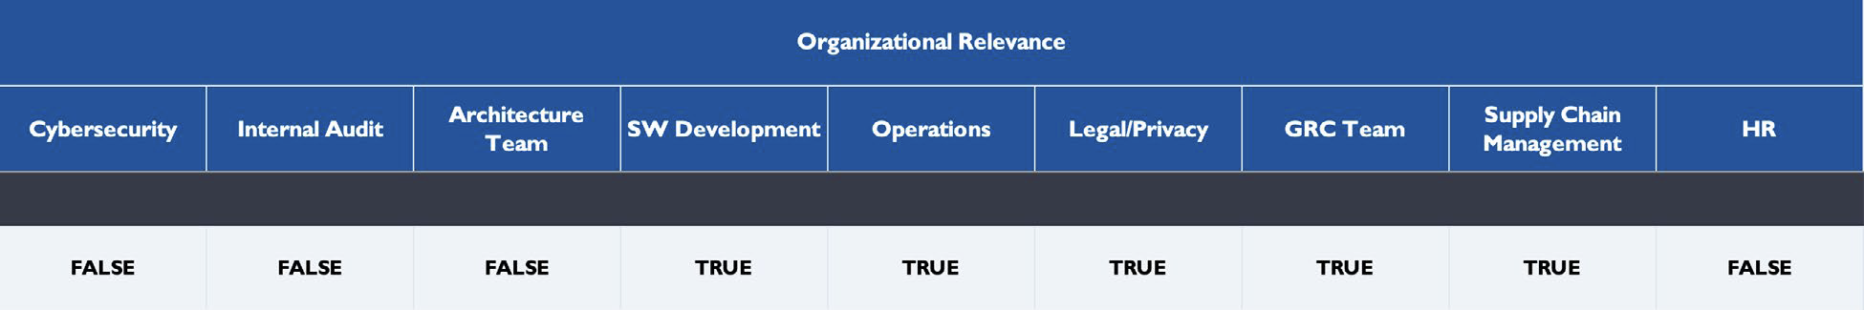
Cloud Security Alliance CCM and CAIQ
The Organizational Relevance

Slide 59
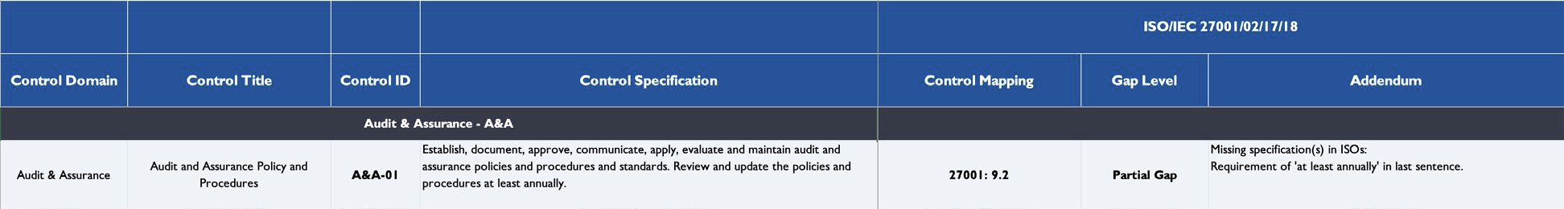
Cloud Security Alliance CCM and CAIQ
Finally, CCM Scope Applicability
Control Mapping. The indication of which control(s) in the target standard (e.g., ISO27001) corresponds to the CCM control.

Slide 60
Cloud Security Alliance CCM and CAIQ
Gap Level
The gap level a control (or controls) in the target standard has when compared with the CCM control. The gap levels used are:
No Gap: In case of full correspondence.
Partial Gap: If the control(s) in the target standard does not fully satisfy the corresponding CCM control’s requirements.
Full Gap: If there is no control in the target standard to fulfill the corresponding CCM control’s requirements

Slide 61
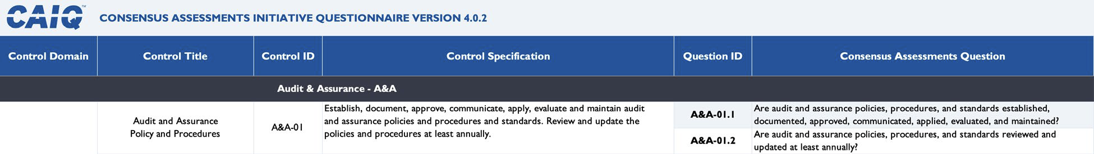
Cloud Security Alliance CCM and CAIQ
So, How do the cloud providers tell you how they support the controls?
Consensus Assessments Initiative Questionnaire (CAIQ)
This tab includes the questionnaire associated with CCM controls, commonly known as CAIQ. The CAIQ consists of 261 questions structured in the 17 domains of the CCM. Each question is described in the following manner:
• Question ID: the question’s identifier.
• Question: the description of the question.

Slide 62
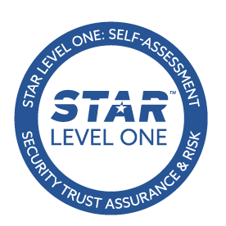
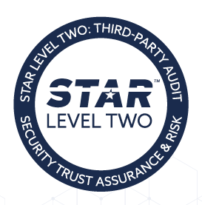
The Security, Trust, Assurance, and Risk (STAR) Registry
Star is a publicly accessible registry that documents the security and privacy controls provided by popular cloud computing offerings.
Organizations listed as CSA Trusted Cloud Providers in the registry are CSA Corporate Members that have also fulfilled additional training and volunteer requirements with CSA.
Currently there are two level of STAR certification. Documentation

Slide 63
STAR Level 1
Level 1: Self Assessment
Organizations can submit one or both of the security and privacy self-assessments. For the security assessment, organizations use the Cloud Controls Matrix to evaluate and document their security controls. The privacy assessment submissions are based on the GDPR Code of Conduct.
Variations of Level 1
Security Self-Assessment
CSA STAR Self-Assessment is a complimentary offering that documents the security
controls provided by various cloud computing offerings, thereby helping users
assess the security of cloud providers they currently use or are considering using.
Cloud providers submit the Consensus Assessments Initiative Questionnaire (CAIQ)
to document compliance with the Cloud Controls Matrix (CCM).
GDPR Self-Assessment
The Code Self-Assessment covers the compliance to GDPR of the service(s) offered
by a CSP. A company after the publication of the relevant document on the Registry
will receive a Compliance Mark valid for 1 year. The Code Self-Assessment consist in
the voluntary publication on the STAR Registry of two documents:
• Code of Conduct Statement of Adherence
• PLA Code of Practice (CoP) Template - Annex 1 self-assessment results

Slide 64
STAR Level 2: Third Party Audit
Organizations looking for a third-party audit can choose from one or more of the security and privacy audits and certifications.
Which organizations pursue level 2?
Organizations should pursue this level if they are...
• Operating in a medium to high risk environment
• Already hold or adhere to the following: ISO27001, SOC 2, GB/T 22080-2008,
or GDPR
• Looking for a cost-effective way to increase assurance for cloud security and
privacy

Slide 65
STAR Level 2: Third Party Audit
Variations of STAR Level 2
STAR Attestation: For SOC 2
The CSA STAR Attestation is a collaboration between CSA and the AICPA to provide
guidelines for CPAs to conduct SOC 2 engagements using criteria from the AICPA
(Trust Service Principles, AT 101) and the CSA Cloud Controls Matrix.
STAR Certification: For ISO/IEC 27001:2013
The CSA STAR Certification is a rigorous third-party independent assessment of the
security of a cloud service provider. This technology-neutral certification leverages
the requirements of the ISO/IEC 27001:2013 management system standard
together with the CSA Cloud Controls Matrix.
C-STAR: For the Greater China Market
The CSA C-STAR Assessment is a robust third party independent assessment of the
security of a cloud service provider for the Greater China market that harmonizes CSA best practices with Chinese national standards. C-STAR leverages the requirements of the GB/T 22080-2008 management system standard together with the CSA Cloud Controls Matrix, plus 29 related controls selected from GB/T 22239-2008 and GB/Z 28828-2012.

Slide 66
Part 3 – The CCAK Class and Exam

Slide 67
CCAK Class Outline
Class is 2 days delivered virtually or onsite (you could probably bundle other classes)
Publicly Available Outline
CCAK Objectives
The objectives of the CCAK training are to provide knowledge about:
cloud security assessment methods and techniques and how to use them to evaluate a cloud service prior to and during the provision of the service and
how to ensure that a cloud service is compliant with the company requirements and is aligned with the governance approach of the organization.
In addition, the CCAK will give those individuals with an auditing role and background the necessary knowledge to be able to update their expertise from on-prem IT security auditing to cloud and hybrid security auditing.
Course Structure MODULE 1: Cloud Governance (4 hrs)
Overview of governance
Cloud assurance
Cloud governance frameworks
Cloud risk management
Cloud governance tools

Slide 68
CCAK Class Outline
MODULE 2: Cloud Compliance Program (3 hrs)
Designing a cloud compliance program
Building a cloud compliance program
Legal and regulatory requirements
Standards and security frameworks
Identifying controls and measuring effectiveness
CSA certification, attestation and validation
MODULE 3: CCM and CAIQ Goals, Objectives and Structure (1.5 hrs)
CCM
CAIQ
Relationship to standards: mappings and gap analysis
Transition from CCM V3.0.1 to CCM V4
MODULE 4: A Threat Analysis Methodology for Cloud Using CCM (1 hr)
Definitions and purpose
Attack details and impacts
Mitigating controls and metrics
Use case

Slide 69
CCAK Class Outline
MODULE 5: Evaluating a Cloud Compliance Program (1.5 hrs)
Evaluation approach
A governance perspective
Legal, regulatory and standards perspectives
Risk perspectives
Services changes implications
The need for continuous assurance/continuous compliance
MODULE 6: Cloud Auditing (2 hrs)
Audit characteristics, criteria & principles
Auditing standards for cloud computing
Auditing an on-premises environment vs. cloud
Differences in assessing cloud services and cloud delivery models
Cloud audit building, planning and execution
MODULE 7: CCM: Auditing Controls (1 hr)
CCM audit scoping guidance
CCM risk evaluation guide
CCM audit workbook
CCM an auditing example

Slide 70
CCAK Class Outline
MODULE 8: Continuous Assurance and Compliance (1 hr)
DevOps and DevSecOps
Auditing CI/CD pipelines
DevSecOps automation and maturity
MODULE 9: STAR Program (1 hr)
Standard for security and privacy
Open Certification Framework
STAR Registry
STAR Level 1
STAR Level 2
STAR Level 3

Slide 71
CCAK Exam
The CCAK exam consists of 76 multiple-choice questions and the exam duration is 2 hours. Once done, you can get a preliminary score immediately, and a confirmed verification of your score within 10 days after the exam date.
Exam is virtual only. Locked down browser is installed. Make sure you have the necessary permissions, and you understand the process.

Slide 72
Part 4 – Questions?

Slide 73
Any other question feel free to LinkedIn or email me ted@chathamtech.com

Slide 74
To talk to ISACA about training contact Jorge Tovar jtovar@isaca.org

Slide 75
Website https://engage.isaca.org/nur-sultanchapter/ Emails: president@nur-sultan.isacachapter.org secretary@nur-sultan.isacachapter.org

