Slide 1
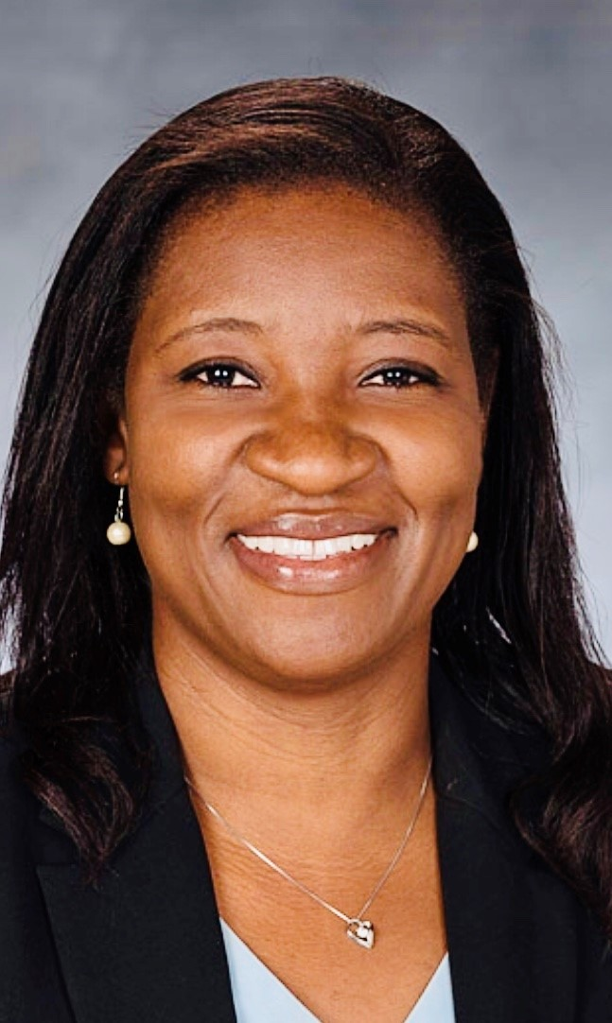
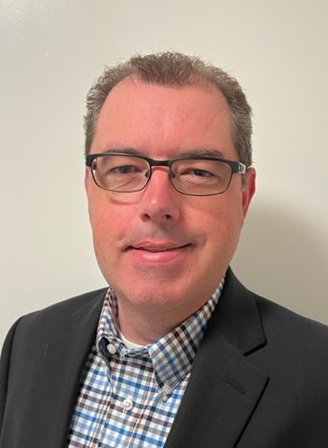
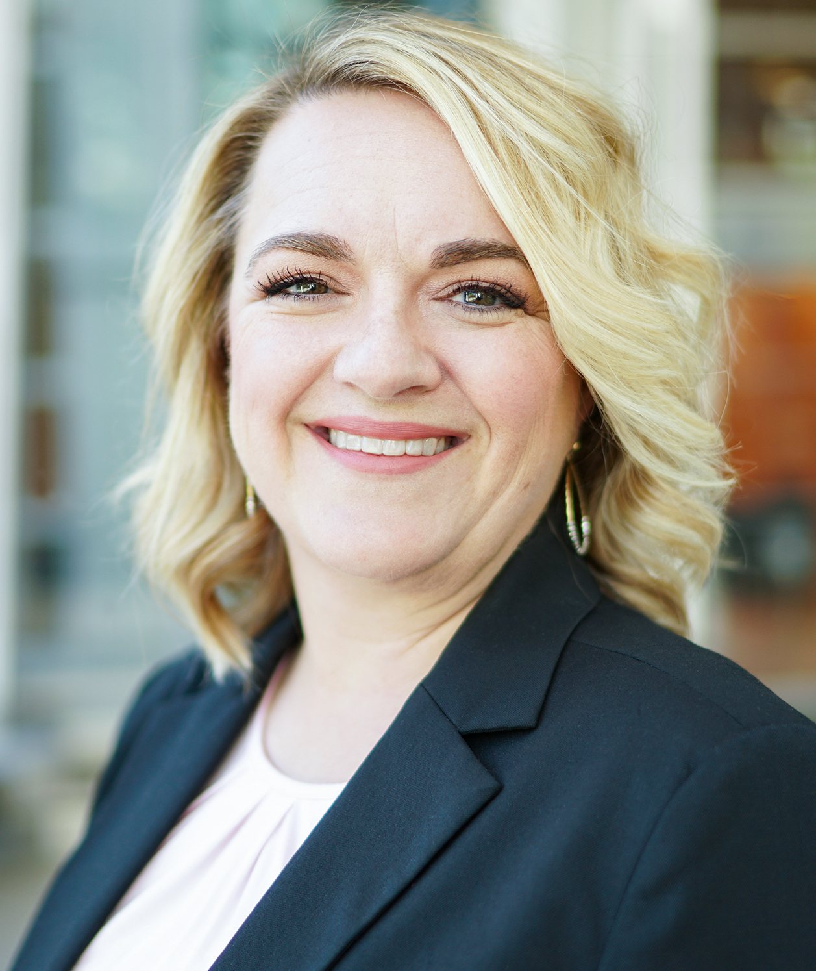
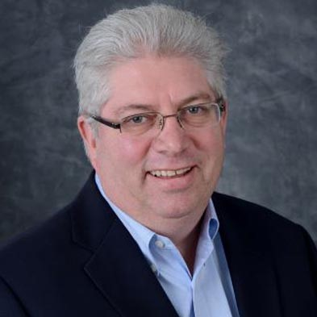
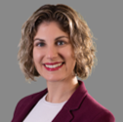
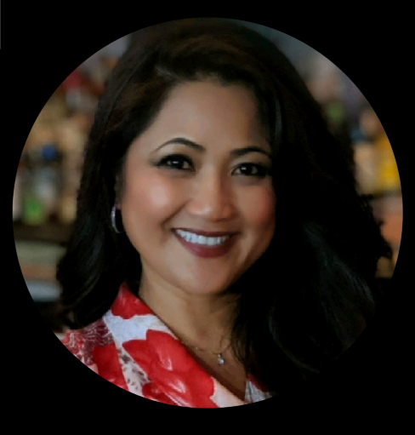
FY2024 Chapter Officers
Announcing the slate of chapter officers who will continue to lead chapter advocacy, membership, programs, and events for our members in 2023-2024.
Not Pictured:
VP, Seminars Officer – Donna Parker
Board of Governors elected to a 3 year term June 1, 2023 through May 31, 2026
Mabel Lun
Heather Lyons
Antonio Madrigal
Christian Okoye
Chapter leaders and volunteers may receive up to 20 CPEs annually. If you are interested in volunteering and receiving CPEs, please contact chapter66@theiia.org.
President
Hilary Cabodi
Managing Director, Effectus Group
VP, Programs
Aileen Wong
Senior Audit Manager,
CalPERS
Secretary
Dr. Grace Mubako
Assistant Professor, California State University, Sacramento
Treasurer
Dan Washburn
Senior Management Auditor, Caltrans
Membership Officer
Meghann Stedman
Assistant Division Chief, CalPERS
Certification Officer
Dell Coats
Director of Internal Audit, Partnership HealthPlan of California

