Slide 1
From Conflict to Collaboration
Developing Collaborative Relationships by Approaching Conflict as an Opportunity

Slide 2
Today’s Objectives
Accept conflict in your work
Understand the “Human Element” – in yourself and others
Understand and apply key actions in establishing collaboration
Apply concepts to real work situations
Set foundation for further development and learning

Slide 3
Conflict as an Opportunity
Describe conflict.
Why is it viewed negatively and/or avoided?
How does conflict appear in your work? Generate list in groups.
Notes:
Conflict Without Casualties in which the author defines conflict as: “Conflict is simply the energy created by the gap between what we want and what we’re experiencing,” He goes on to say “If we define conflict as energy that’s created by the gap, then the real question is ‘How are we going to use that energy?’ ”
Conflict is not going to go away. Whenever people are involved, there will be conflict.
Why do so many people view it negatively and/or avoid it?
Most of us try to avoid conflict, especially at work. At the sight of a disagreeable/pot stirring colleague coming down the hall, we might turn and walk the other way. Or if you disagree with your boss, you may choose not to share a valuable viewpoint. You’ve learned from experience that opposing others has negative consequences.
What are some of the negative things that come from conflict?
Negative conflict, characterized by struggling against other people, drains energy, which is costly to companies, teams and relationships. A CCP Global Human Capital report estimated the annual cost of workplace conflict in the U.S. to be $359 billion in lost time and productivity.
For many professionals, avoiding conflict probably sounds like a great idea.
It isn’t. Eliminating tension in the workplace isn’t feasible—and isn’t healthy for your organization in the long run. A better approach is to redirect the attention wasted on petty fighting toward a positive pursuit.
What positive outcomes can occur? Innovation, trust and engagement. Can relationships be built and strengthened because of conflict?
At your table, generate list of how conflict appears at work?

Slide 4
Good leaders recognize that conflict doesn’t need to be destructive and should be leveraged rather than “managed” or “controlled”.

Slide 5
Conflict to Collaboration as a Skill
What is challenging for you in establishing collaboration?
What comes easily to you?
What are the differences?
What can we learn from your strengths / areas of improvement?
How can your strengths / areas of improvement affect your work?
Notes:
What is challenging for you in establishing collaboration? Does it seem personal when someone disagrees with your idea or solution?
What comes easily to you? For me, it’s being positive about the outcome.
What are the differences? - What can you learn from identifying your strengths and areas of improvement? If identified and worked on this is how collaboration starts to be the outcome.
How can your strengths and areas of improvement affect your work?
Conflict can be emotional; it’s important to create a safe place for people to talk and develop strategies for healthy resolution

Slide 6
The Human Element
Drill Sergeant
Brick Mason
Historian
Magician
Prosecuting Attorney
Notes:
The human element… people, are a part of every interaction and can create challenging barriers. They can also serve as significant positive resources. It is important to understand how personalities, behavior patterns and communication styles can affect collaboration and deepen conflict, as well as ways to manage them to support effective collaboration.
It is also very important to be self-aware and understand the human element we bring to any conflict and the effect we may have on others in developing and maintaining collaborative relationships.
Drill Sergeant
Speaks with authority
Dominates and can intimidate others
Can be hostile and belligerent
Pushes others around
Doesn’t seem to take a breath
Table Discussion – Overpowering, loud, workaholic, forceful, in your face, dominating, dictate tasks, rigid, by the book, inflexible, not open to being challenged.
Brick Mason
Builds emotional walls
Avoids conflict
Remains silent or says little
Changes the subject
Table Discussion – Rigid, highly structured, gritty, inflexible, defensive, precise, lay foundation for argument, build wall of supporting details for argument, shut down when approached about argument.
Historian
Has a long and detailed memory
Keeps score of past problems & grievances
Recounts events from the past
Whether they apply or not
Table Discussion – Keeper of facts, researcher, change may be difficult, knowledgeable, dependable, no innovation.
Magician
Expects problems to disappear
Refuses to address issues
Hides behind higher goals
Repeats… quality customers, services, etc.
Table Discussion – Charismatic, shape shifter, deceptive, entertaining, things aren’t as they appear, your idea turns into their idea, ghost you.
Prosecuting Attorney
Argues point by point
Finds weakness in each point
Cross-examines others
Focuses on irrelevant details
Table Discussion – Defend at all costs, detail oriented, influence the jury, cold hard facts, attack dogs, strong and fast, factual, pick apart argument, not open, my way or the highway, ask questions with an agenda, try to make you look bad.

Slide 7
Your Human Element
What characteristics, beliefs, and patterns do you engage in that may affect your ability to collaborate with others?
How can you learn about them and self-correct when / if they occur?
Notes:
In looking at the types and lists above, you thought about “they” as in other people, but what about “we”… or “I.”

Slide 8
Compassionate Accountability
Be more open
Empathize
Understand motives, emotions and responses
Listen and then validate feelings
Be more resourceful
Avoid sharing your ideas first
Ask others for their thoughts
Disagree while respecting others’ intentions
Be persistent
See things through with integrity and respect
Be clear about your expectations
Hold yourself and other accountable
Acknowledge when you make mistakes, and try to make it right

Slide 9
Key Actions in Establishing Collaboration
Establish Mutual Involvement
Understand Others’ Point of View
Present Your Perspective of the Problem and Its Impact
Decide on an Appropriate Plan of Action
Express Appreciation for Others’ Efforts
Notes:
Ask participants to read through each one separately and have them share what point under each action stands out to them as something they could incorporate or something that has worked for them and they could share with the group.
1. Establish Mutual Involvement.
Establish ground rules if appropriate
Briefly describe the problem.
Establish the other person’s stake.
State your positive intentions.
2. Understand Others’ Point of View.
Assume and admit you don’t have all information.
Ask questions to bring out critical issues.
Listen to gain understanding.
Check your understanding.
Be apologetic when appropriate.
3. Present Your Perspective of the Problem and Its Impact.
Use information gained in Key Action 2.
Describe the problem from your perspective.
Describe the impact of the problem.
4. Decide on an Appropriate Plan of Action.
Agree on issues to be addressed.
If no agreement seems possible try and reframe the discussion.
Identify the next logical step.
Share responsibility for implementing your plan.
Document agreed-upon actions, accountability, and follow-up times.
5. Express Appreciation for Others’ Efforts
Thank the other person(s)
Provide feedback
Summarize what was learned, accomplished and/or agreed upon

Slide 10
Leading the Way vs. Getting in the Way
What’s the difference?
How do you most often “Lead the Way”?
How do you most often “Get in the Way”?
Notes:
Continue - Key Actions in Establishing Collaboration
While we do our best to be perfect in our work, perfection is out of reach. A more realistic approach to our work includes an emphasis on professionalism and improved performance through learning, experience, and reflection.
Please take a moment and reflect on ways in which you “Lead the Way” & “Get in the Way” when trying to collaborate/ assist others through collaboration.

Slide 11
Intentional Collaboration
What are opportunities/ practices that can leverage conflict as a tool to develop relationships and achieve goals?
Consider proactively preventing negative aspects of conflict that may arise along the way.
Notes:
What are some opportunities and practices that can help leverage conflict as a tool to develop relationships and achieve goals? Consider proactively preventing negative aspects of conflict that may arise along the way.
Everyday Activities
Meeting Preparation
Meetings
Post-Meetings

Slide 12
Application
Find friends (small groups)
Read each scenario
Discuss how to move to collaboration
Prepare to share with large group

Slide 13
Scenario 1
You got a promotion that your friend at work was also in the running for. Now things are awkward between you two, and he avoids you. You want to keep the friendship going, but he won’t even speak to you outside of meetings. What should you do?

Slide 14
Scenario 2
Sarah is speaking in a meeting when her colleague, Greg, interrupts her. She decides saying something to him about it could be a mistake, and it's best to focus on the positives in her relationship with Greg. In the next meeting, she notices Greg interrupts her even more often and she cannot fully express her ideas. What should Sarah do?

Slide 15
Scenario 3
Ian is planning a presentation with a few colleagues. The presentation is three weeks away, and he prefers to divide large tasks into small daily steps. He wants to work on the presentation for 20 minutes every day until the meeting. One of his colleagues, Sue, prefers to complete tasks in larger sections. Sue wants to complete the task in one day, closer to the deadline. What should Ian do?

Slide 16
Scenario 4
Dan requires data/ numbers each month to create reports for a client which he needs to get from Bill. Bill is consistently late getting his data/ numbers to Dan which, in turn, which affects Dan’s ability to get his report to his client on time. Bill also has been with the company for 10 more years than Dan and is a senior level employee. What should Dan do?

Slide 17
Scenario Outcomes
Similarities in scenario responses?
Differences in scenario response? Why?
Other common scenarios to discuss?

Slide 18
Solution = Conflict + Collaboration

Slide 19
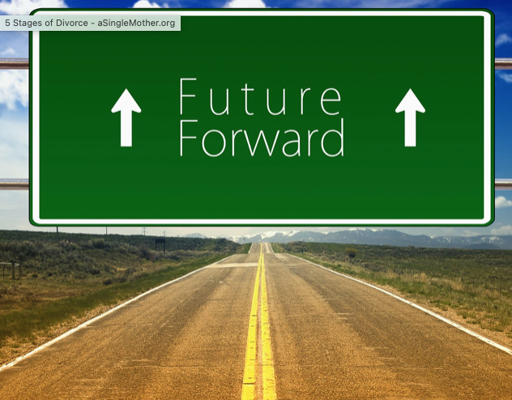
Moving Forward: Ongoing Development
What are your strengths in Conflict to Collaboration?
What areas do you want to further develop?
How will you use what you learned?

Slide 20
From Conflict to Collaboration
Kim Brammer
brammer.kim@gmail.com

