Slide 1

IIA Chattanooga Area Chapter
2024-2025 Annual Report

Slide 2
President’s Message
As we end the chapter year, I wish to express my gratitude and appreciation for trusting me to serve as your Chapter President. I have been surrounded by amazing officers, volunteers, and board members who believe in Internal Audit’s mission and the Chattanooga area. Without their dedication, the Chapter would not achieve our mission to cultivate and promote knowledge and information concerning internal audit. I thank you all for your efforts and applaud your dedication to the Internal Audit profession.
The 2024 –2025 chapter year has been a year of success, but also a year of focus. Providing continuing education in the post-Covid era brings many considerations and our chapter has risen to the challenge by combining both in-person and virtual events. This year, the chapter provided ten continuing professional education hours with presentations from six speakers. However, membership attendance at chapter events remains a significant focus.
Connecting with colleagues can lead to greater job satisfaction, more meaningful work relationships, and ultimately, greater personal and professional success. Even with all the distractions that the world can throw at us, I believe the Chattanooga Chapter will continue to strive to promote personal and professional success though our chapter activities. I have been enriched beyond measure by my involvement in this wonderful organization. Get out of your comfort zone, talk to people, ask for help, offer help – the Chattanooga IIA has so much to offer and I want you to take advantage of it all!
Looking forward, the new Chapter Officers are planning for a great 2025–2026 and it will be the Chapter’s 45th year. I plan to give them my support and I hope you will too.
Sincerely,
Kimberly Clingan

Slide 3






Chapter Membership
130 total members
10 board members
4 certified this year
25 student members
4 new professional
members
3 new volunteers

Slide 4
2024-2025 Board Members
Board | Name
President | Kim Clingan
Vice President | Amanda Conner
Programming | Amanda Conner
Secretary | Michael Powell
Treasurer | Pam Swinney
Membership Officer | Pam Swinney
Certification Officer | Dennis Cunningham
Academic Relations Chair | Richard Walls
Advocacy Chair | Richard Walls
Governor/Communications | Karen Templeton
Governor | Lisa Culver
Governor | Susanne Fuller
Governor (Student) | Peyton Webster
Audit Committee | Jennifer Benefield and Ashley Lewis

Slide 5
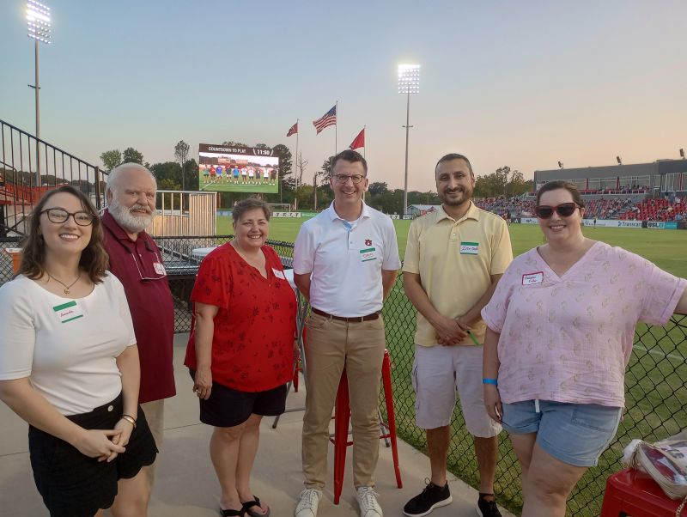
Networking Events
Chattanooga Red Wolves summer social
Five CPE events (1 in-person, 2 hybrid, and 2 virtual)
Six speakers totaling ten NASBA CPE hours covering topics including:
  Fraud Prevention & Detection
  Forensic Accounting Research
  Professional Skepticism
  Generative AI Strategies
  Thinking Beyond Patterns
  The Science of Audit Excellence

Slide 6
Financial Snapshot
Our chapter establishes an annual financial plan to support our mission in a responsible, effective, and sustainable manner. We entered this year in a strong financial position due to our stewardship in prior years. This allowed us to provide quality CPE to members at a low or no cost.
The Chattanooga Area Chapter receives a member allotment from the national organization, which covered 19% of our event expenses for the year. The remainder is funded exclusively by our event registration fees. We ended the fiscal year with a deficit of $1,051, which was expected due to planned investment in chapter events. As of year-end, the chapter funds are sufficient to cover approximately 3.3 years' worth of operating expenses if needed.

Slide 7
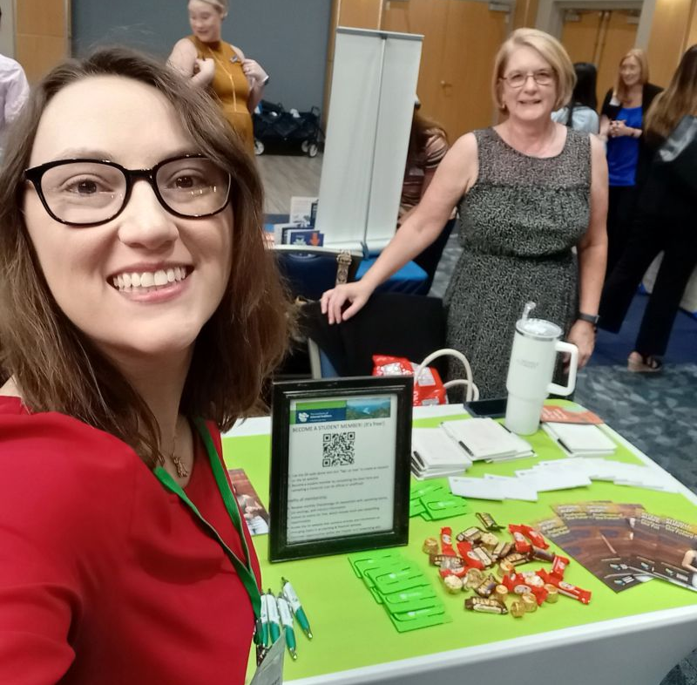

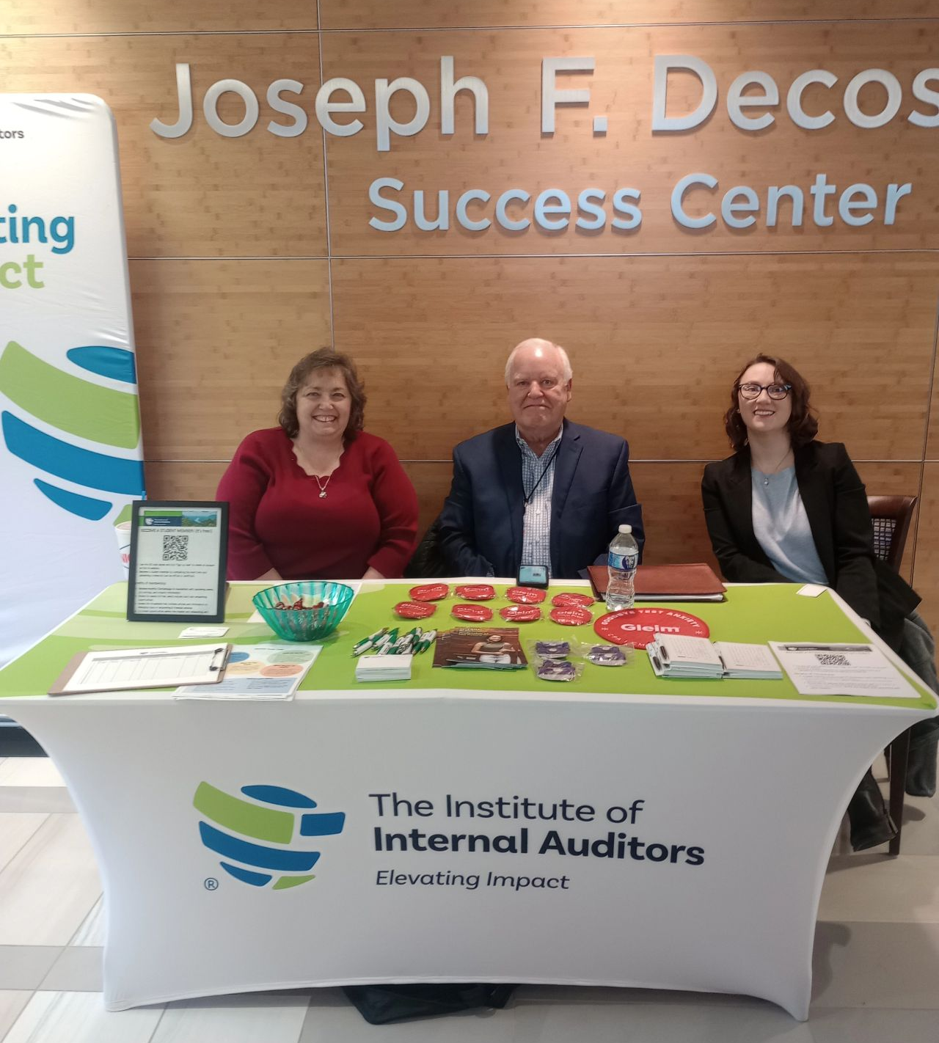

Academic Relations
UTC
  9/5/24 Meet the Firms
  1/16/25 New semester networking
  3/3/25 Career Fair
Lee University
  9/17/24 Career Fair

Slide 8
Chapter Achievement Status
The Chapter Achievement Program (CAP) is a recognition program for chapters that align with the North American Strategic Plan in four primary service categories – Programming, Certifications, Advocacy, and Membership. Each North American Chapter works to achieve one of three performance levels – Bronze, Silver, or Gold.
Each year, our chapter officers diligently work to achieve gold status through planning activities, monitoring progress, and providing all necessary reporting.
For the 2024-2025 year, we completed all requirements to achieve Gold status, as well as Sapphire status for achieving gold status for over 25 consecutive years.
This is all thanks to our amazing members and volunteers!

Slide 9


Thank you!

