Slide 1
IIA Annual Report
Chattanooga Area Chapter
June 2023 – May 2024

Slide 2
Table of Contents
TITLE | PAGE NUMBER
President’s Message | 3
Chapter Membership | 4
Chapter Achievement Program | 5
Academic Relations | 6
Chapter Events | 7
Mystery Fraud 2023 | 8
Financial Update | 9
Leadership in Action | 10
Chapter Officers | 11
Board of Governors & Audit Committee | 12
Thank you! | 13

Slide 3
President's Message
Members/Friends,
As we close out another chapter year, I am filled with both deep gratitude and anticipation. Despite challenges such as boosting attendance at our in-person events and engaging more volunteers, the spirit and dedication within our Chapter have remained unwavering.
As I continue my transition to Tulsa, I want to express how much I will miss Chattanooga and all of you. This city and this chapter have been more than just places of professional engagement; they have been my home and my community. The friendships, professional connections, and the community spirit I've experienced here will hold a special place in my heart.
I am particularly proud of how our influence goes beyond our immediate circle by appointing members to the City of Chattanooga Audit Committee. This role not only underscores the impact we can have on our wider community but also highlights the respect and trust placed in our chapter. It’s a reflection of the professional esteem and personal growth that being a part of this chapter can bring to each of us.
Looking forward, I am excited about the future of our chapter and my new journey in Tulsa. I believe that the foundations we have built here are strong and will continue to support the chapter’s growth and success. Our challenges are simply stepping stones, leading us to greater engagement and innovation. I encourage everyone to step forward, get involved, and utilize this wonderful platform we have created together.
As we welcome new leadership, I am confident in their vision and excited to see where they will lead us. Wishing everyone the very best in the coming years!
Sincerely,
Rob Zunt, CPA, CISA, CIA, CFE, CRMA President | Chattanooga Area Chapter

Slide 4
Chapter Membership
Membership by the Numbers*
Total Members
163
Certified Members
45
New Members
65
Chapter Officers
4
Board of Governors
6
*as of April 23, 2024
Notes:
33 - 36

Slide 5
Chapter Achievement Program
Gold Chapter Status for 25+ Years!
The Chapter Achievement Program (CAP) is a recognition program for chapters that align with the North American Strategic Plan in four primary service categories – Programming, Certifications, Advocacy, and Membership. Each North American Chapter works to achieve one of three performance levels – Bronze, Silver, or Gold.
Each year, our chapter officers diligently work to achieve gold status through planning activities, monitoring progress, and providing all necessary reporting.
For the 2023-2024 year, we completed all requirements to achieve gold status. Currently, we have been awarded Sapphire status for achieving gold status for over 25 consecutive years. The Chattanooga Area Chapter is in the process of submitting all necessary documents for the 2023-2024 Chapter Achievement Program.

Slide 6
Academic Relations
The Chattanooga Area IIA Chapter is committed to increasing awareness within and educating the next generation of Internal Auditors. To aid in that mission, the Academic Relations Committee partners with local universities and colleges. Student members also receive copies of the newsletter and free access to events.
This year, our chapter was able to present for classes at the University of Tennessee at Chattanooga and Lee University.
08/26/23 – Student Night
11/13/23 – Pasta with Professionals Panel
09/07/23 – Career Fair
Student Members
61

Slide 7
Auditing Sacred Cows
Lessons Learned from an $8.5M Fraud
Dr. Ursula Schmidt
Nathan Mueller and David Kukura
Data Analysis in Audits + Fostering Mental Health
Anthony Odarczenko and Dr. Jennifer Schwirzer
Partnership with the IIA Barbados Chapter
2 hours (virtual)
Top Risks to Monitor & Cybersecurity
Lindsay Patterson, CIA, CPA
Adam Marthaler
4 hours (in-person)
Statistical Auditing
Zac Rhyne
Protecting Your Organization from Occupational Fraud
Ron Steinkamp, CPA, CIA, CFE, CGMA, CRMA, CCA, CCP
1 hour (virtual)
4 hours (in-person)
2 hours (virtual)
1 hour (virtual)
IT AudITing for All
Jude Viator CIA, CISA, CRMA, CRISC
4 hours (virtual)
Partnership with Chattanooga ACFE chapter
Collaborative Auditing
Jami Shine
1 hour (virtual)
Chapter Events
Provided 19 hours of Continuing Education (8 in-person)

Slide 8
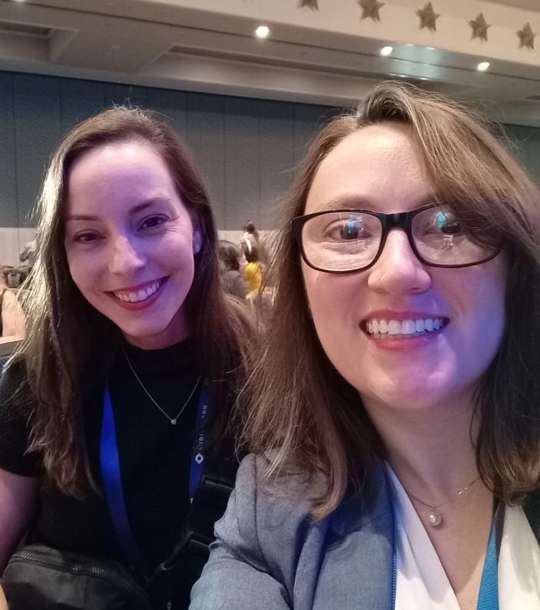
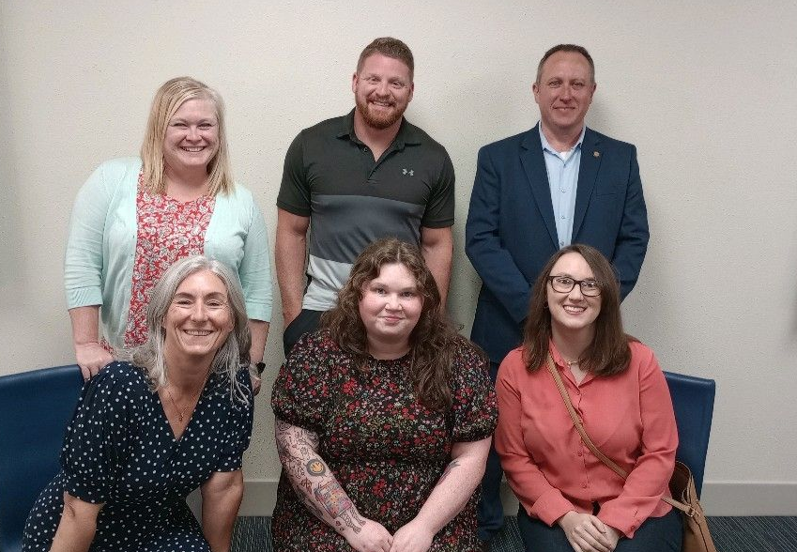
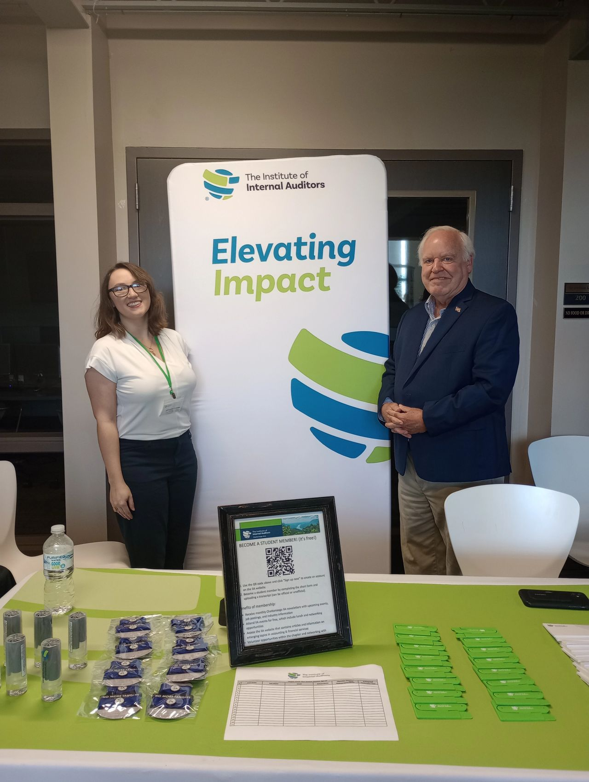
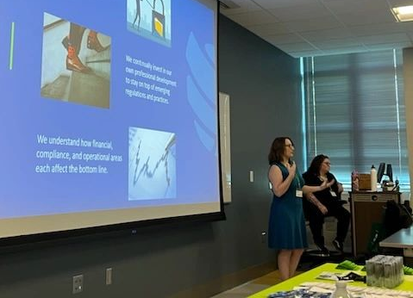
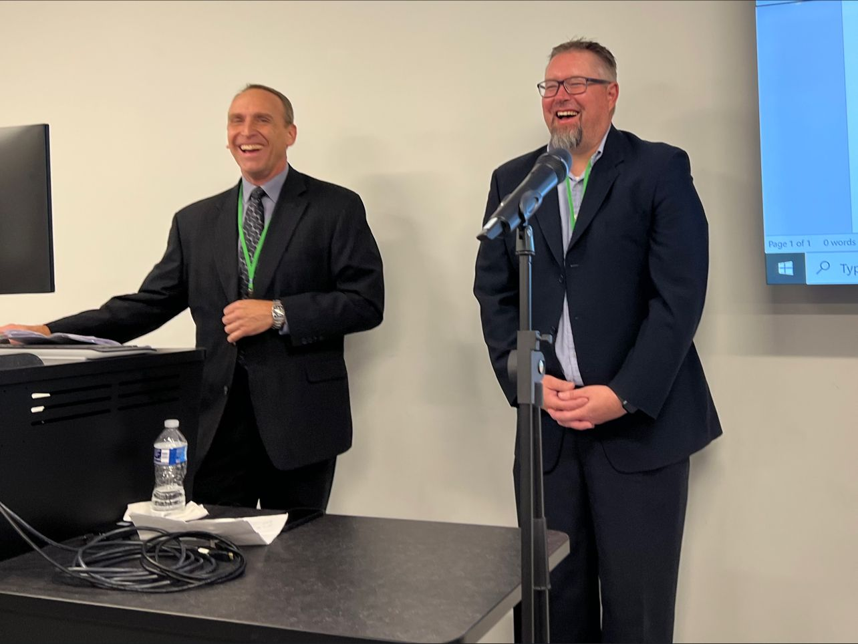
Leadership Conference
In Person Events
District Workshop
Lee University Career Fair
UTC Student Night
Lessons Learned Seminar

Slide 9
Financial Update
Utilizing Surplus to Focus on Members
Our chapter establishes an annual financial plan to support our mission in a responsible, effective, and sustainable manner. We entered this year in a strong financial position due to our stewardship in prior years. This allowed us to provide quality CPE to members at a low or no cost.
The Chattanooga Area Chapter receives a member allotment from the national organization, which covered 21% of our event expenses for the year. The remainder is funded exclusively by our event registration fees. We ended the fiscal year with a surplus of $2,480, which we plan to invest back into chapter events and networking over the next fiscal year. As of year-end, the chapter funds are sufficient to cover approximately 2.35 years' worth of operating expenses if needed.

Slide 10
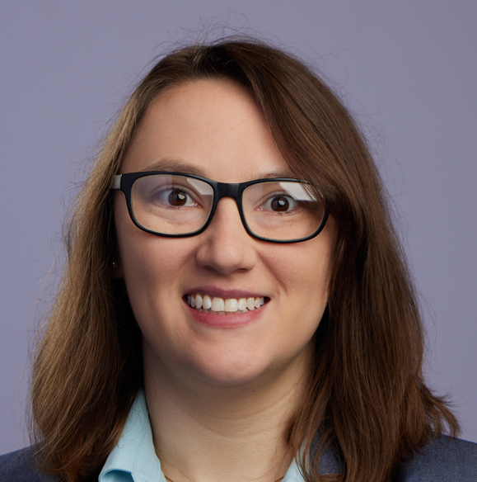
Chapter Officers
Rob Zunt, CPA, CISA, CIA, CFE, CRMA
President
Bambi Gifford, CPA, CIA
Vice President
Amanda Conner, CPA, CFE
Treasurer
Amaya Beck
Secretary

Slide 11
Board of Governors & Audit Committee
Lisa Culver
Dennis Cunningham
Karen Templeton
Amanda Thacker
Richard Walls
Ashley Lewis
Jennifer Benefield
Kim Clingan
Peyton Webster (student)

Slide 12
Thank you to all of our members, officers, board members and volunteers for making 2023-2024 a successful year for the Chattanooga Chapter!
Thank you!
Chapter177@iiachaptercommunications.org
https://www.linkedin.com/company/iia-chattanooga
https://www.theiia.org/en/chapters/united-states/tennessee/chattanooga/

