Slide 1
Analytics – It’s not the Software, it’s the Mindset.
Joy Gray
Bentley University
July 28, 2021
Notes:
Session Description (one hour 10:10 – 11:10)
There are few topics that have gained as much recent attention in university curricula as Data Analytics and Technology, with the events of the last 18 months only accelerating the demand for analytics and technology skills. Internal auditors in practice are called upon both to perform data analytics and to evaluate the use of data analytics by their organizations; responsibilities that require students to understand data quality, analytics techniques, and enabling technologies. Too often this education is fragmented into silos of statistics, communications, accounting, finance, and information systems; leaving students with less understanding of effective analytics than desired. In addition, accounting faculty are often reluctant to include analytics into already packed curricula, and often do not receive training on the tools that enable analytics.
At the end of this session, participants will be able to:
Identify projects and exercises that can be used to develop an analytics mindset.
Discuss how to overcome the need to know more than your students before introducing a software application into your class.
Identify, evaluate, and implement applications for teaching use.
Understand where and how to obtain technology training and support, using vendor resources, user groups, educator colleagues, and resources on their own campuses.
Understand and discuss the barriers to effective implementation of active learning analytics projects in classes, and brainstorm ways to overcome these.
Prepare a plan for how to introduce a new technology as early as Fall 2021.

Slide 2

SPEAKER BIO
Joy M. Gray, PhD, CIA, CISA
  Internal Audit Education Partnership Coordinator at Bentley University (Massachusetts, USA)
  Internal Audit Experience at multiple firms including GE, Lockheed Martin, and OSRAM Sylvania.
  PhD (2016) Bentley University, Dissertation Title “Information Technology Audits by Internal Auditors: Exploring the Evolution of Integrated IT Audits”
  IIA Course Facilitator 1996 - present.
Sr. Lecturer & Vice Chair,
Department of Accountancy
Bentley University
Waltham, MA
jgray@Bentley.edu

Slide 3
Learning Objectives
Understand the barriers to effective analytics education
Discuss how to overcome the need to know more than your students before introducing new software
Identify projects and exercises that can be used to develop an analytics mindset
Identify, evaluate, and implement applications for teaching use
Identify available analytics education resources
Develop a plan for new technology introduction

Slide 4
Agenda
Analytics
  Why
  What
Barriers to Effective Analytics Education
Analytics Education Resources
  Exercises and Projects
  Training Sources
  Implementing Analytics Applications
Goals & Planning

Slide 5



Why Analytics
Explosive Growth

Slide 6
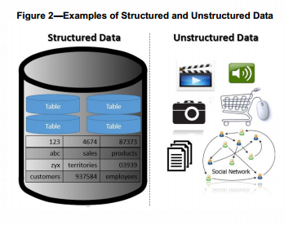


Variety
Source: GTAG Understanding & Auditing Big Data. The IIA. USA.
Notes:
The Wonderful World of Data
Unstructured includes text, voice, video
Not included here: Sensors!
Every expanding ways of creating data, and types of data created

Slide 7
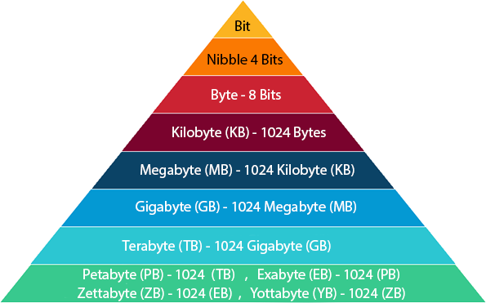
Volume
2018 – 2.5 quintillion bytes (2.5 Exabytes) of data created each day ~ Forbes 90% of data in the world generated between 2016-2018
Notes:
All the different data sources and lessening storage costs… and larger storage capabilities

Slide 8
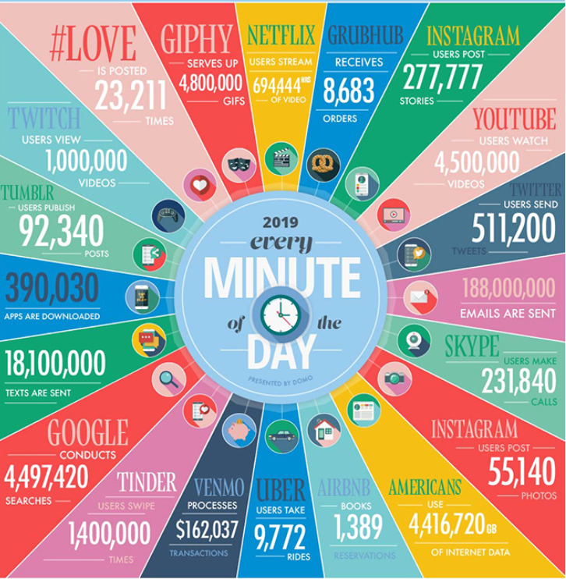
Velocity
Source: domo.com/learn/data-never-sleeps-7
Notes:
It isn’t slowing down……
Streaming data = data in motion
Not mentioned here – sensors
Contrast with batch processing

Slide 9
What is Analytics?
Polling Question 1
Please open the conference app to participate
Notes:
But – amid all this data we must ask…..

Slide 10
Polling Question 1
Which of the following topics are applicable to analytics? (multiple responses allowed)
  Statistics
  b. Data quality
  c. Advanced Microsoft Excel
  d. Data visualization tools
  Databases
  Programming languages (e.g., R, Python)
  Extract, transform and load (ETL)
  Process analysis and root cause analysis
  IT controls
  Other (please comment in chat)
Notes:
Accounting Faculty Survey Says:
Survey of AIS educators from 85 schools
“Regarding the new accreditation requirement, there is disagreement at my school about what constitutes the use of data analytics / technology.”
“Staff auditors are apparently getting by with the use of Tableau and Microsoft Power BI (and not using R in conjunction with these tools). While I think Data Visualization is important, I think that it hardly qualifies as data analytics or data science.”
“Some professors are trying to pass off financial ratios computed in Excel as “data analytics” with the use of technology. I do not agree, but perhaps I am naive in assuming that the accreditation standards intend to encourage new skills and not just repackage everything taught in accounting for the last 20 years as “data analytics”
Sarkar, Boss and Gray (under 3rd round review at Issues in Accounting Education). Pedagogical Practices of Accounting Departments Addressing AACSB Technology Requirements.

Slide 11
Why Analytics
Employer Demands
  critical thinking
  data skills
  enhanced business understanding
  increased diversity
Accreditor Demands
  AACSB A5 (2018)
Professional Association & Certification Demands
  The IIA – CIA update 2019
  ISACA – CISA update 2019
  IMA – CMA update
  AICPA – CPA (Evolution of CPA 2024)
Notes:
Demand Data. Fedorowicz and Gray, (forthcoming). The MSA is Dead. Long Live the MSA(A). Journal of Emerging Technologies in Accounting.
Internship postings – shift toward more technology skills
Upskilling investments by professional service firms (PwC, KPMG)
IFAC/IMA call for skill enhancement 1) stats, 2) data applications 3) business domain applications (viz and workflow)
Journal Review 2016 versus 2019 – Internal Auditor Magazine, Journal of Accountancy, ISACA Journal. Marked increase in analytics topics… ISACA also increased controls topics and SOC attention during this time.
Accounting educators need to ensure a curriculum that not only enhances skill and knowledge development, but also integrates more robust technology and analytics tools. (Sarkar, Boss and Gray)

Slide 12
AACSB A5
Three Components of Accounting Technologies
  “Information systems and business processes including data creation, manipulation/management, security, and storage.
  Data analytics including, for example, statistical techniques, clustering, data management, modeling, analysis, text analysis, predictive analytics, learning systems, or visualization.
  Developing information technology agility among students and faculty, recognizing the need for continual learning of new skills needed by accounting professionals.” (AACSB 2018)

Slide 13
Business Objectives Achieved
GOOD DATA FOR DECISION-MAKING
Confidentiality, Integrity, Availability
Compliance, Reliability, Efficiency, Effectiveness
Applications
Data
Business Processes
Risks
Controls
Risks
Controls
Risks
Controls
Controls
IT Architecture: Networks, O/S, Hardware
Risks

Slide 14
Which of the following barriers to effective analytics education do you believe exist in your school?
Polling Question 2
Please open the conference app to participate

Slide 15
Polling Question 2
Which of the following barriers to effective analytics education do you believe exist in your school? (multiple responses allowed)
  a. Lack of interested faculty
  Lack of faculty skills/confidence
  Lack of administrative interest and/or support
  c. Student resistance to technology topics
  d. Student reliance on step-by-step instructions
  Lack of technology infrastructure for software licensing and lab support
  Student computers unable to handle large datasets
  Students unable to install software on computers
  Unaware of available resources and no time to look for them
  Other (please comment in chat)

Slide 16
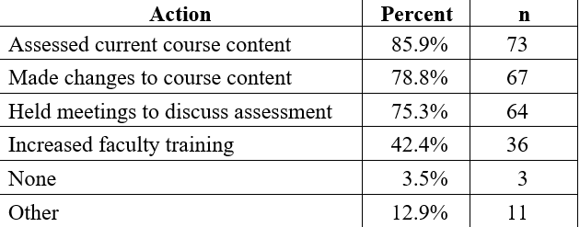
Barriers
Over-Reliance on AIS course
Siloed resources
Lack of faculty training
Lack of faculty time
Lack of faculty rewards
Pace of change
Lack of ‘good’ materials that ‘fit’
Sarkar, Boss & Gray
Notes:
Sarkar, Boss and Gray paper
Silos:
Just because a stats professor knows stats does not automatically enable them to make it relevant to a business major.
Risk a focus on how the stat is calculated versus how to interpret it.

Slide 17
Analytics Education Resources

Slide 18
Exercises and Projects
Textbooks
Academic conferences
Academic publications
Firm academic resource centers
Re-imagined cases
  Pizza Inc (IIA textbook) x Pizzeria Mia (Celonis)
  Dated Issues in Accounting Education Cases
  EYARC (P-Card case)
Coming soon – a new IAEP case
Notes:
Conferences – AMCIS, AAA, AIS Educators, ICIS, IIA International, IIA local
Publications – Issues in Accounting Education, JETA, Journal of Accounting Education, AIS Educators Journal
Resource Centers – provide links/contacts here… include KnowledgeLeader
IAEP – provide link to cases and information on getting access
Old Issues Cases: Blazer and FFC

Slide 19
Training and Application Sources
Alteryx
  SparkED
Celonis
  Celonis for Teachers
Cliq
Microsoft Power BI
Tableau
  Tableau for Teaching
UiPath
  Academic Alliance
Notes:
The big categories and the Gartner Magic Quadrant leaders…. Augmented analytics, process mining, analytics, data visualization, RPA
Don’t forget the oldies but goodies: IDEA (Audimation in US), SAP Academic Alliance, Oracle
More alliances forming between vendors too: UiPath partnering with SAP, Celonis with ERPSim, etc…
Alteryx – Kim Yohannan | Education Manager Americas kim.yohannan@alteryx.com
Celonis – Kate Lovejoy Senior Academic Alliance Manager
+1 704 421 1084 | k.lovejoy@celonis.com
UiPath – Robert Love Robert Love
Robert.Love@uipath.com
Sr. Program Manager – Learning Alliances & Certifications

Slide 20
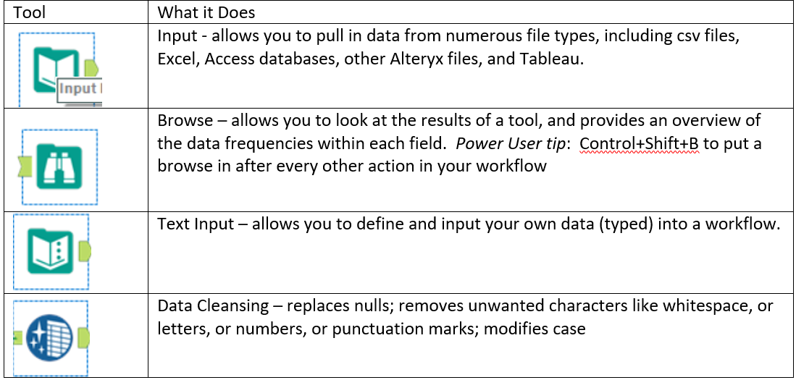
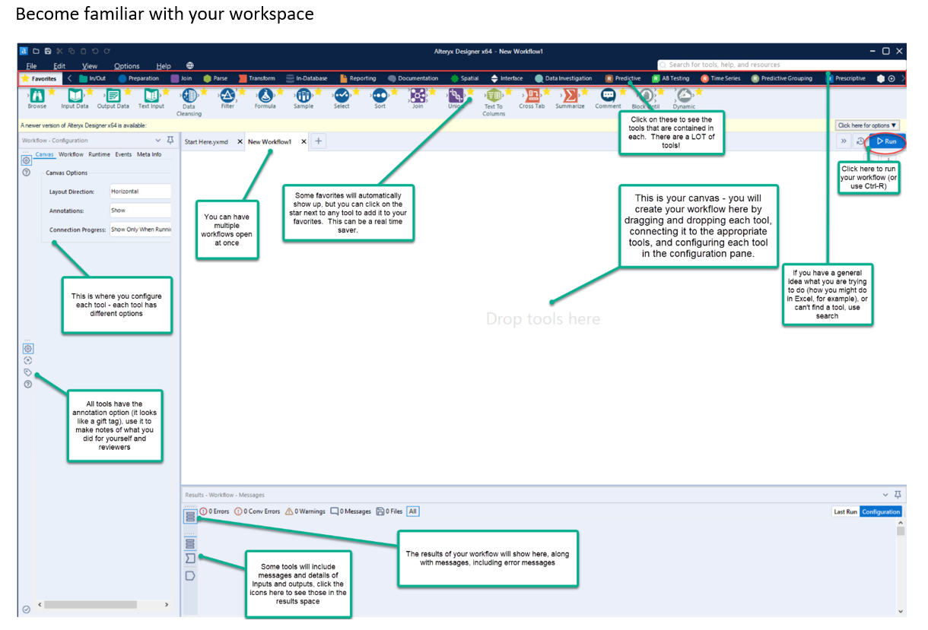
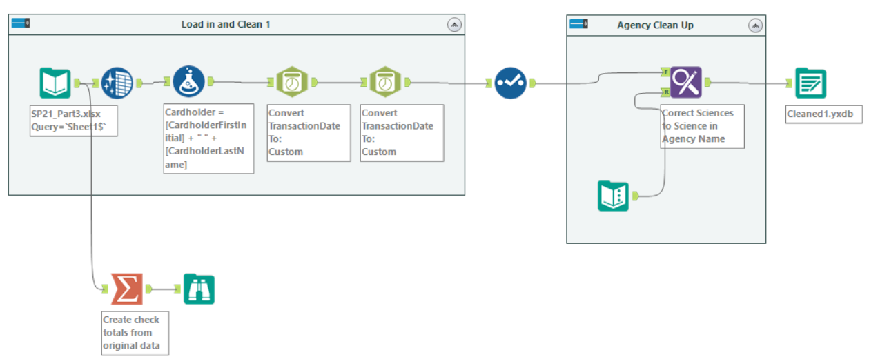
Alteryx Samples

Slide 21
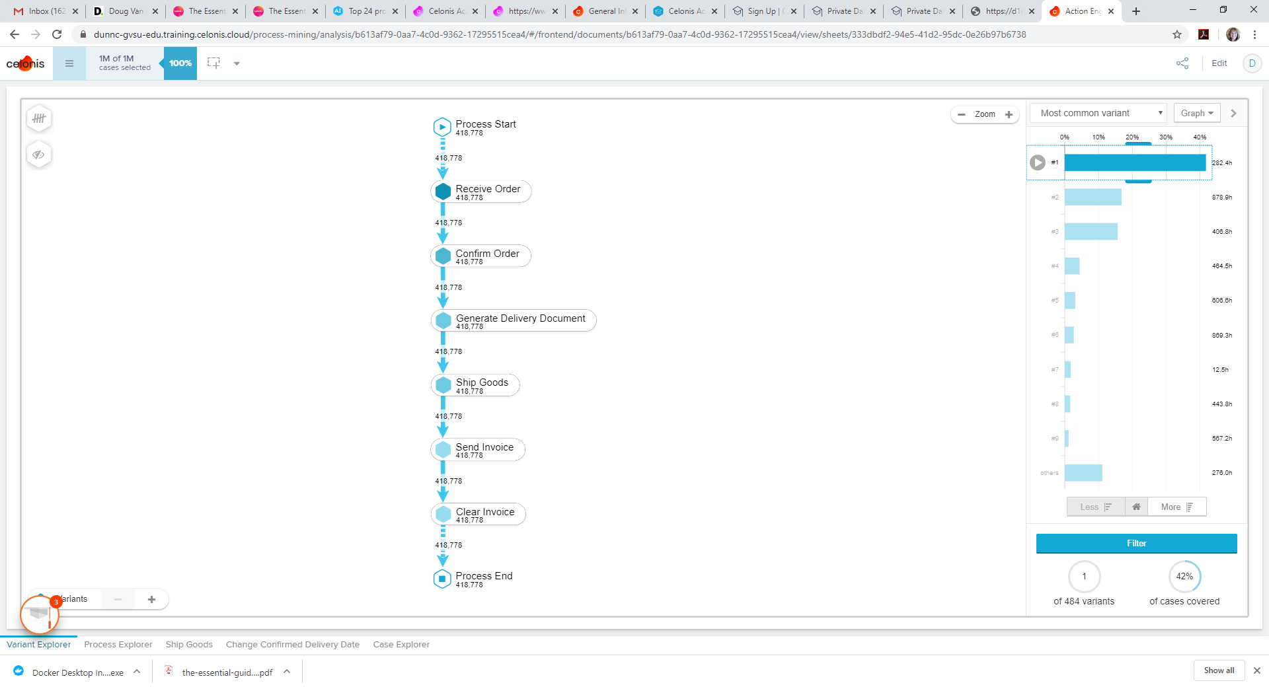
Celonis Sample

Slide 22
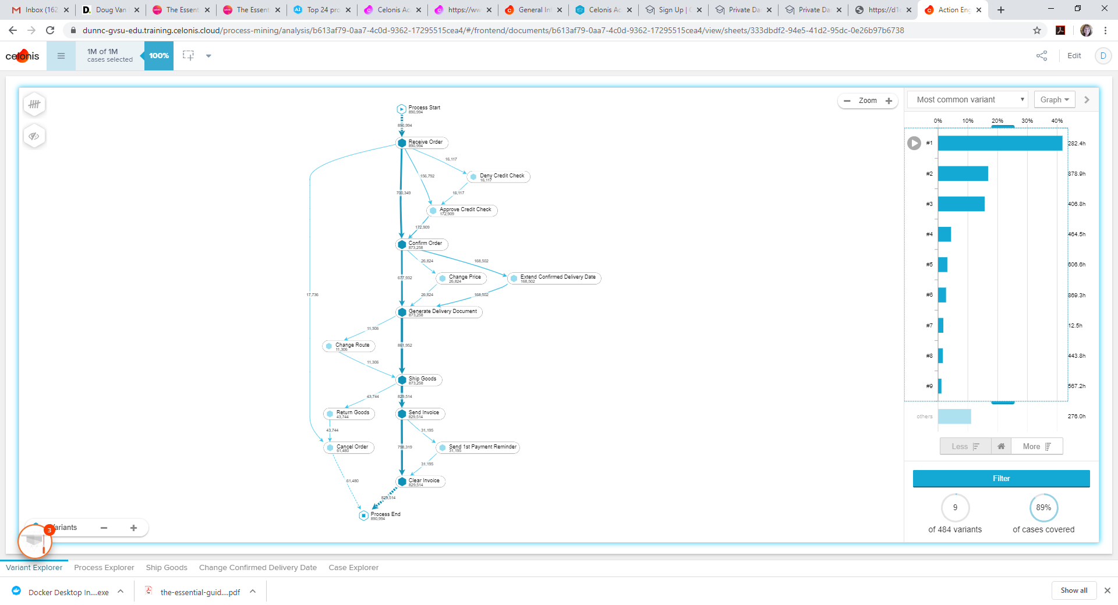

Slide 23
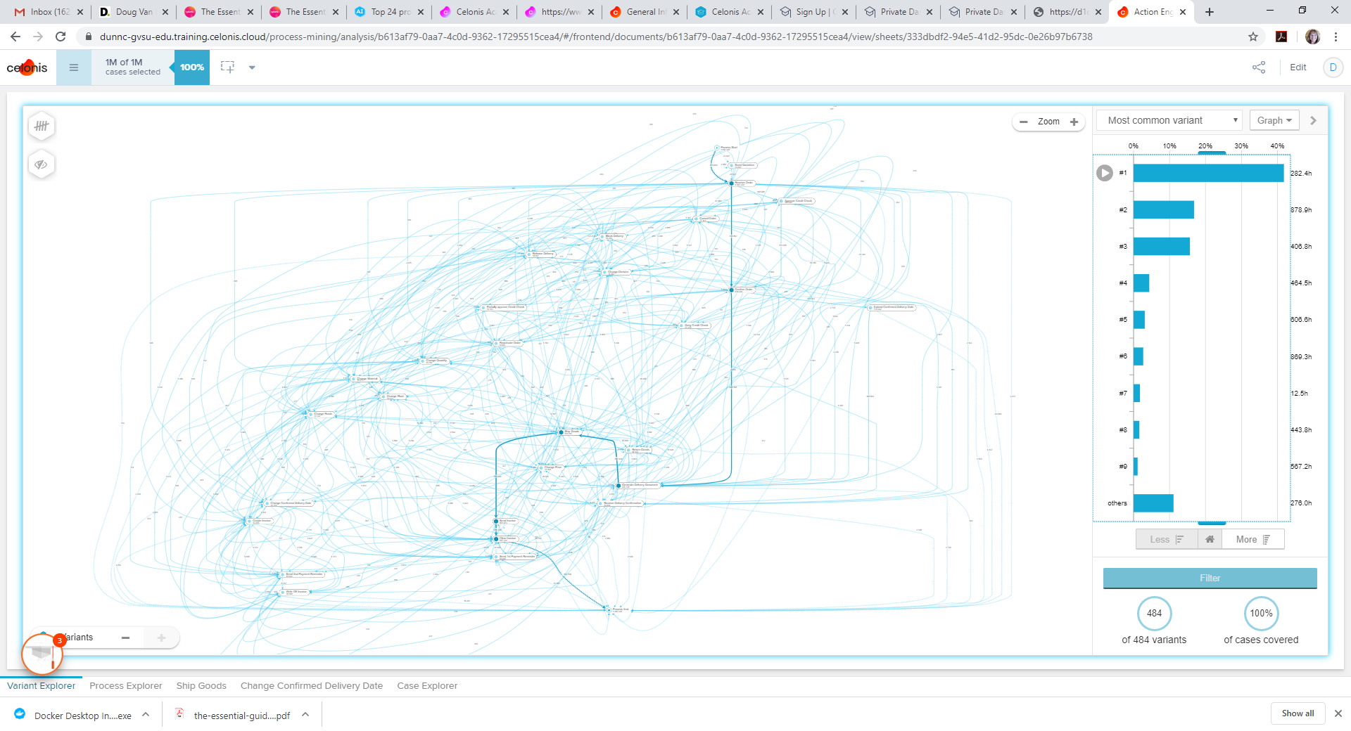

Slide 24
Learning Resources
Google
Professional associations
Application software vendors and conferences
User groups
Alumni
Library subscriptions: Books 24x7 (Skillsoft)
LinkedIn Learning
YouTube
AWS

Slide 25
Implementation Tips
Start small – but start
Gradually build/add applications
Enlist IT and lab support early
Virtual labs are your friend
Look for cloud-based solutions if you don’t have IT support
Grade to encourage exploration, not fear
It is OK to say “I don’t know, let me look into that”
It is OK to delegate to students: “A 5-point bonus to whomever can find the answer to this technical problem.”

Slide 26
What are your analytics plans this academic year?
Polling Question 3
Please open the conference app to participate

Slide 27
Polling Question 3
What are your analytics plans this academic year? (multiple responses allowed)
  a. Busy learning new technology this summer
  Looking for cases to include in my class(es)
  We’ve designated an analytics coordinator, relying on them to help
  c. We are using this year to plan and recover from AY 20-21
  d. Using students and/or alumni to assist
  Can I just pretend it’s still June?
  Contemplating retirement or career change

