Slide 1
The Impact of Domain Specific Internal Audit Education on Financial Reporting Quality and External Audit Efficiency
Christopher G. Calvin
Matthew Holt
University of Dayton
July 28th, 2021

Slide 2


Research Objective
Investigate whether internal audit-focused education yields observable financial reporting and audit efficiency benefits.
University
Faculty
Curriculum
IAEP Program

Slide 3
Polling Question 1
What level of internal auditing education is typically (pre-pandemic) in place at your university?
  IAEP Center for Internal Auditing Excellence
  b. IAEP Comprehensive Program
  c. IAEP Foundation Program
  d. An internal auditing course offering not enrolled in IAEP
  e. No internal auditing-specific curriculum
  f. Unsure / Not Applicable
Notes:
Acknowledge that this is probably a pro-IA biased group

Slide 4
Polling Question 2
Has the level of internal auditing education in place at your university been negatively impacted by the pandemic?
  Yes
  b. No
  c. Unsure / Not Applicable
Notes:
Use example where course was taught by adjunct who was lost during pandemic and hasn’t returned.

Slide 5
Research Motivation
Relative to its external auditing counterpart, there is little internal auditing-specific education offered at the university level.
As of August 2020 (U.S.):
  6 Centers for Internal Auditing Excellence
  15 Comprehensive Internal Auditing Programs
  16 Foundation Internal Auditing Programs
  ?? Non-IAEP Course Offerings
Per the National Center for Education Statistics:
  2,487 U.S. Universities Offering Accounting Degrees
Notes:
Note that U.S. IA education figures are presented for comparison to total accounting program stats.
However, global numbers for IA education aren’t much better:
5 CIAE
8 Comprehensive
5 Foundation
As a benchmark, 2 out of 11 competitor Ohio universities offer non-IAEP courses.

Slide 6
Research Motivation
Internal auditing education should increase internal audit quality, and thus financial reporting quality, where a concentration of those students are employed.
From the Definition of Internal Auditing:
  Internal audit should evaluate and improve the effectiveness of risk management, control, and governance processes.
From Standard 2021 “Risk Management”:
  One of the areas of risk that internal audit should evaluate is that regarding the reliability and integrity of financial and operational information.

Slide 7
Research Motivation
Internal auditing education should increase internal audit quality, and thus external audit reliance, where a concentration of those students are employed.
From PCAOB Auditing Standard 2605:
  The work of internal audit may affect the nature, timing, and extent of the external audit.
  The external auditor should assess the competency of internal audit, including education level and professional experience.

Slide 8
Research Framework
$$AuditOutcome=α+IAEducation+controls+ε$$
Internal Control Failures
Financial Misstatements
Audit Reporting Time
University-Level Internal Auditing Curriculum

Slide 9
Research Challenges
Financial reporting quality is a joint product of management and internal/external audit
$$AuditOutcome=α+IAEducation+controls+ε$$
Audit reporting time is a joint product of audit completion and management financial statement preparation
Collecting the full scope of internal audit education and job placement across all universities and years is an insurmountable task

Slide 10
Overcoming Challenges
Measuring internal auditing education.
IAEP Foundation Programs
  Principles of IA + 1 additional course
  No internship requirement
  No professional participation requirement
  No CIA exam requirement
  Educators must have B.S. and IA knowledge
  Falls under scope of accounting advisory board
  No student flow requirement
IAEP Comprehensive Programs
  Principles of IA + 2 additional courses
  5 week internship
  2 IA professional meetings
  CIA exam encouragement
  Educators must have B.S., CIA, and active research or participation
  IAEP advisory board with one practitioner
  Flow of 10 students
IAEP Centers of IA Excellence
  IA concentration or degree, including 4 courses
  8 week internship
  3 IA professional meetings with active role
  CIA exam expected
  Educators must have M.S., CIA, and active research or participation
  IAEP advisory board with majority practitioners
  Flow of 25 students
Notes:
Mention that Non-IAEP programs are basically “unknowns”

Slide 11
Overcoming Challenges
Measuring internal auditing education.
Centers for Internal Auditing Excellence:
  Produce graduates with the strongest level of internal auditing education.
  Provide internal audit knowledge to students who may enter other related fields.
  Involve local internal auditing communities to create “knowledge hubs.”
  Limited number and press coverage enables identification of active years.
  Biases against our research design by allowing IAEP comprehensive, IAEP foundation, and non-IAEP internal audit curriculum to be part of the control group.

Slide 12
Overcoming Challenges
Measuring internal auditing job placement.
Gravity Model of Migration / Distance Friction:
  The migration of graduates between two places is constrained by the distance between the two places and the relative sizes of the two places.
  Even if a graduate initially accepts a job away from their education center, they may have personal and professional connections to the area that incentivize them to return in the future.
City #1
City #2
City #3

Slide 13
Polling Question 3
What percent of university alums, on average, remain in or return to the city/region in which they received their education?
  75%-100%
  b. 50%-75%
  c. 25%-50%
  d. 0%-25%

Slide 14



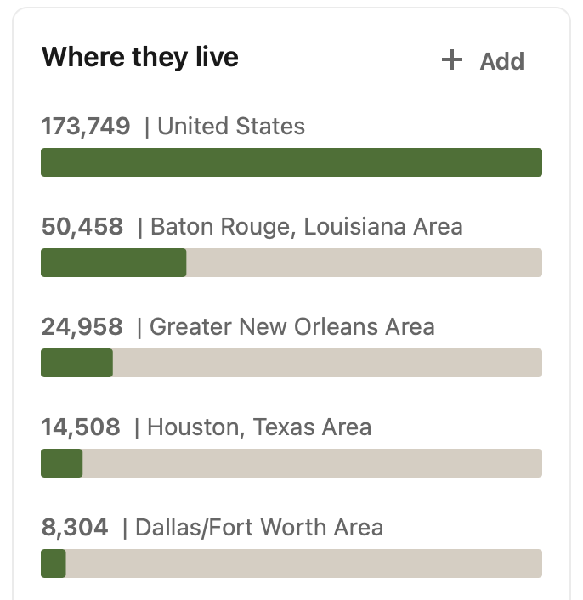
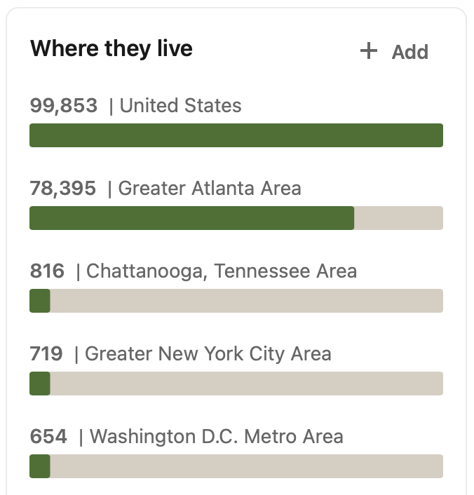

LinkedIn Alumni Data

Slide 15
Overcoming Challenges
Addressing the joint effects of management and auditors.
Matching on Financial Reporting Quality:
  Match all CIAE city companies to non-CIAE city companies
  Match on characteristics that determine financial reporting quality
  Match by city and year
Controlling for Audit Characteristics and Regulation:
  Control for auditor characteristics such as Big N, first year, industry specialization, office size, and known failures in quality.
  Control for client characteristics that may impact the audit, such as size, complexity, and financial reporting failures.
  Control for regulation that impacts audit reporting time, including filing deadlines and SFAS 165.

Slide 16
Framework Revisited
Company characteristics
Auditor characteristics
Regulatory concerns
CIAE Transition
CBSA effects
Time effects
$$AuditOutcome=α+IAEducation+controls+ε$$
Adverse SOX 404 Opinions
Subsequent Misstatements
Audit Lag
Companies headquartered in CIAE cities following CIAE program launch date

Slide 17
Sample Construction
Sample Source:
  Companies with information available in both Compustat and Audit Analytics
  Companies either 1) located in a CIAE city, or 2) matched to a CIAE city company
Sample Description:
  6,958 company-years, split evenly between CIAE and non-CIAE cities
  Sample begins in 2006 (current IAEP program launch year)
  Sample ends in 2018 (last year of data available at time of study)

Slide 18
Summary Statistics
Notable Statistics:
  50% of the companies are headquartered in CIAE cities (by design)
  55% of observations occur post-CIAE program launch
  5% of observations report a failure in internal controls
  13% of observation report a financial misstatement
  91% of the filing window is used to complete the audit, on average
Other Statistics:
  79% of companies are audited by Big 4 audit firms
  Companies range from 4 to 67 years old
  81% of companies have a December year-end
  65 unique industries represented

Slide 19
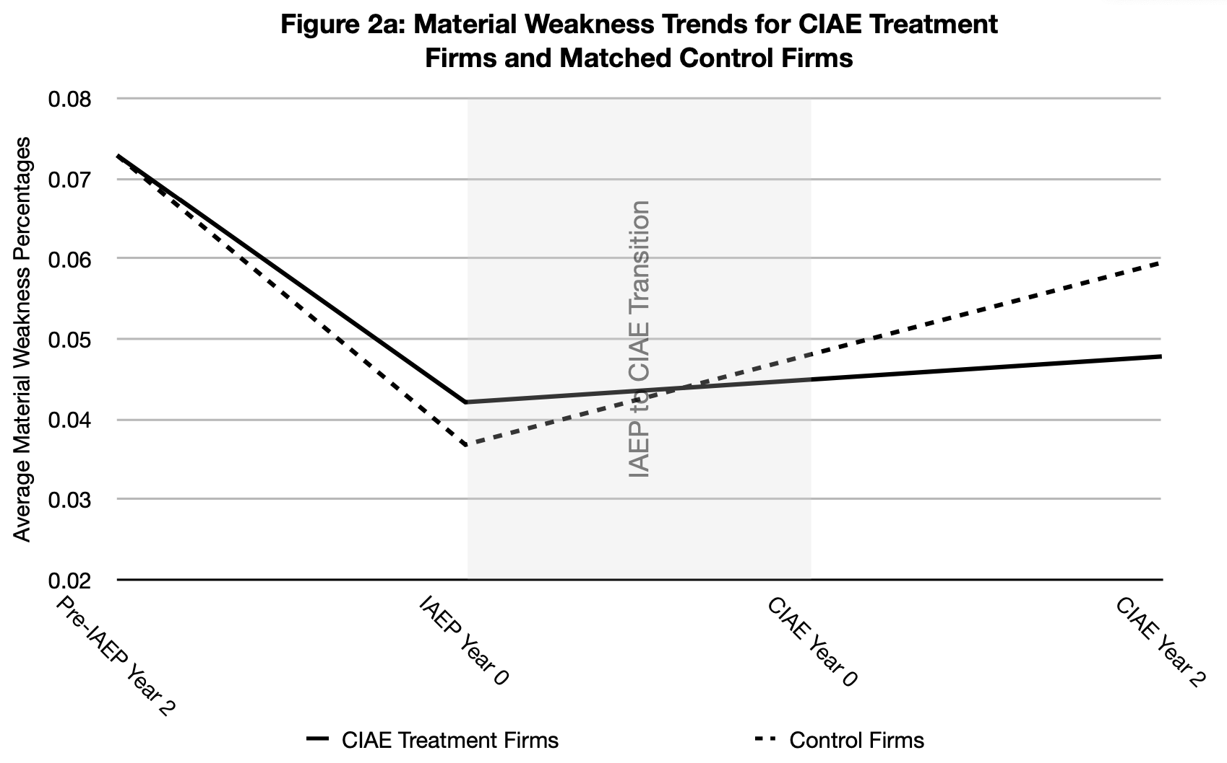
Parallel Trends Analysis

Slide 20
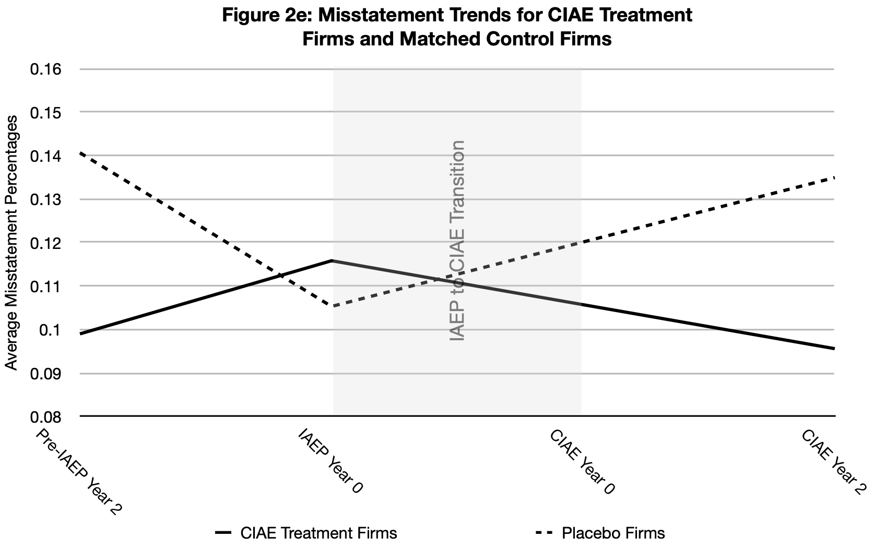
Parallel Trends Analysis

Slide 21
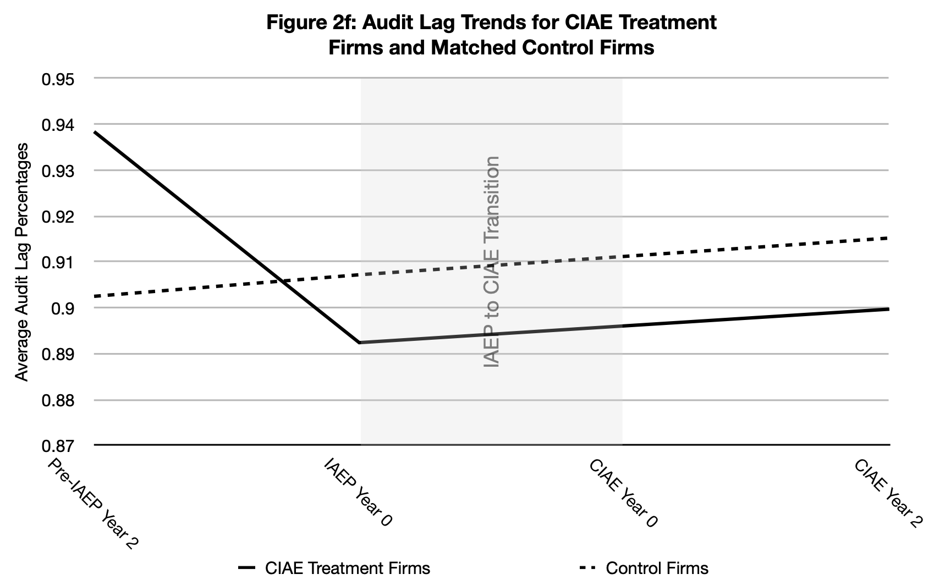
Parallel Trends Analysis

Slide 22
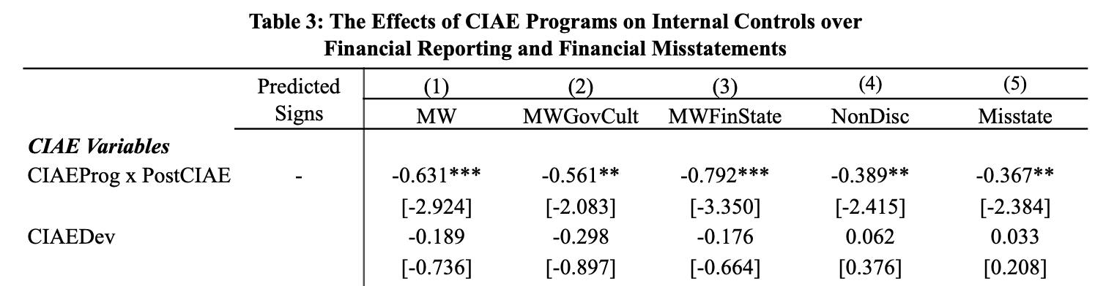
Financial Reporting Quality

Slide 23
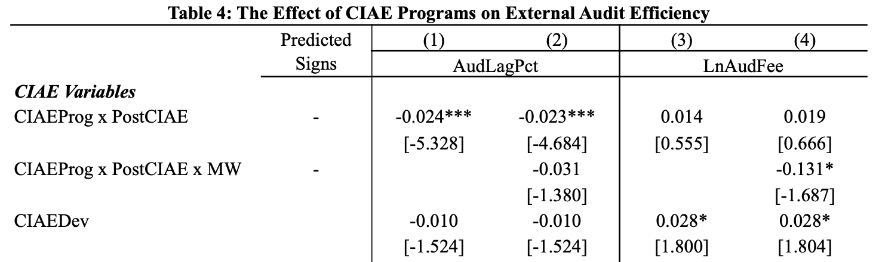
Audit Efficiency

Slide 24
Summary Takeaways
Financial Reporting Quality:
  Reduction in internal control failures (in general)
  Reduction in governance and culture related control failures
  Reduction in financial statement related control failures
  Reduction in control failures that go undetected
  Reduction in financial misstatements
Audit Efficiency:
  Reduction in external audit completion time (may occur prior to CIAE launch)
  Some evidence of lower audit fees (very weak / sensitive)

Slide 25
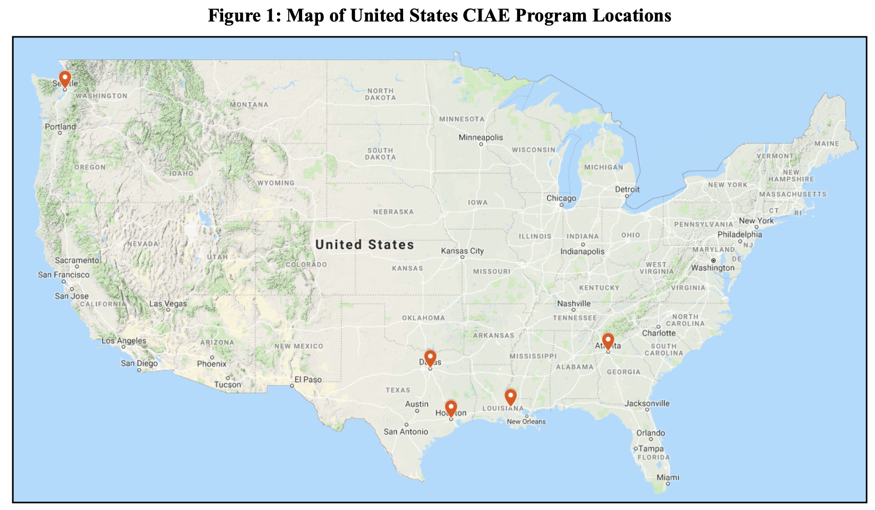
Despite the Benefits....
Notes:
Mention St. Johns
Also mention that heatmapping the other IAEP schools expands to some medium/large cities such Chicago, Los Angeles, Nashville, and Detroit, but coverage is still quite barren.

Slide 26
Limitations & Opportunities
Limitations:
  Gravity model of migration may not hold for CIAE graduates
  Universities not participating in the IAEP program may still deliver high-quality internal audit education
Opportunities:
  Study the benefits of internal audit education based on actual employee data rather than migration model assumptions
  Develop a more comprehensive record of internal audit education that enables further studies of the benefits and costs of that education
  Study how benefits of internal audit education vary by IAEP tier
  Identify the specific mechanisms by which internal audit education leads to capital market benefits (e.g., knowledge, networking, awareness, etc.)

Slide 27
Polling Question 4
Do you feel the benefits of offering dedicated internal auditing curriculum (whether individual courses or an IAEP participating program) outweigh the costs of implementation?
  Yes
  b. No
  c. Unsure

Slide 28
Polling Question 5
Do you feel there are enough qualified educators to implement wide-scale internal audit education across the U.S.?
  Yes
  b. No
  c. Unsure

Slide 29
Questions?
Christopher G. Calvin
ccalvin1@udayton.edu
Matthew Holt
mholt1@udayton.edu

