Slide 1
The impacts of the use of data analytics and the performance of consulting activities on perceived internal audit quality
Nathanaël Betti, UCLouvain, Belgium
Steven DeSimone, College of the Holy Cross, USA
Joy Gray, Bentley University, USA
Ingrid Poncin, UCLouvain, Belgium
July 29, 2021

Slide 2
Research context
Business environment increasingly digitalized
Organizations adapt their business models, strategies, and processes
IT risks gain in importance
Integration of new technologies
Internal audit function
Debate on the performance of consulting activities
Objectivity?
Integration of data analytics

Slide 3
Research objective
Investigate the effects of the use of data analytics and the performance of consulting activities on top management’s perceived internal audit quality.

Slide 4
Background
Internal audit quality framework (Trotman and Duncan, 2018)
Input
Technical skills
Experience
Objectivity
Soft skills
+
Process
Technical production
Service interactions
+
Output
Reports
Relevant recommendations
+
Outcome
Value-add
Contextual factors
Culture Management Access to staff Digitalisation /use of
training ground data analytics

Slide 5
Hypotheses
H1: Perceived internal audit quality will be higher when internal auditors use data analytics.
H2: Perceived internal audit quality will be higher when internal auditors perform consulting activities.
H3: When internal auditors perform consulting activities, perceived internal audit quality will be higher when internal auditors use data analytics.

Slide 6
Methodology
Research design: Online scenario-based experiments
120 middle and top managers in the US
2X2 between-subjects experiment
Manipulation 1: Use or not of data analytics
Manipulation 2:
Performance or not of consulting activities
Condition 1
- 100% assurance, 0% consulting
- Analyses based on samples
Condition 2
- 100% assurance, 0% consulting
- Analyses of full data sets
Condition 3
- 50% assurance, 50% consulting
- Analyses based on samples
Condition 4
- 50% assurance, 50% consulting
- Analyses of full data sets

Slide 7
Methodology
Section 1
General context and information about the fictional company
Section 2
Internal audit department
Condition 1: No Consulting
OR
Internal audit department
Condition 2: Yes Consulting
Section 3a
General internal audit program
Section 3b
Internal audit work
Condition 1: No Data Analytics
OR
Internal audit work
Condition 2: Yes Data Analytics
Section 4
Questions

Slide 8
Results
H1 supported regarding the input dimension
Perceived competence higher when internal auditors use data analytics
H2 supported regarding the process and output dimensions
When internal auditors perform consulting activities:
quality of the relationship between internal auditors and management is higher
perceived relevance of internal auditors’ recommendations is higher

Slide 9
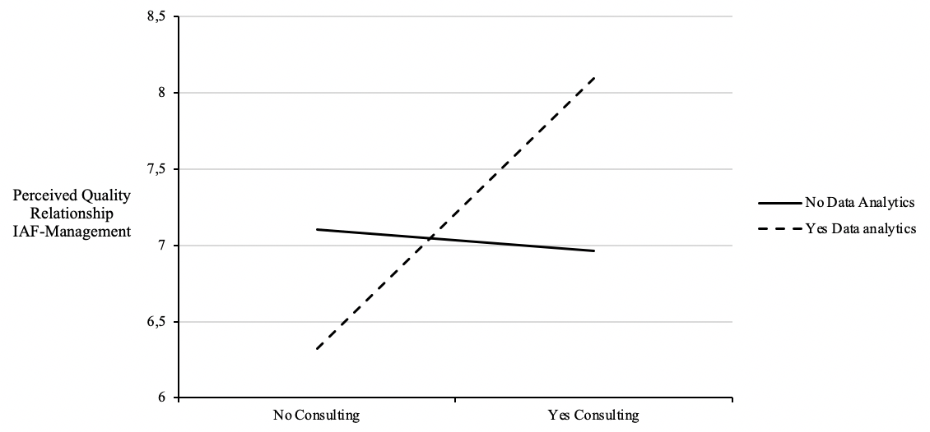
Results
H3 supported regarding the process dimension
Interaction effect between consulting activities and data analytics on the perceived quality of the relationship between internal auditors and management

Slide 10
Discussion
1. Data analytics increases the perceived competence of internal auditors
2. Consulting activities
increase the perceived relevance of recommendations
increase the quality of the relationship with management...
... but without influencing the perceived objectivity
3. Data analytics combined with consulting activities
could improve management's perception of IA quality

Slide 11
Thank you for your attention!
Questions?

